Slide 1

Lecture5
Hydroponic Growing Systems ‑ basic concepts and designs

Slide 2
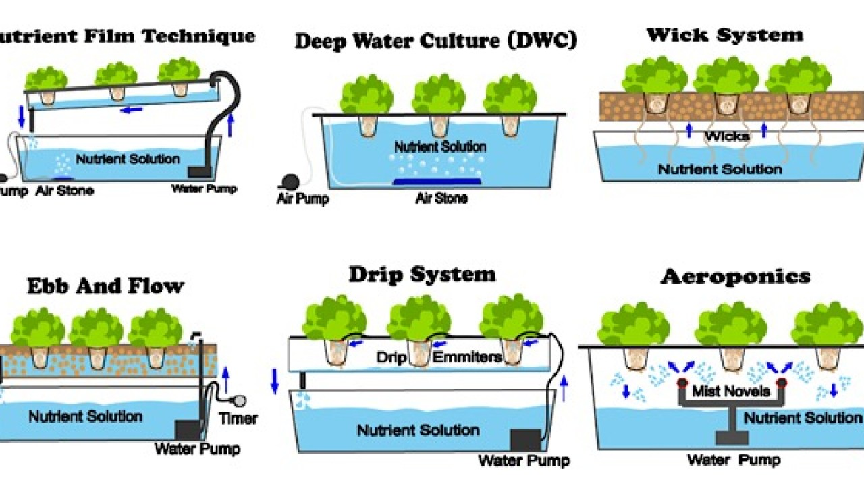
Types of Hydroponics

Slide 3
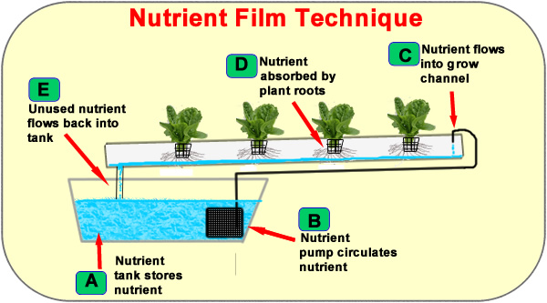
1. Nutrient film technique systems

Slide 4
Pros of a nutrient film technique system
Low consumption
Modular design
Cons of nutrient film technique system
Pump failure
Overcrowding

Slide 5


