Slide 1

Lecture 6
Deep water culture, Ebb & Flow,

Slide 2
2. Deep water culture systems
Deep water culture hydroponics are simply plants suspended in aerated water. Deep water culture systems, also known as a DWC system, are one of the easiest and most popular methods of hydroponics on the market. A DWC system dangles net pots holding plants over a deep reservoir of oxygen-rich nutrient solution. The plant’s roots are submerged in the solution, providing it with perpetual access to nutrition, water, and oxygen. Deep water culture is considered by some to be the purest form of hydroponics.

Slide 3
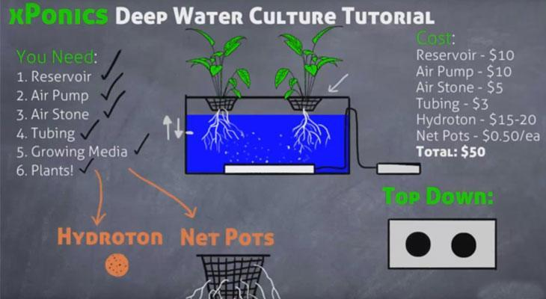

Slide 4
Pros of deep water culture systems
Low maintenance
DIY appeal
Cons of deep water culture systems
Limitations
Temperature control

Slide 5
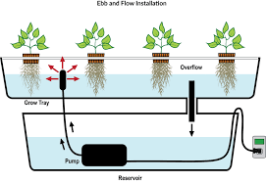
3. Ebb and flow systems

Slide 6
Pros of Ebb and flow systems
Versatility
DIY appeal
Cons of Ebb and flow systems
Pump failure
Rot & disease

Slide 7


