Slide 1

Lecture 7
Other Techniques ‑ wick systems, flood & drain, bag culture, aeroponics, etc.

Slide 2
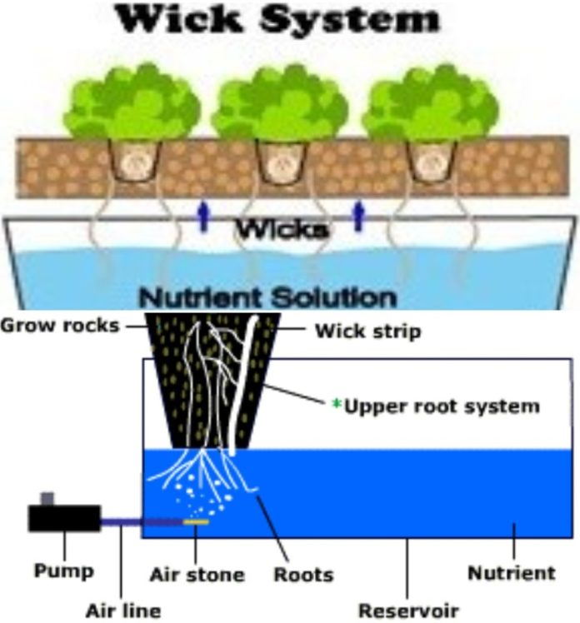
4. Wick systems

Slide 3
Pros of a wick system
Simplicity
Space-efficient
Cons of a wick system
Limitations
Susceptible to rot

Slide 4
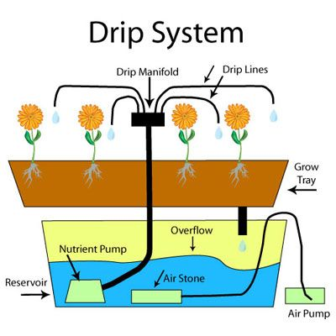
5. Drip systems

Slide 5
Pros of a drip system
Variety of plant options
Scale
Cons of a drip system
Maintenance
Complexity

Slide 6
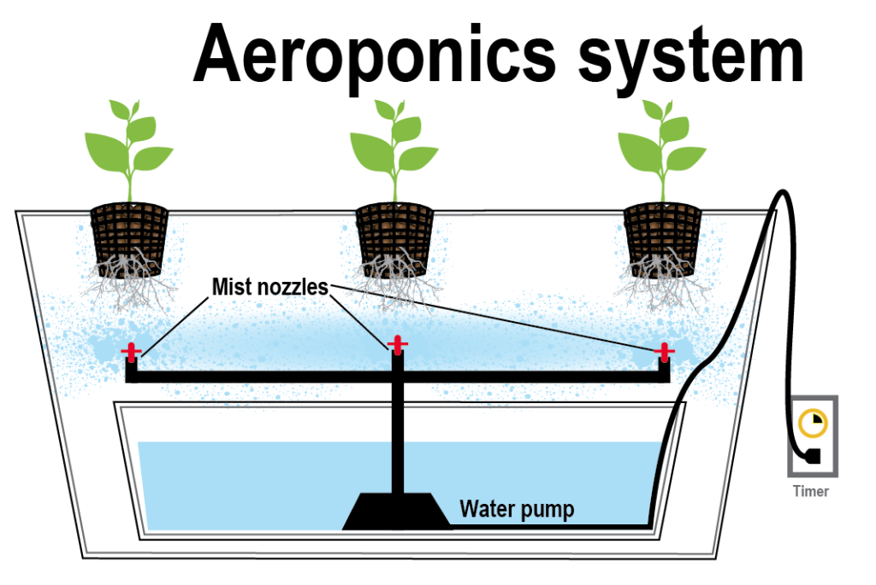
6. Aeroponics

Slide 7
Pros of an aeroponics system
Oxygen surplus
Mobility
Cons of an aeroponics system
Expensive
Maintenance

Slide 8


