Slide 1

Lecture 8
Familiarize with the electrical equipment available in a hydroponic unit

Slide 2
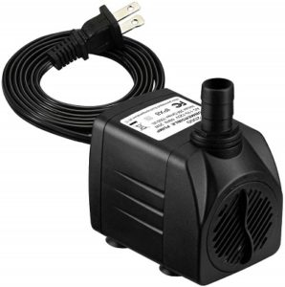
Water Pump

Slide 3
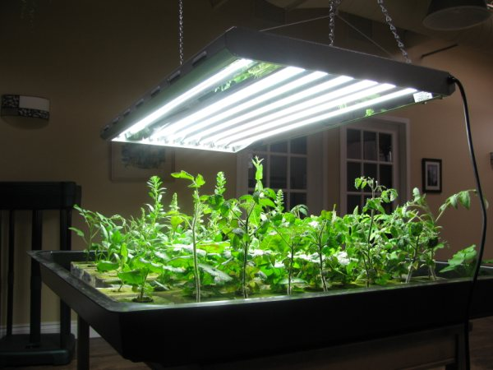
Artificial Lights

Slide 4
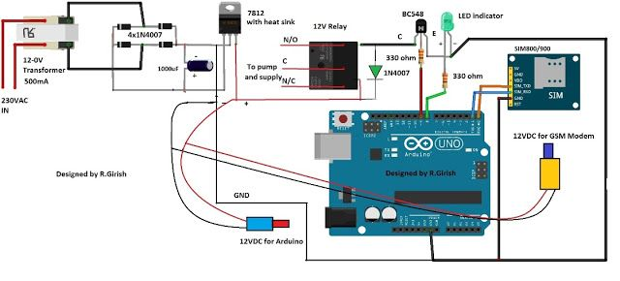
Isolation Circuit

Slide 5
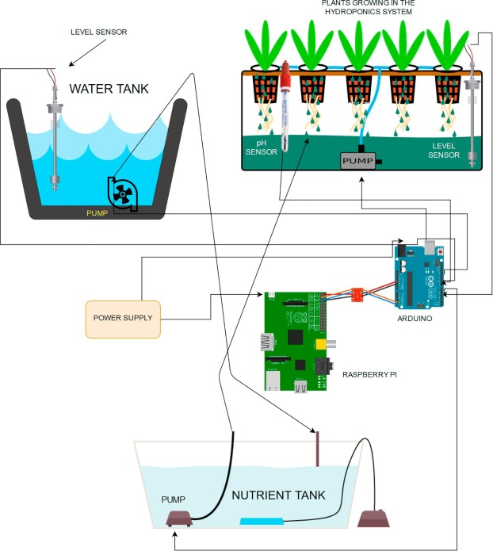
RTC Circuit

Slide 6
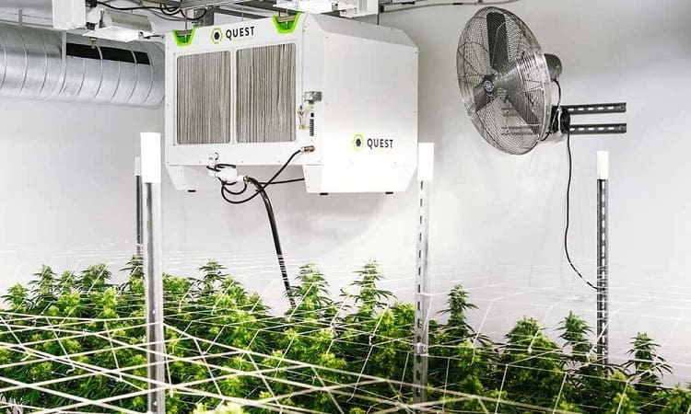
Air Conditioner (AC) Controlling Subsystem

Slide 7


