Slide 1
Introduction to NodeMCU,Rasberry Pi
By
N.Jeevaratnam

Slide 2
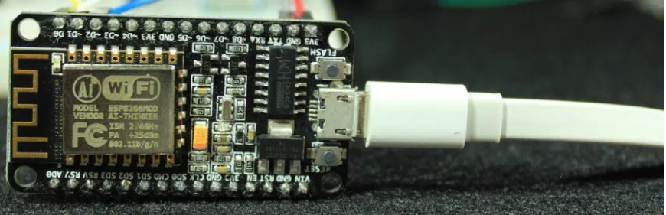
Introduction to NodeMCU

Slide 3
The ESP8266 is Wi-Fi module. It allows you to control inputs and outputs as you would do with an Arduino, but it comes with Wi-Fi. So, it is great for home automation/internet of things applications.
Comparing the ESP8266 with other Wi-Fi solutions on the market, it is a great option for most “Internet of Things” projects! It’s easy to see why it’s so popular: it only costs a few dollars and can be integrated in advanced projects.

Slide 4
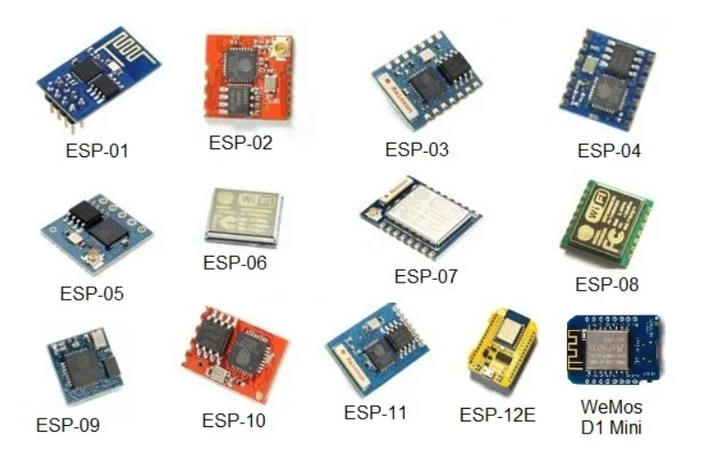
ESP8266 Versions

Slide 5
The ESP8266 comes in a wide variety of versions (as shown in the figure below). The ESP-12E or often called ESP-12E NodeMCU Kit is currently the most practical version, in our opinion.
We highly recommend using the ESP8266-12E NodeMCU Kit, the one that has built-in programmer and lots of GPIOs. The built-in programmer makes it easy to prototype and upload your programs.

Slide 6
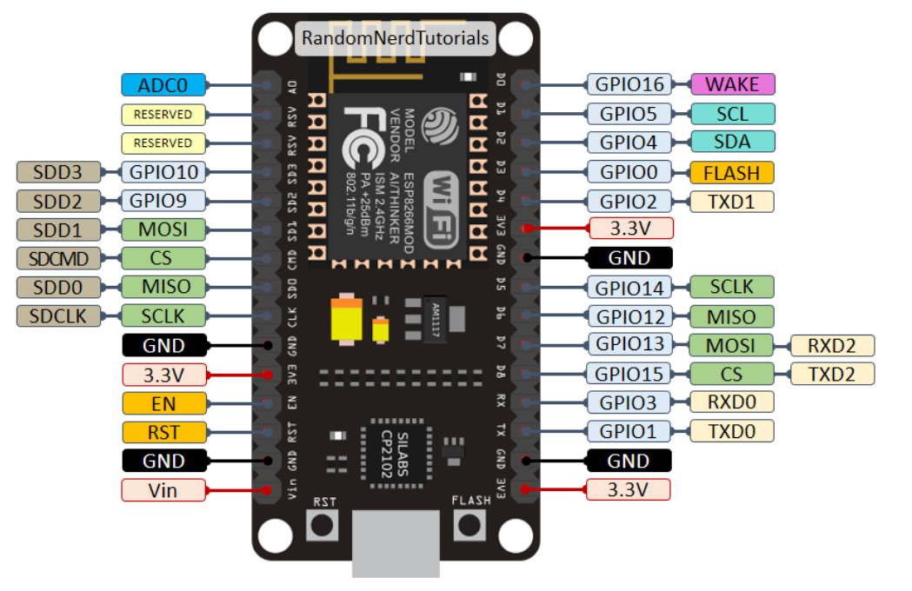
ESP8266 Pinout

Slide 7
Microcontroller: Tensilica 32-bit RISC CPU Xtensa LX106
Operating Voltage: 3.3V
Input Voltage: 7-12V
Digital I/O Pins (DIO): 16
Analog Input Pins (ADC): 1
UARTs: 1
SPIs: 1
I2Cs: 1
Flash Memory: 4 MB
SRAM: 64 KB
Clock Speed: 80 MHz
USB-TTL based on CP2102 is included onboard, Enabling Plug n Play
PCB Antenna
Small Sized module to fit smartly inside your IoT projects

Slide 8
The NodeMCU ESP8266 development board comes with the ESP-12E module containing ESP8266 chip having Tensilica Xtensa 32-bit LX106 RISC microprocessor. This microprocessor supports RTOS and operates at 80MHz to 160 MHz adjustable clock frequency. NodeMCU has 128 KB RAM and 4MB of Flash memory to store data and programs. Its high processing power with in-built Wi-Fi / Bluetooth and Deep Sleep Operating features make it ideal for IoT projects.
NodeMCU can be powered using Micro USB jack and VIN pin (External Supply Pin). It supports UART, SPI, and I2C interface.

Slide 9
Programming NodeMCU ESP8266 with Arduino IDE
The NodeMCU Development Board can be easily programmed with Arduino IDE since it is easy to use.
Programming NodeMCU with the Arduino IDE will hardly take 5-10 minutes. All you need is the Arduino IDE, a USB cable and the NodeMCU board itself.

Slide 10
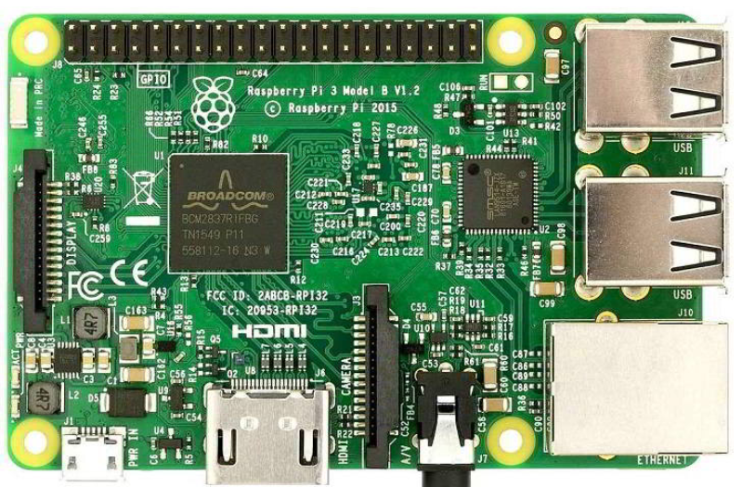
Raspberry Pi Introduction

Slide 11
Raspberry Pi is a small single board computer. By connecting peripherals like Keyboard, mouse, display to the Raspberry Pi, it will act as a mini personal computer.
Raspberry Pi is popularly used for real time Image/Video Processing, IoT based applications and Robotics applications.
Raspberry Pi is slower than laptop or desktop but is still a computer which can provide all the expected features or abilities, at a low power consumption.
Raspberry Pi Foundation officially provides Debian based Raspbian OS. Also, they provide NOOBS OS for Raspberry Pi. We can install several Third-Party versions of OS like Ubuntu, linux.
We should use SD card (minimum 8 GB recommended) to store the OS (operating System).
Raspberry Pi is more than computer as it provides access to the on-chip hardware i.e. GPIOs for developing an application. By accessing GPIO, we can connect devices like LED, motors, sensors, etc and can control them too.
The CPU speed of Raspberry Pi varies from 700 MHz to 1.2 GHz. Also, it has on-board SDRAM that ranges from 256 MB to 1 GB.
Raspberry Pi also provides on-chip SPI, I2C, I2S and UART modules.

Slide 12
There are different versions of raspberry pi available as listed below:
Raspberry Pi 1 Model A
Raspberry Pi 1 Model A+
Raspberry Pi 1 Model B
Raspberry Pi 1 Model B+
Raspberry Pi 2 Model B
Raspberry Pi 3 Model B
Raspberry Pi Zero

Slide 13
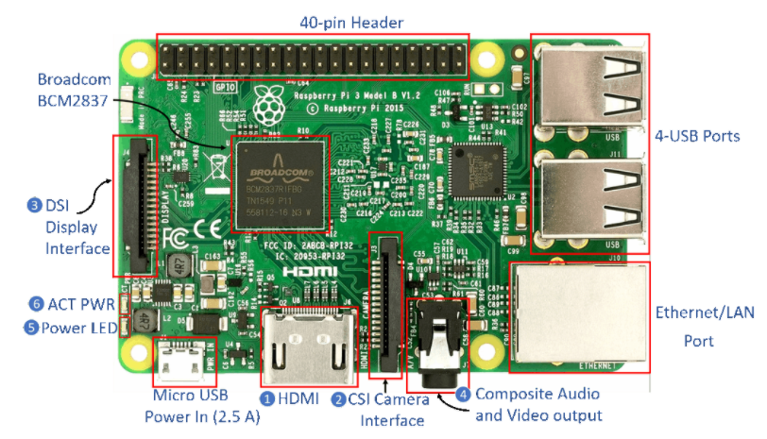

Slide 14
HDMI (High-Definition Multimedia Interface): It is used for transmitting uncompressed video or digital audio data to the Computer Monitor, Digital TV, etc. Generally, this HDMI port helps to connect Raspberry Pi to the Digital television.
CSI Camera Interface: CSI (Camera Serial Interface) interface provides a connection in between Broadcom Processor and Pi camera. This interface provides electrical connections between two devices.
DSI Display Interface: DSI (Display Serial Interface) Display Interface is used for connecting LCD to the Raspberry Pi using 15-pin ribbon cable. DSI provides fast High-resolution display interface specifically used for sending video data directly from GPU to the LCD display.
Composite Video and Audio Output: The composite Video and Audio output port carries video along with audio signal to the Audio/Video systems.
Power LED: It is a RED colored LED which is used for Power indication. This LED will turn ON when Power is connected to the Raspberry Pi. It is connected to 5V directly and will start blinking whenever the supply voltage drops below 4.63V.
ACT PWR: ACT PWR is Green LED which shows the SD card activity.

Slide 15
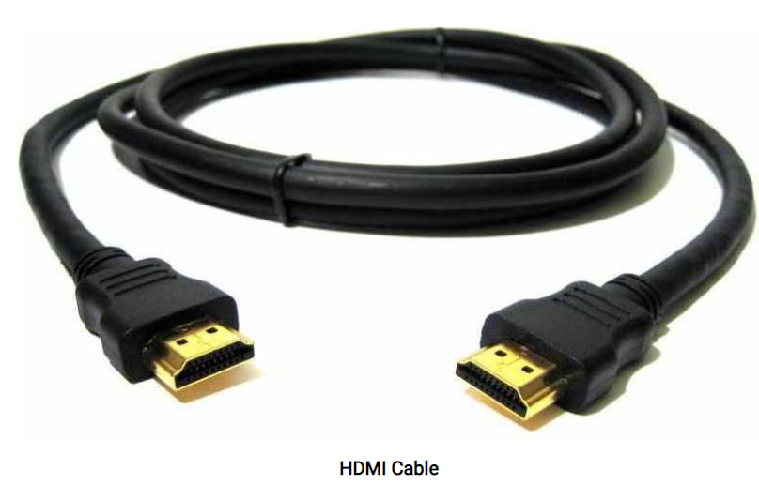
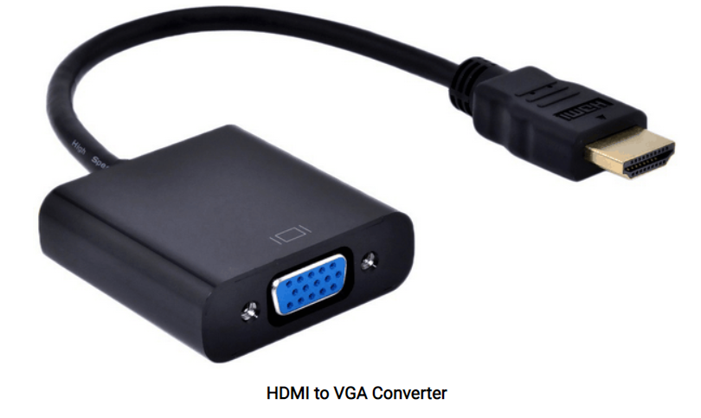
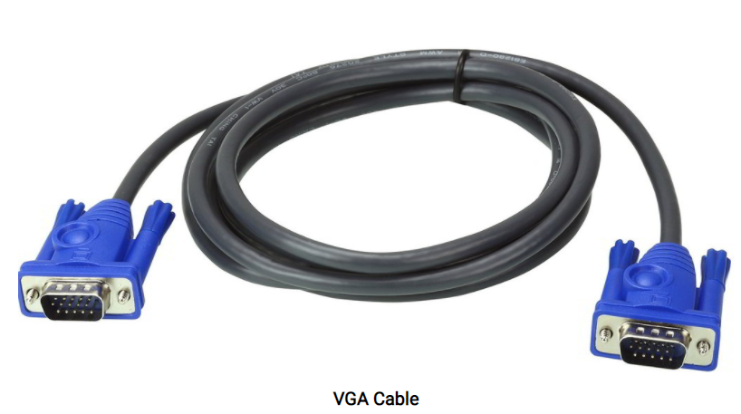

Slide 16
Getting Started with Raspberry Pi
To get started with Raspberry Pi, we have to store required OS on SD card.
Now to store OS on SD card we need to install OS on SD card. If you want to know how to install/store OS on SD card you can refer Installing Operating System Image on SD card.
Here, we installed the Raspbian OS on SD card.
Now, we have an SD card with installed OS and Raspberry Pi Board.
Initially to use raspberry Pi we need computer monitor or Digital Display.
We can directly connect Raspberry Pi to the Digital Display using HDMI cable.

Slide 17
But, if we have a computer monitor (VGA Display), then we need an HDMI to VGA converter along with a VGA cable for connecting Raspberry Pi with monitors. HDMI to VGA converter and VGA cable is shown below.
Now, connect the Raspberry Pi to the Display/monitor and Power-On Raspberry Pi. We will get a Black command window asking for Login and Password as shown below

Slide 18
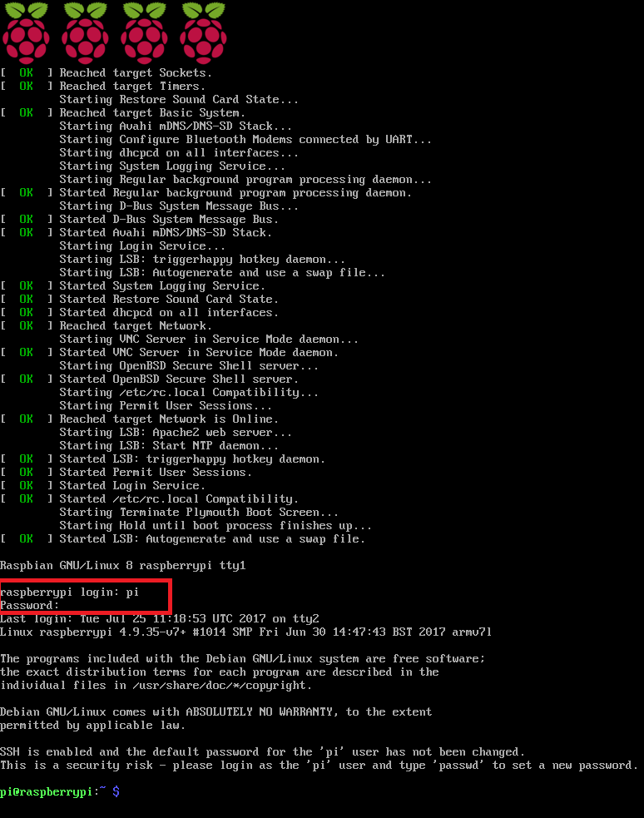

Slide 19
Then, use the following login name and password
raspberrypi Login: pi
Password: raspberry
This is the default user name and password. You can change the password after the first login.
The above command window can be used to operate Raspberry Pi.
To get GUI environment on Raspberry Pi, use below command,
And we will get Home Screen of Raspberry Pi as shown below:

Slide 20
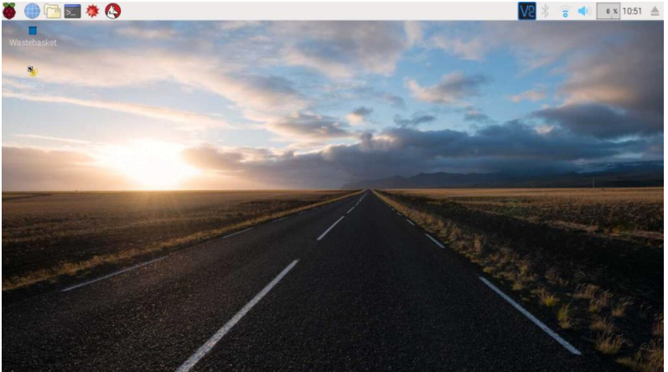

Slide 21
On display, there is a symbol of raspberry to the top-left corner of display. After clicking on it, we will get menu as shown below,
As we can see, the Raspbian OS has installed Python 2 & 3. It also has different programming IDE like Geany, BlueJ Java IDE, etc. As raspberry pi 3 has On-chip WiFi, we can connect it to the network and will get access over Internet.
We can also change password of “Pi” user.
To change password, click on preferences and then select Raspberry Pi Configuration which will provide a pop-up window.

Slide 22
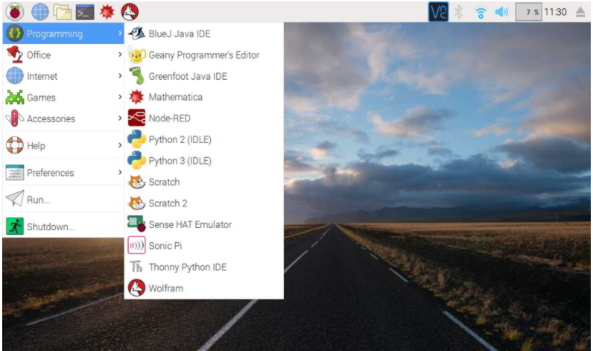

Slide 23
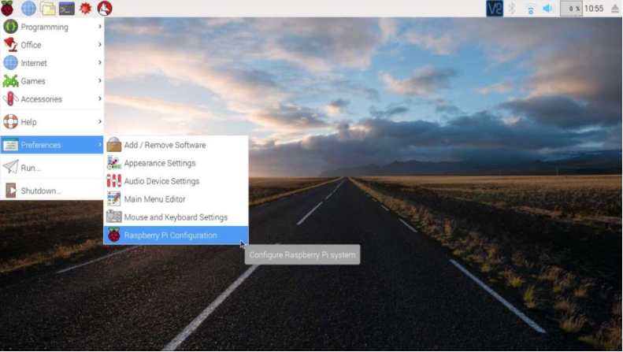

Slide 24
Then, click on change password option shown below.

Slide 25
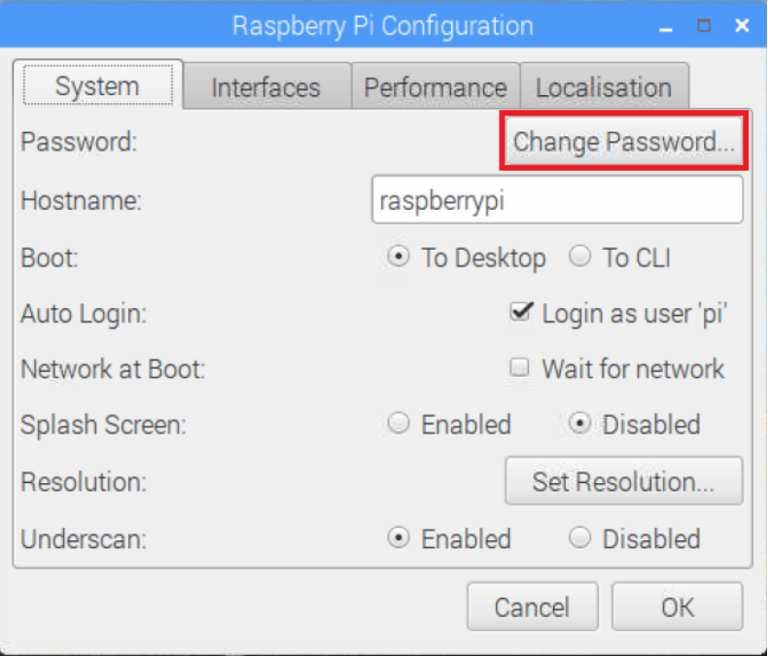

Slide 26
Now, we are quite familiar with Raspberry Pi OS.
How to write C program on Raspbian OS
So, let’s write our First C code on Raspbian and execute it.
First Create Empty file and label it with .c extension.
Now write a small program to print “Hello World”

Slide 27
After writing the code, open terminal (ctrl+alt+t) to execute it. Then, type following commands for compiling and execution.

Slide 28
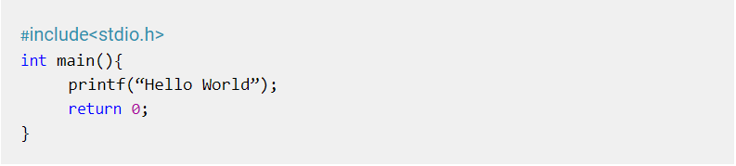
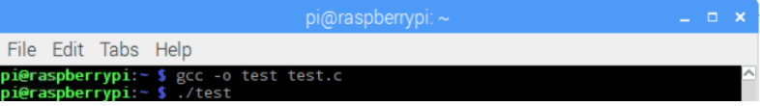

Slide 29
Now, we are quite familiar with Raspberry Pi OS.
How to write C program on Raspbian OS
So, let’s write our First C code on Raspbian and execute it.
First Create Empty file and label it with .c extension.
Now write a small program to print “Hello World”

Slide 30


