Slide 1
Modules and Sensors Interfacing
By
N.Jeevaratnam

Slide 2
ESP8266 DHT11/DHT22 Temperature and Humidity Web Server with Arduino IDE
ESP8266 that displays the temperature and humidity with a DHT11 or DHT22 sensor using the Arduino IDE. The web server you’ll build can be accessed with any device that has a browser on your local network.

Slide 3
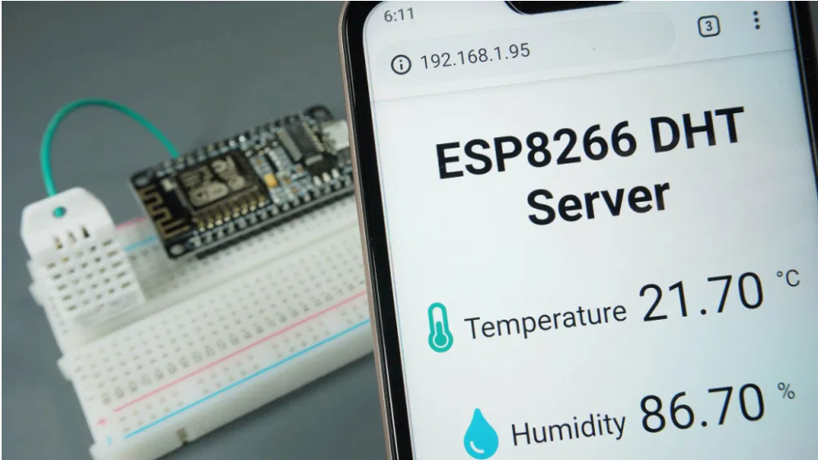

Slide 4
Recommended resources:
How to Install the ESP8266 Board in Arduino IDE
ESP8266 Web Server
ESP8266 Boards Comparison
DHT11/DHT22 Humidity and Temperature Sensor with Arduino
ESP8266 Pinout: Ultimate GPIOs Guide

Slide 5
Parts Required
To build this project, you need the following parts:
ESP8266 development board (read ESP8266 development boards comparison)
DHT22 or DHT11 Temperature and Humidity Sensor
4.7k Ohm Resistor
Breadboard
Jumper wires

Slide 6
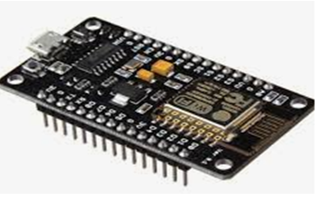
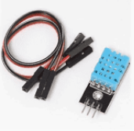
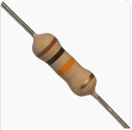
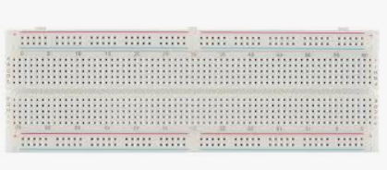

Slide 7
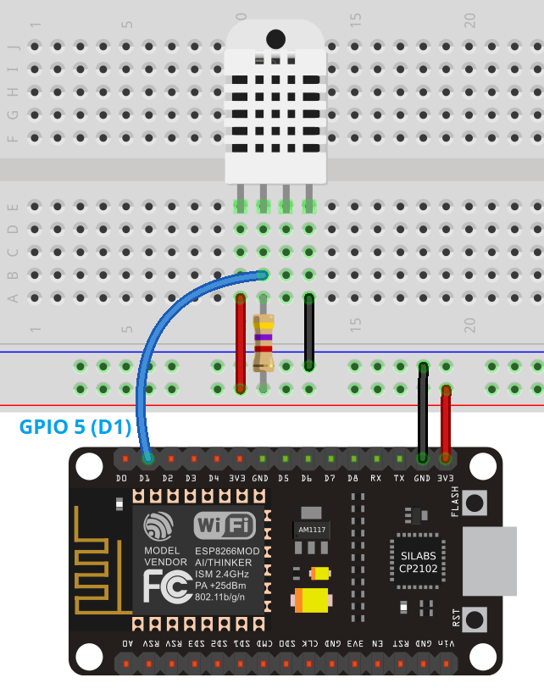
Schematic Diagram

Slide 8
In this example, we’re wiring the DHT data pin to GPIO5 (D1), but you can use any other suitable GPIO. Read our ESP8266 GPIO Reference Guide to learn more about the ESP8266 GPIOs.

Slide 9
Installing the DHT Library for ESP8266
To read from the DHT sensor, we’ll use the DHT library from Adafruit. To use this library you also need to install the Adafruit Unified Sensor library. Follow the next steps to install those libraries.
1. Open your Arduino IDE and go to Sketch > Include Library > Manage Libraries. The Library Manager should open.
2. Search for “DHT” on the Search box and install the DHT library from Adafruit.

Slide 10
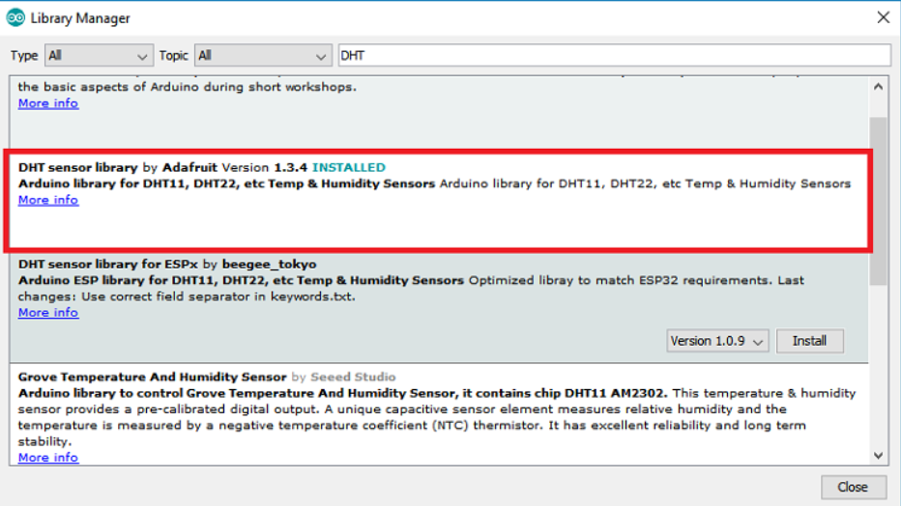

Slide 11
3. After installing the DHT library from Adafruit, type “Adafruit Unified Sensor” in the search box. Scroll all the way down to find the library and install it.
After installing the libraries, restart your Arduino IDE.

Slide 12
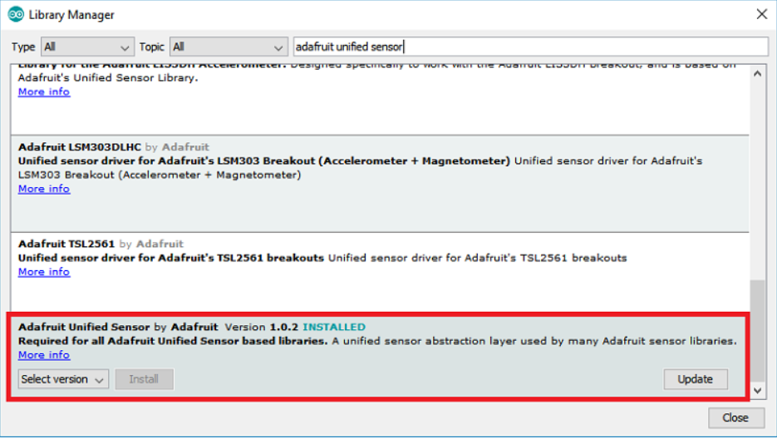

Slide 13
ESP8266 Asynchronous Web Server

Slide 14
CODE
/********* Rui Santos Complete project details at https://randomnerdtutorials.com/esp8266-dht11dht22-temperature-and-humidity-web-server-with-arduino-ide/ *********/ // Import required libraries #include <Arduino.h> #include <ESP8266WiFi.h> #include <Hash.h> #include <ESPAsyncTCP.h> #include <ESPAsyncWebServer.h> #include <Adafruit_Sensor.h> #include <DHT.h> // Replace with your network credentials const char* ssid = "REPLACE_WITH_YOUR_SSID"; const char* password = "REPLACE_WITH_YOUR_PASSWORD"; #define DHTPIN 5 // Digital pin connected to the DHT sensor // Uncomment the type of sensor in use: //#define DHTTYPE DHT11 // DHT 11 #define DHTTYPE DHT22 // DHT 22 (AM2302) //#define DHTTYPE DHT21 // DHT 21 (AM2301) DHT dht(DHTPIN, DHTTYPE); // current temperature & humidity, updated in loop() float t = 0.0; float h = 0.0; // Create AsyncWebServer object on port 80 AsyncWebServer server(80); // Generally, you should use "unsigned long" for variables that hold time // The value will quickly become too large for an int to store unsigned long previousMillis = 0; // will store last time DHT was updated // Updates DHT readings every 10 seconds const long interval = 10000; const char index_html[] PROGMEM = R"rawliteral( <!DOCTYPE HTML><html> <head> <meta name="viewport" content="width=device-width, initial-scale=1"> <link rel="stylesheet" href="https://use.fontawesome.com/releases/v5.7.2/css/all.css" integrity="sha384-fnmOCqbTlWIlj8LyTjo7mOUStjsKC4pOpQbqyi7RrhN7udi9RwhKkMHpvLbHG9Sr" crossorigin="anonymous"> <style> html { font-family: Arial; display: inline-block; margin: 0px auto; text-align: center; } h2 { font-size: 3.0rem; } p { font-size: 3.0rem; } .units { font-size: 1.2rem; } .dht-labels{ font-size: 1.5rem; vertical-align:middle; padding-bottom: 15px; } </style> </head> <body> <h2>ESP8266 DHT Server</h2> <p> <i class="fas fa-thermometer-half" style="color:#059e8a;"></i> <span class="dht-labels">Temperature</span> <span id="temperature">%TEMPERATURE%</span> <sup class="units">&deg;C</sup> </p> <p> <i class="fas fa-tint" style="color:#00add6;"></i> <span class="dht-labels">Humidity</span> <span id="humidity">%HUMIDITY%</span> <sup class="units">%</sup> </p> </body> <script> setInterval(function ( ) { var xhttp = new XMLHttpRequest(); xhttp.onreadystatechange = function() { if (this.readyState == 4 && this.status == 200) { document.getElementById("temperature").innerHTML = this.responseText; } }; xhttp.open("GET", "/temperature", true); xhttp.send(); }, 10000 ) ; setInterval(function ( ) { var xhttp = new XMLHttpRequest(); xhttp.onreadystatechange = function() { if (this.readyState == 4 && this.status == 200) { document.getElementById("humidity").innerHTML = this.responseText; } }; xhttp.open("GET", "/humidity", true); xhttp.send(); }, 10000 ) ; </script> </html>)rawliteral"; // Replaces placeholder with DHT values String processor(const String& var){ //Serial.println(var); if(var == "TEMPERATURE"){ return String(t); } else if(var == "HUMIDITY"){ return String(h); } return String(); } void setup(){ // Serial port for debugging purposes Serial.begin(115200); dht.begin(); // Connect to Wi-Fi WiFi.begin(ssid, password); Serial.println("Connecting to WiFi"); while (WiFi.status() != WL_CONNECTED) { delay(1000); Serial.println("."); } // Print ESP8266 Local IP Address Serial.println(WiFi.localIP()); // Route for root / web page server.on("/", HTTP_GET, [](AsyncWebServerRequest *request){ request->send_P(200, "text/html", index_html, processor); }); server.on("/temperature", HTTP_GET, [](AsyncWebServerRequest *request){ request->send_P(200, "text/plain", String(t).c_str()); }); server.on("/humidity", HTTP_GET, [](AsyncWebServerRequest *request){ request->send_P(200, "text/plain", String(h).c_str()); }); // Start server server.begin(); } void loop(){ unsigned long currentMillis = millis(); if (currentMillis - previousMillis >= interval) { // save the last time you updated the DHT values previousMillis = currentMillis; // Read temperature as Celsius (the default) float newT = dht.readTemperature(); // Read temperature as Fahrenheit (isFahrenheit = true) //float newT = dht.readTemperature(true); // if temperature read failed, don't change t value if (isnan(newT)) { Serial.println("Failed to read from DHT sensor!"); } else { t = newT; Serial.println(t); } // Read Humidity float newH = dht.readHumidity(); // if humidity read failed, don't change h value if (isnan(newH)) { Serial.println("Failed to read from DHT sensor!"); } else { h = newH; Serial.println(h); } } }

Slide 15
Insert your network credentials in the following variables and the code will work straight away.
const char* ssid = "REPLACE_WITH_YOUR_SSID"; const char* password = "REPLACE_WITH_YOUR_PASSWORD";

Slide 16
Uploading the cod
fter modifying the sketch with the necessary changes, if needed, upload the code to your ESP8266.
Make sure you have the right board and COM port select. Go to Tools> Board and select the ESP8266 model you’re using. In our case, we’re using the ESP8266 12-E NodeMCU Kit.

Slide 17
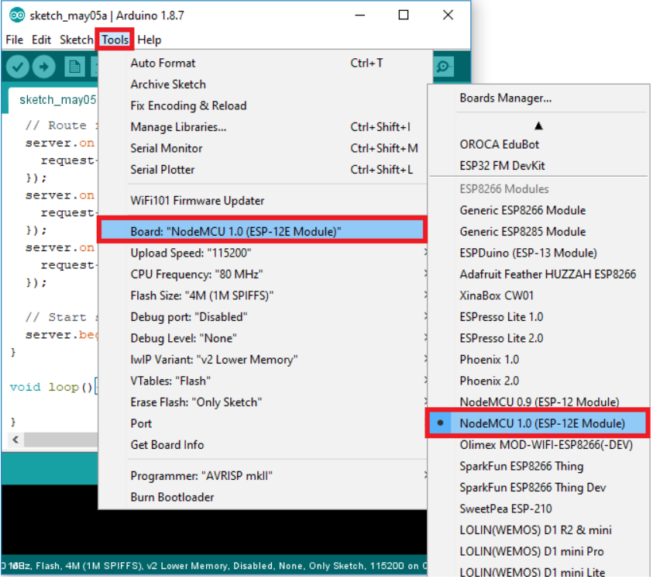

Slide 18
Go to Tools > Port and select the COM port the ESP8266 is connected to.

Slide 19
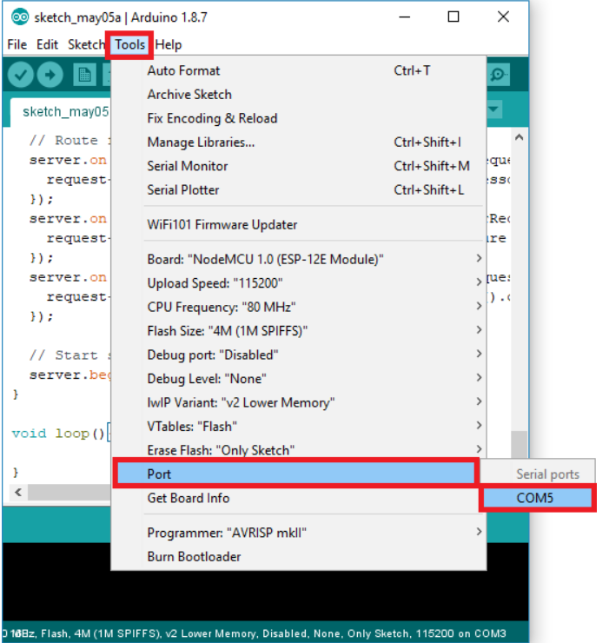

Slide 20
Press the Arduino IDE upload button.

Slide 21
ESP8266 IP Address
After uploading the code, open the Serial Monitor at a baud rate of 115200. Press the ESP8266 reset button. The ESP8266 IP address will be printed in the serial monitor as shown in the following figure.

Slide 22
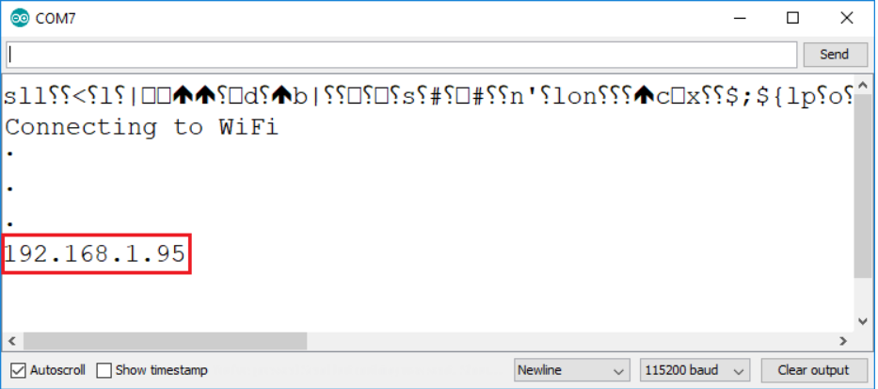

Slide 23
Demonstration
In your local network, go to a browser and type the ESP8266 IP address. It should display the following web page with the latest sensor readings.

Slide 24
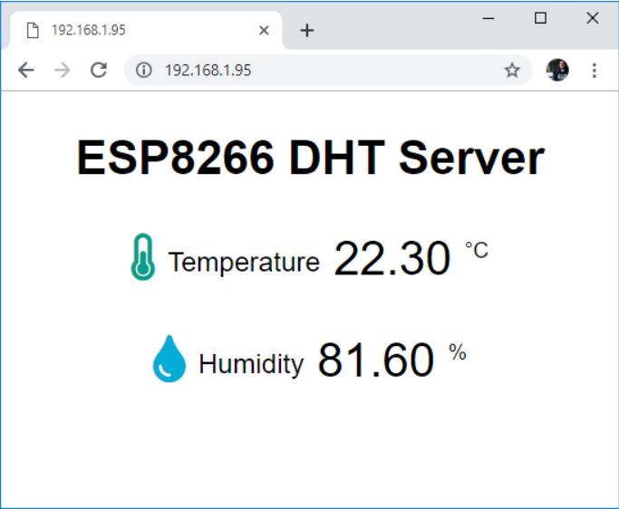

Slide 25
The temperature and humidity readings update automatically every 10 seconds without the need to refresh the web page.

Slide 26


