Slide 1
MODULE 10
Harvest mature vermicompost and Earthworms

Slide 2
Harvest mature vermicompost:
Collect the top layer manually following approved procedures and in accordance with the vermicomposting method used such as tub method, container, etc.
Verify that harvesting of the worm castings are limited to layer above the earthworm’s presence .
Feed the worms with partially decomposed organic wastes (prepared in correct ratio) to continue composting cycle relevant to the type of method selected.

Slide 3
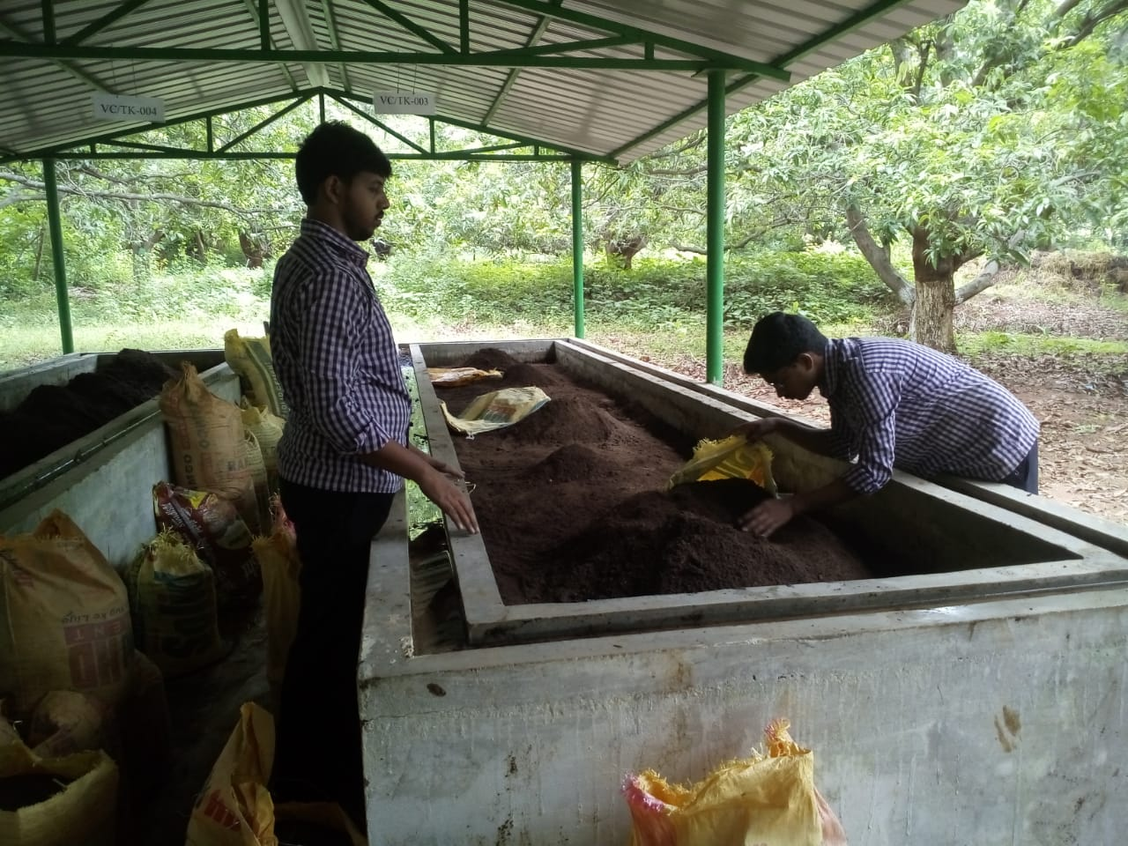

Slide 4
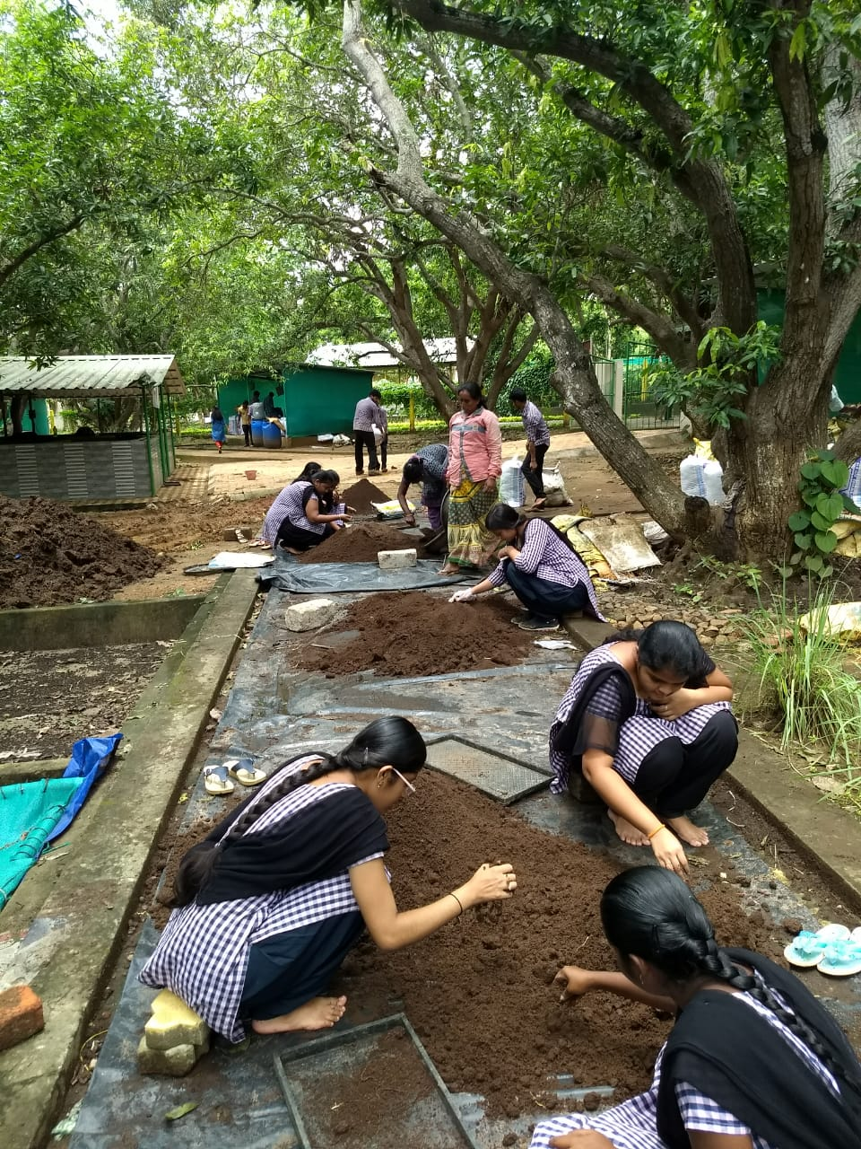

Slide 5
Harvest earthworms
Remove the upper layer of the stable and mature compost before harvesting the earthworms as per approved procedures.
Carry out harvesting of earthworms using technique appropriate to the type of vermicomposting method adopted Techniques: Examples—trapping method, sieving method, manual method, self-harvesting method, etc.

Slide 6
