Slide 1
MODULE 8 Control Predator Attacks

Slide 2
Control predator attacks:
Ensure that the vermibed is properly covered with appropriate materials such as wire mesh, gunny bag, etc. to prevent birds from picking the earthworms.

Slide 3
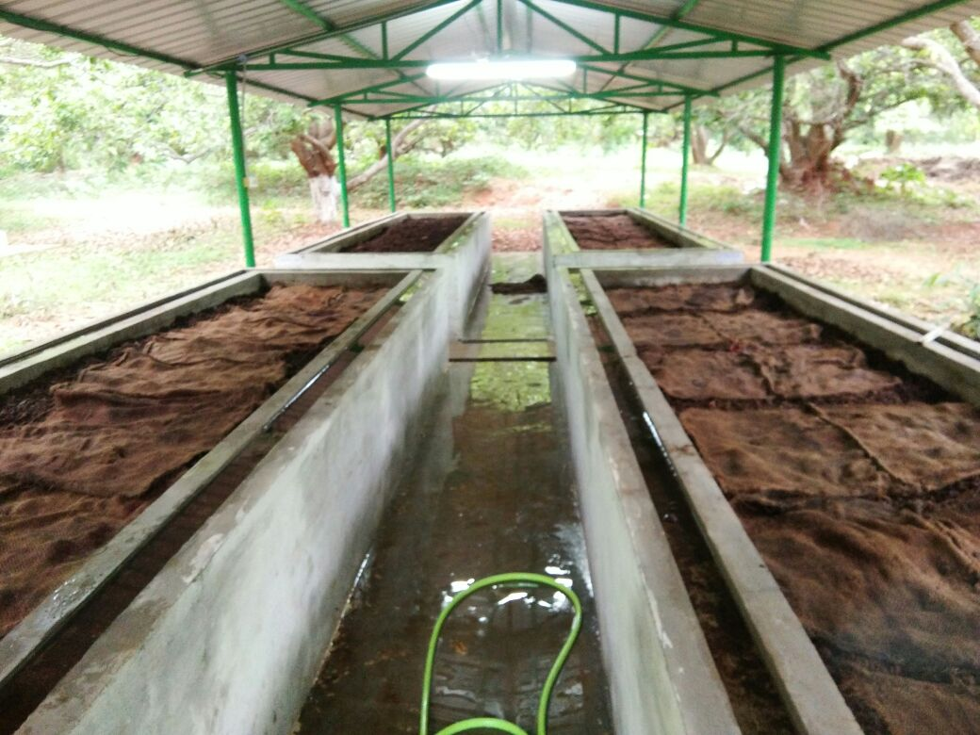

Slide 4
Comply with relevant agricultural practices to protect earthworms from some animals and insects such as red mites, ants, flatworm, centipedes, rats, etc.
The important natural enemies of vermiculture are ants, termites, centipedes, rats, pigs, birds etc.

Slide 5
Preventive measures include treating of the site with 4% neem based insecticide before filling the heap.
Establish favorable environmental conditions during the vermicomposting process against diseases such as 'sour crop'.

