Slide 1
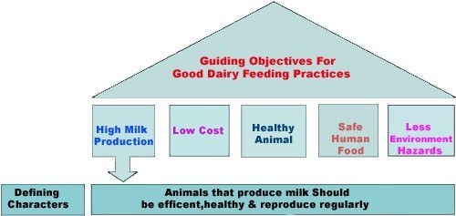
Feeding practices of different stages of Dairy cattle

Slide 2
Feeding ruminant animals at different life stages
Start from Pregnancy to End of Lactation Period
Peak lactation
Mid lactation
late lactation

Slide 3
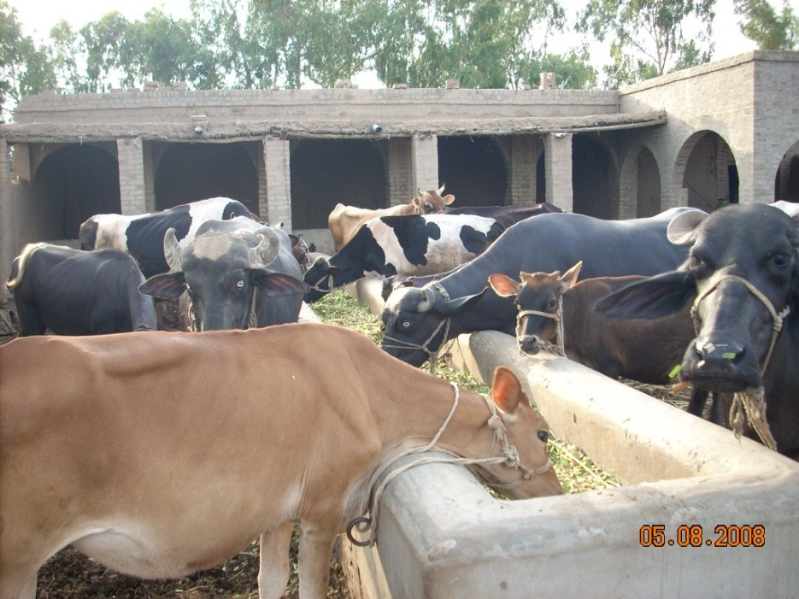
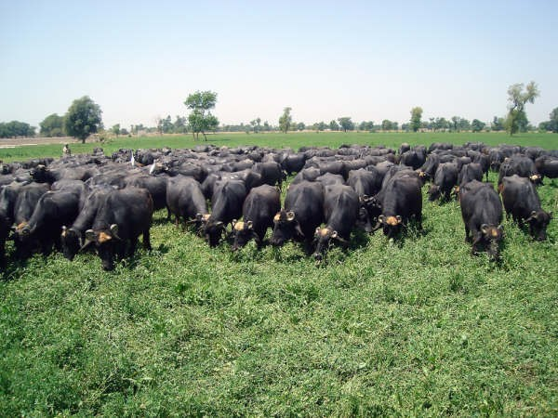
Dairy Nutrition
■ Nutrition is important in order to be profitable in the dairy industry from growth of the calves through milk production in lactating cows.

Slide 4
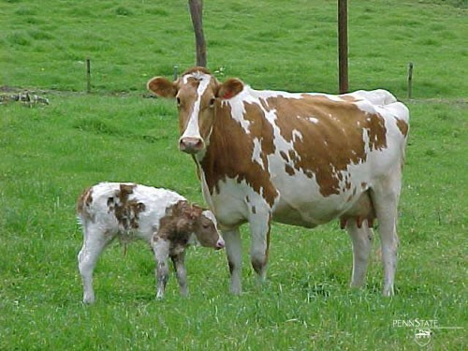
Stages of A Dairy Cow
Calf
Heifer
Dry Cow
Close-up Cow
Lactating Cow

Slide 5
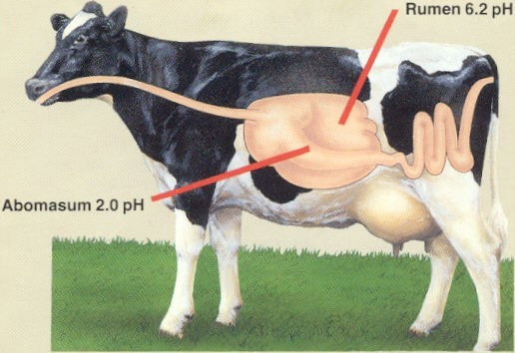
Digestive system

Slide 6
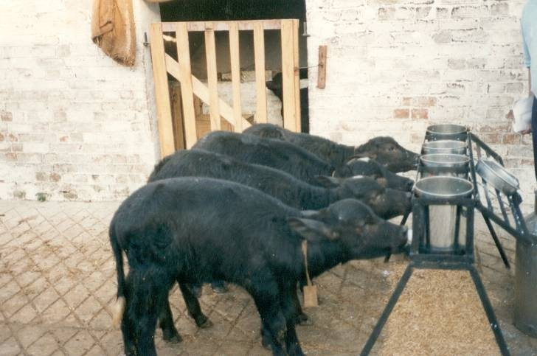
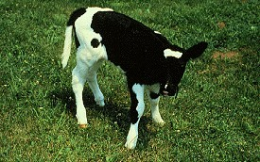
Calf Nutrition
Calves are born as monogastric animals (simple stomach)
So offer feed that must be easy to digest (high quality digestable proteins, energy, vitamines and minerals)

Slide 7
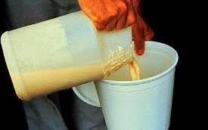
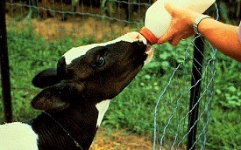
Calf Nutrition
Energy is important first two weeks because can not digest starch, sugar or unsaturated fats.
Colostrum feed at first feeding to get higher amounts of protein, minerals, immunoglobulins, and antibodies. Lines to walls of digestive tract to protect against diseases

Slide 8
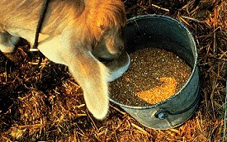
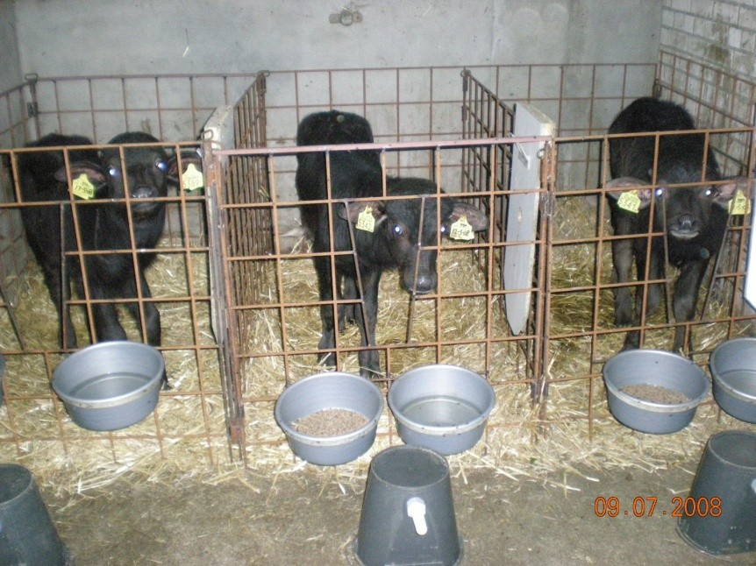
Calf Nutrition
Grains (Dry Matter) stimulate production of VFAs in rumen (acetic, propionic, butyric)
Digestive system develops from 2
weeks until 4-6 months and calf evolves into ruminant

Slide 9
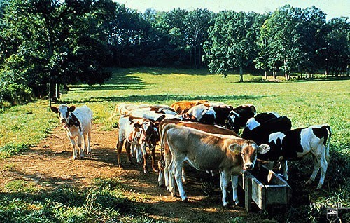
Heifer Nutrition
■
Nutrition is important at this time because reproduction depends on sound, healthy animals.
If underfed, diseased or have parasites then puberty is delayed. Low energy will lead to ovarian inactivity. Low protein will cause irregular or silent heats.
30-40% of adult weight at breeding age (13-15 months)
■
■

Slide 10
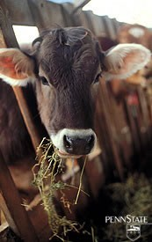
Heifer Nutrition
Pasture is a good choice of forage (high energy and less expensive)
3 lbs concentrate/ day
12% crude protein, 15% crude
fiber and .41% Calcium at 6
months, .29% Calcium at 12 months
Final 3 months of pregnancy heifer will need extra nutrients for developing calf

Slide 11
Dry Cow Nutrition
Low energy diet (less expensive)
Pasture often used
Important for successful lactation to follow
Restore body energy and nutrient reserves
Want to maintain 3+ to 4- body condition score

Slide 12
Feeding in Pregnancy (Last 2 months)
For
Rapid growing fetus
Develop body reserves for use in subsequent lactation
■
■
Give rest if in milk (forced drying)
Feed concentrate 2 kg/day + good quality fodder, restrict straw
■
■

Slide 13
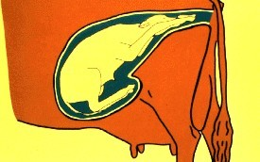
Close-up cows
Move cows and heifers to close-up pen at 2 weeks before calving
High dry matter intake to gain nutrients for cow and calf to reduce metabolic problems

Slide 14
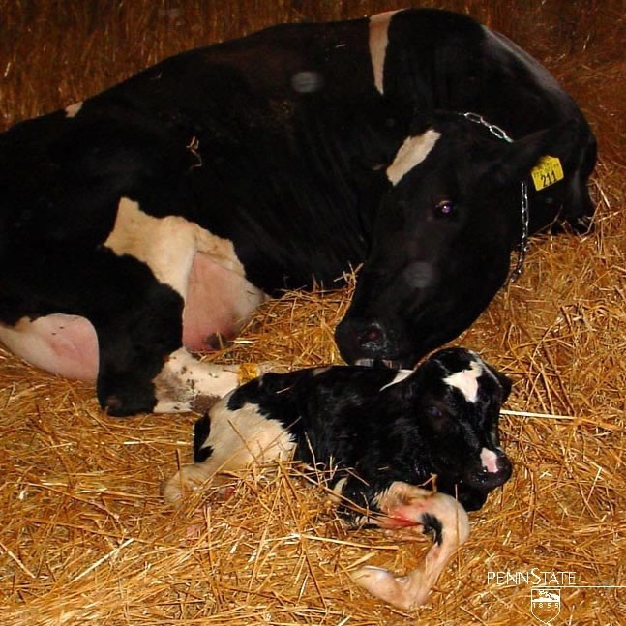
Close-up Cows
■
■
■
Start grain feeding Increase CP to 15% Limit added fat 100 gm/d
■
Low energy with adequate levels of minerals vitamines and protein and watch forage levels (<50% DM)
Decrease metabolic problems and maintain condition while not lactating
■
Decrease Calcium to begin to use stored Ca to prepare for lactation changes

Slide 15
Early lactation (First 60 days)
Most critical period
Period of peak milk yield
Higher the peak yield more will be the milk yield throughout lactation until drying off.
Good quality forage
Maintain healthy level of fiber
Avoid high starch level
Undegradeable protein & digestible fiber

Slide 16
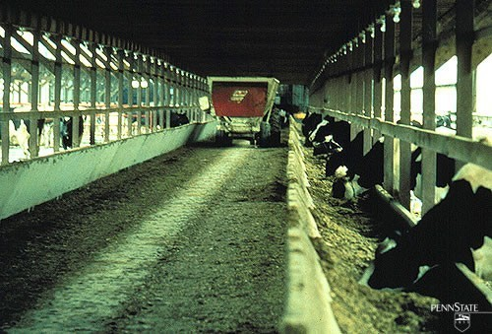
Lactating Cows
Highest energy diet (most expensive)
Supports not only growth, reproduction and maintenance but also production
Free feed at all times to increase and support production

Slide 17
Consequences of Feed Restriction in early lactation as a traditional practice
Low peak milk production & total lactation yield
Drastic body weight losses in high potential cows leading to;
Metabolic diseases ( milk fever, acetonaemia, red water disease etc)
Delayed estrus resumption
■ Long dry period
■

