Slide 1
Center for Smart Agriculture
Bio fertilizer and Bio pesticide Production Technology
Module
Session 10: Isolation of AM fungi by wet sieving and sucrose gradient method

Slide 2
Wet sieving method
Also known as wet sieving and decanting method (Gerdemann and Nicolson, 1963). Developed to isolate different size of spores.
The soil near the root system is collected and an aqueous suspension is passed through different sieves to collect spores of different sizes.
The wet sieving and decanting is one of the popular technique when compare to other techniques. This technique is used for sieving the coarse particles of the soil and retaining AMF spores and organic particles on sieves of different sizes.10 g of soil was mixed with 100ml of water in the 500 ml conical flask. The soil mixture was agitated vigorously to free the AMF spores from soil and allowed to settle for 15-45 minutes and the supernatant was decanted through standard sieves. By using a dissecting microscope, spores were picked by means of pipette or needle.

Slide 3
Earlier, Gerdemann (1955) devised the first useful technique for extracting spores from soil. A soil sample was suspended in four times its volume of water, heavier particles were allowed to settle for a few seconds, then the liquid was decanted through a sieve with 1mm mesh. Whatever passed through this sieve was then poured through another sieve with 0.25 mm mesh. Material retained by this sieve was washed and transferred to a petridish, and the spores picked out by hand under a dissecting microscope.
Technique given by Gerdemann (1955) was slightly refined by Gerdemann and Nicolson (1963) who used the following series of sieves: 1.0 mm ; 710 µm; 420 µm; 250 µm; 149 µm; 105 µm; 74 µm; and 44 µm.
They found that most of the desired spores fell in the 420- 149 µm range, and they used this fraction for their study.

Slide 4
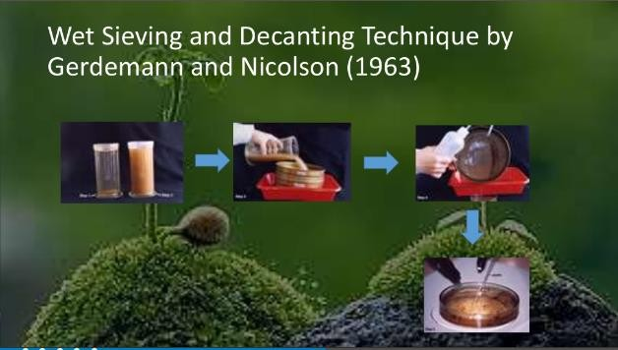
Source: https://www.slideshare.net/NawabKhatoon/mycorrhyzae-association

Slide 5
Sieving method
Soil sample + sterile water
Hot water
Filter and sieve
( 719μm → 250μm → 50μm → 45μm) Spores separated from soil particles
Mix with carrier material
Use when required as biofertilizer

Slide 6
Floatation method
Soil sample + sterile water
Separate the soil particles using
membrane filter
Centrifuge
( Density gradient centrifuge = at 3000rpm
for 30 min )
Spores separated from soil particles Mix with carrier material
Use when required as biofertilizer

Slide 7
Isolation of Vesicular-Arbuscular Mycorrhizal (VAM) spores from the soil
Sieving method
Requirements
Soil sample
500 ml beaker
Sieves of 710 µm, 250 µm, 75 µm and 45 µm.
Bunsen burner

Slide 8
Procedure
Take 200 ml water in 500 ml beaker.
Heat the water to 40-50˚ C.
Add 50 g of soil and mix well to form a suspension.
Allow the heavier particles to settle down.
Decant most of the suspension through a 710 µm sieve to remove large organic matter and roots.
Add 200 ml of water to the suspension.
Decant the suspension through 710 µm sieve.
Decant this through 250 µm, 75 µm and 45 µm sieves consequently.
Collect the residue on the 45 µm sieve.
Wash the residues well with water and collect the spore.

Slide 9
Floatation method
Requirements
Soil sample
Sucrose solutions (20, 40 and 60 %)
Blender
Fine sieve
Centrifuge
Centrifuge tube (50 ml)

Slide 10
Procedure
Collect fresh soil samples from the field, mix them well and weigh 20 g soil.
Transfer the soil into a blender.
Blend it at high speed for 1-2 minutes so that the spores attached to the soil particles or roots may become free.
Filter the contents through a fine sieve and wash with strong stream of water.
Pour 10 ml of 20% sucrose into a centrifuge tube followed by the same amount of 40% and 60% sucrose into the bottom of the tube.
(Cont….)

Slide 11
Take 10-15 ml of blended sieving and add onto the surface of 20% sucrose layer.
Centrifuge the contents for 3 minutes at 3000 rpm. Thereafter, remove the debris which accumulate at the interfaces of 20-40% and 40-60% of sucrose.
Gently wash the spores present on fine sieve with a strong stream of water so that sucrose should be removed.
Collect the spores and observe under microscope.

Slide 12
Sucrose gradient method
Developed by Daniel and Skipper (1982); commonly used technique for AM spore extraction. Requires prior sieving and decanting.
This gradient centrifugation method is result of many modifications, right from Ohms (1957), Mosse and Jones (1968), Mertz et al. (1979) etc.
Spores were purified by re-suspending the sieving in the 40% sucrose solution and centrifugation was carried out. Centrifugation was carried out at 1750 rpm for 5 minutes. The supernatant was removed and poured into the sieves. The spores that hold on the sieves are carefully rinsed with tap water. The spores were collected by using dissecting microscope.

Slide 13
Mertz et al. (1979) protocol needs a special mention.
They used discontinuous sucrose gradients to recover large number of spores from massive soil samples. They decanted and wet sieved 18 kg of soil with cold water, and found that most spores were present in the 425-250 µm fraction.
Spores were separated from most of the remaining debris using discontinuous 30% (w/v) aqueous sucrose gradients. The sieved material was layered on 600 ml water over 200 ml sucrose in 1 L beaker. After settling, the spores and debris that collected at the interface were removed by vacuum aspiration, rinsed in cold water, and centrifuged for 1- 5 min at 1600 X g in clinical centrifuge on a second gradient (15 ml water over 20 ml sucrose in a 50 ml tube), the duration of centrifugation being determined by the kind and amount of debris present.

Slide 14


