Slide 1
Center for Smart Agriculture
Bio fertilizer and Bio pesticide Production Technology
Module
Session 11: Mass Production of AM Inoculants

Slide 2
Mass Production: Problems and prospects
Being obligate symbionts AM fungi could be mass produced only in the presence of living roots.
Since AM fungal associations are universal and have been reported in almost all terrestrial plants, these can be reproduced on a wide range of host plants.
There are several techniques reported for mass production of AM inoculum.

Slide 3
a. In vivo culture
AM fungi are grown on roots of green house plants and chopped mycorrhizal roots, often mixed with growth media containing hyphae and spores, are used as source of inoculum.
Soil could be replaced by inert substances such as vermiculite, perlite, sand or a mixture of these for crude inoculum production.

Slide 4
Mass production
Spores + antibiotic solution
( streptomycin of 220 ppm concentration for 15 min )
Wash spores with mercuric chloride Wash with distilled water
Inoculate the plant pots ( Guinea grass or Bahiya grass )
Keep in green house for 3 - 4 weeks
Uproot the plants
Cont….
Cont….

Slide 5
Check for colonization
Again keep for field growth ( 1 – 1½ months ) Macerate the root
Check for moisture content ( only 5 % should be there)
Use as biofertilizer

Slide 6
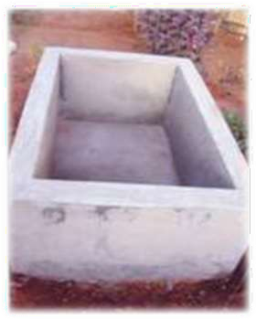
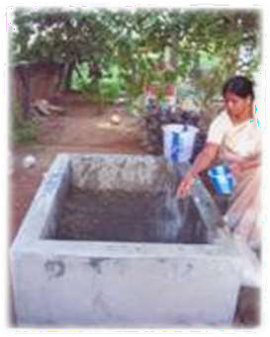
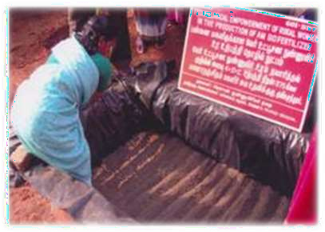
Method of production OF VAM
1. Tank for mass
multiplication of
AM
2. Sprinkling of water in tank with vermiculite
3. Making of furrows to sow maize seeds

Slide 7
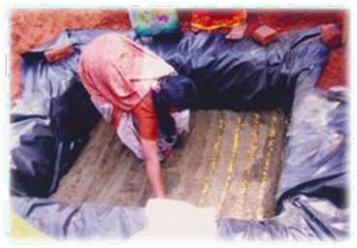
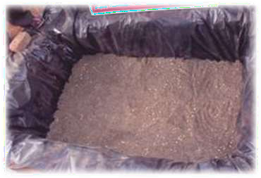
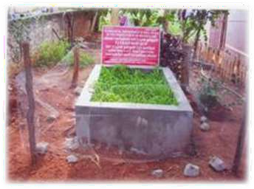
4. Sowing the seeds in furrows
5. View of the maize sown AM pit
6. Vermiculite contained raised AM infected maize plants
•

Slide 8
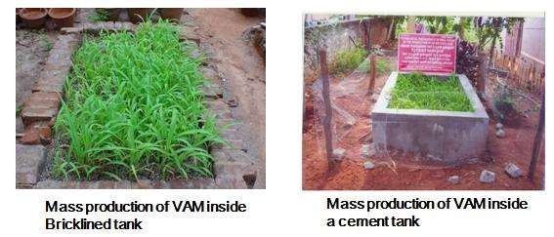
Mass production of VAM

Slide 9
b. In vitro/ axenic culture techniques
i) Solution culture
ii) Aeroponic culture
iii) Root organ culture

Slide 10
i) Solution culture
Involves growing infected roots in aqueous medium enriched with mineral nutrients required for the growth of the roots under controlled biotic and abiotic conditions.
ii) AEROPONIC CULTURE
Involves applying a fine mist of nutrient solutions to colonized roots for AM fungal inoculum production.
iii) Root organ culture
Use of a modified agar medium (MS rooting medium)/ liquid medium for creation of increased amount of roots from callus tissue and these roots are infected by AM spores or by surface sterilized root bits obtained from mycorrhizal plant.

Slide 11
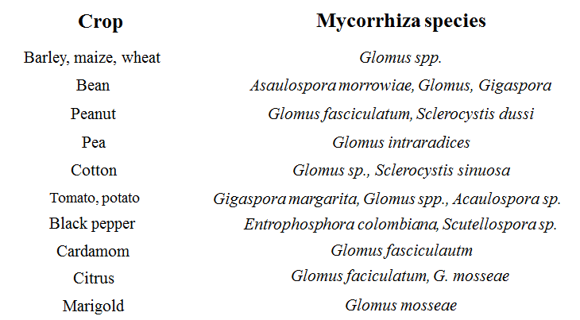

Slide 12


