Slide 1
Center for Smart Agriculture
Bio fertilizer and Bio pesticide Production Technology
Module
Session 8: Isolation and Purification of Azospirillum, Azotobacter, Rhizobium, PSB
and Cyanobacteria

Slide 2
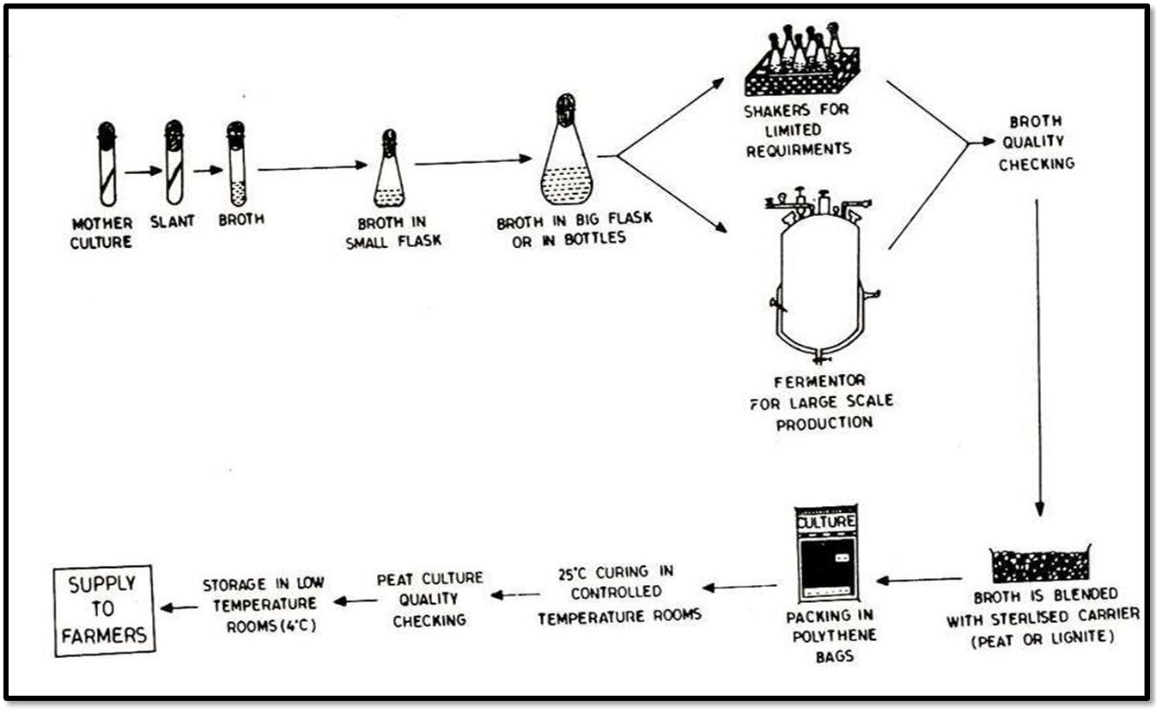
Production of biofertilizers

Slide 3
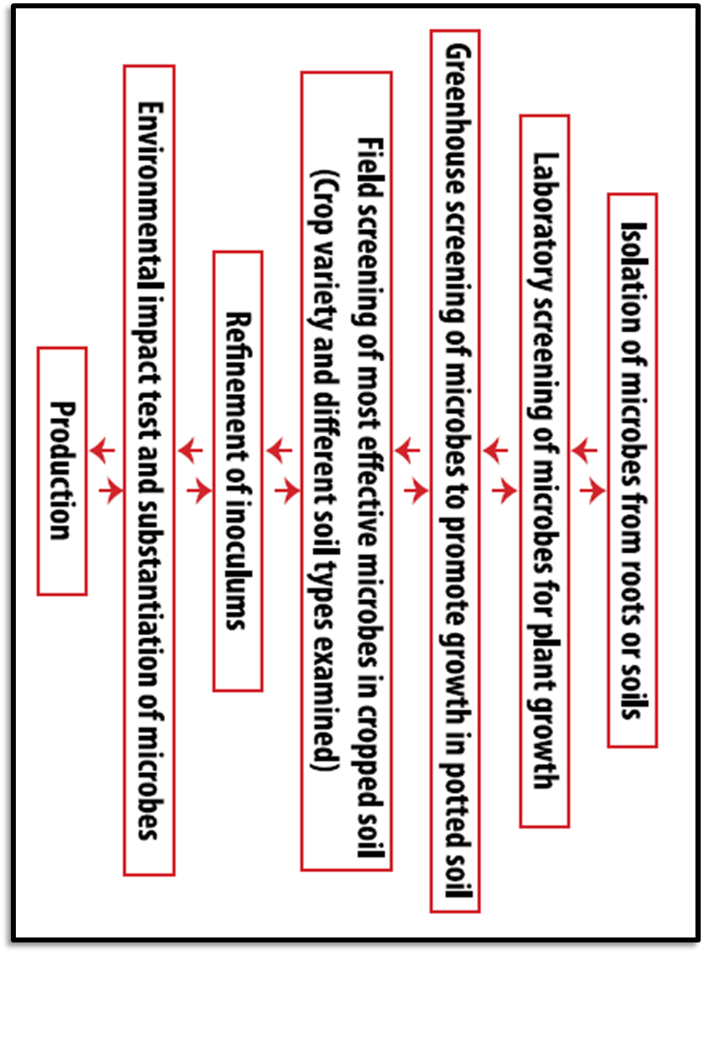
Stages in development of biofertilizers

Slide 4
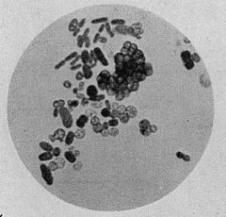
ISOLATION OF AZOTOBACTER
Samples were withdrawn at a depth of 10 – 15 cm below the surface, collected into sterile vials and then Azotobacter is isolated on Jensen’s medium

Slide 5
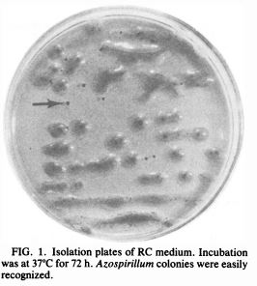
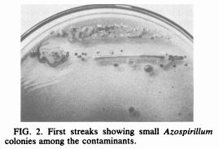
ISOLATION OF AZOSPIRILLUM
Nitrogen-free semisolid malate (NFb) enrichment medium, and Rojo Congo (Congo red; RC), an isolation medium were used for isolation of Azospirillum.

Slide 6
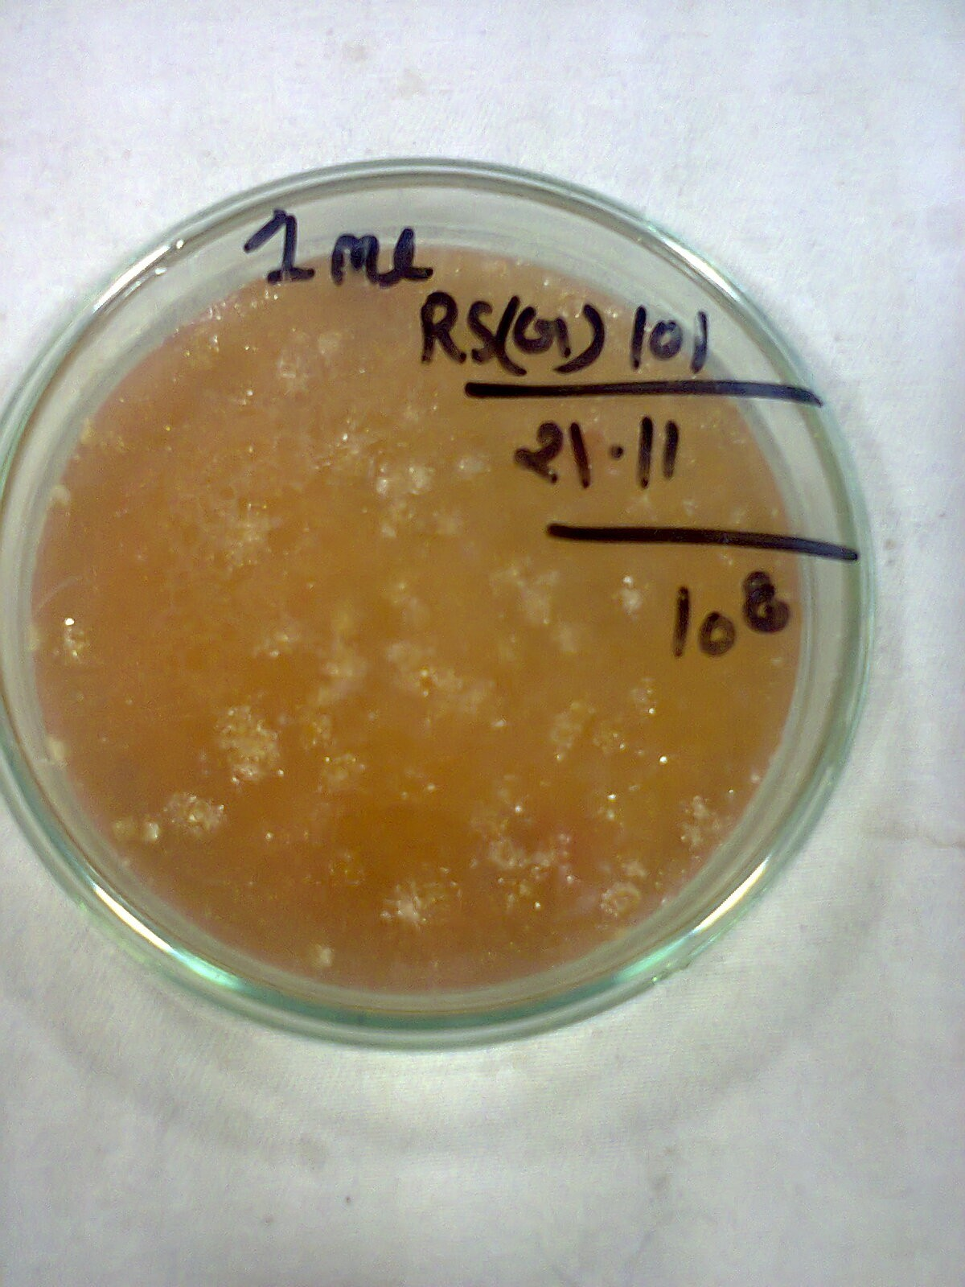
ISOLATION OF RHIZOBIUM
RHIZOBIUM IS ISOLATED ON CONGO RED MEDIUM
The Rhizobium from the freshly crushed root nodule was Gram stained onto a slide and examined at 100X power with oil immersion. The bacteria cells were rods in chains, and clumps that stained Gram negative as indicated by the faint pink red colour of the rod membrane walls.

Slide 7
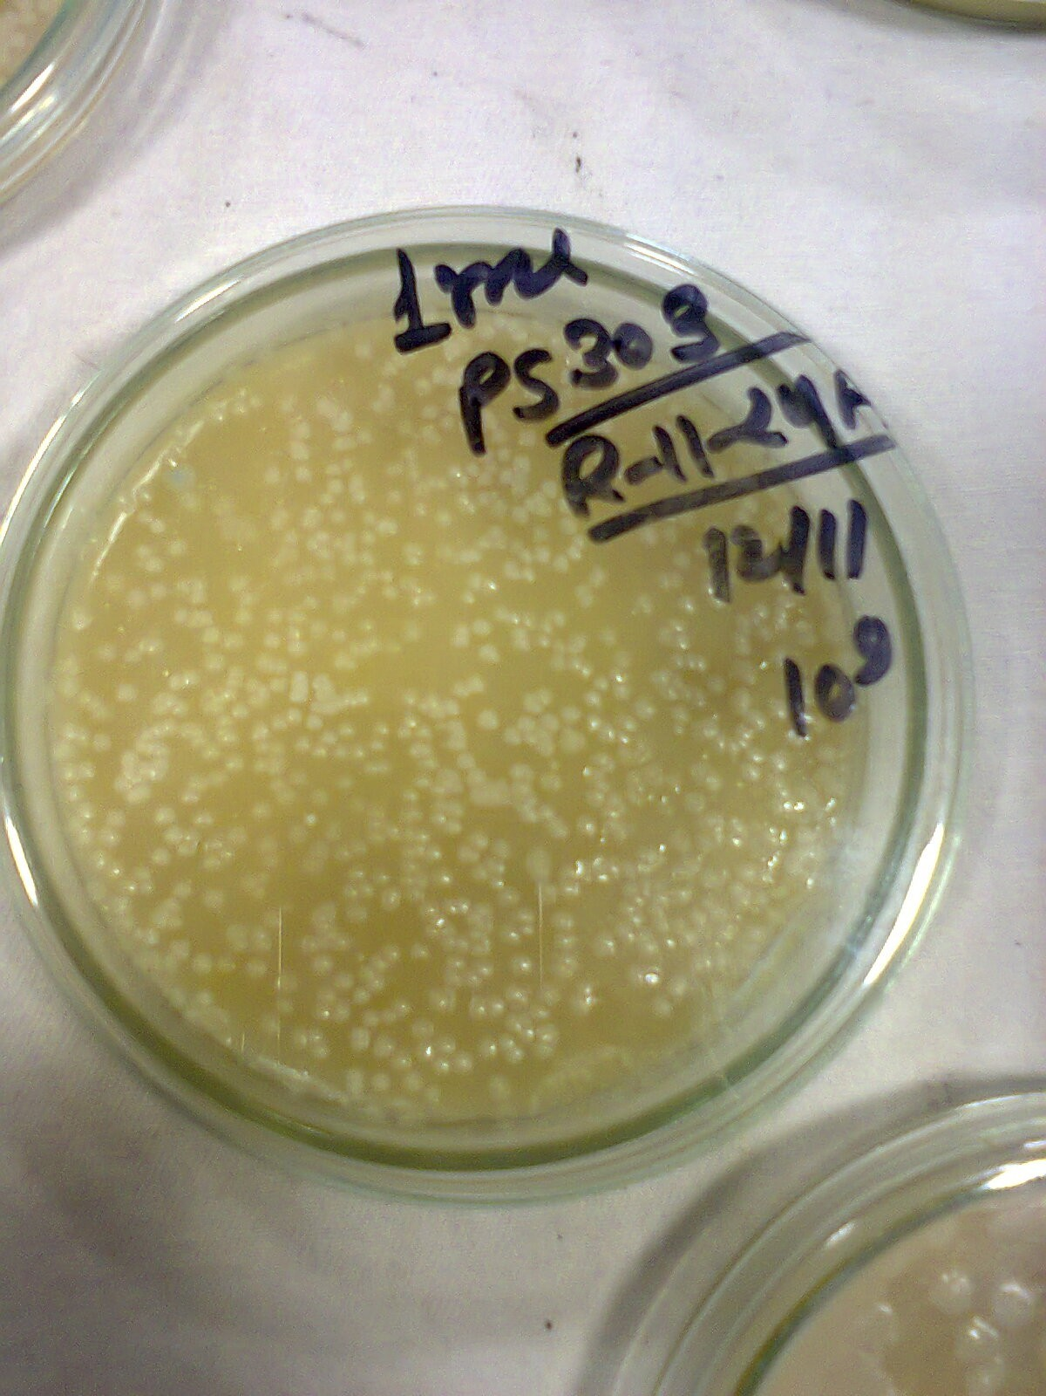
ISOLATION OF PSB
Soils collected from different places and sediment samples of soil is collected by sediment sampler (Peterson crab), it was sterilized with alcohol. The central portion of the top 2 cm sediment samples was taken out with the help of a sterile spatula. The samples were then transferred to a sterile polythene bag and transported.
The serially diluted samples were plated on Pikovskaya’s agar media to isolate the phosphate solubilizing bacteria. The plates were incubated at 28±2 ºC.

Slide 8
ISOLATION OF CYNOBACTERIA
The number of heterotrophic bacteria present on the surface of a membrane filter then was determined by placing each filter into 10 ml of sterile dilution buffer (HEPES, 1.2 g/liter; NaNO3, 1.5 g/liter; pH 7.5) and dispersing the cells by treatment for 3 min in an ultrasonic cleaning bath (model B-220; Branson). Serial dilutions of the resulting cell suspensions were prepared and plated in duplicate on BG-12 medium supplemented with glucose (1.0 g/liter), nutrient broth (Difco; 0.8 g/liter), and cycloheximide. After incubation in the dark at 25°C under ambient atmosphere for 1 week, the bacterial colonies present on the plates were counted with a colony counter (American Optical).

Slide 9


