Slide 1
Center for Smart Agriculture
Bio fertilizer and Bio pesticide Production Technology
Module
Session 9: Mass multiplication and inoculum production of Biofertilizers

Slide 2
Biofertilizers
Live microbes – Naturally present- less in number
Multiplied in laboratory
How they act as fertilizers?
Fix- atmospheric nitrogen,
Solubilize - phosphorus
Decompose organic wastes

Slide 3
Types of biofertilizers
Types of biofertilizers | Microorganisms
Nitrogen Symbiotic Fixers Non symbiotic | Azolla, Rhizobium, Bradyrhizobium Azospirillum Azotobacter, Blue Green algae, Acetobacter, Anabena
Phosphate Fungi solubilisers Bacteria Actinomycetes | Penicillium sp, Aspergillus awamori Bacillus megaterium , B. subtilis, B. Polymixa, Pseudomonas striata
Phosphate Symbiotic-mobilisers Arbuscular mycorrhiza (AM) | Glomus sp.,Gigospora sp., Acaulospora sp., Scutellospora sp, Sclerocystis sp.
Potassium solubilizers | Bacillus mucilaginosus , Fraturia aurantia
Silicate and zinc solubilizers | Bacillus sp, Pseudomonas sp.
PGPR | Pseudomonas fluorescens
Compost making microorganisms | Cellulotytic (Aspergillus, Penicillium, Trichoderma) and lignolytic

Slide 4
Advantages of biofertilizers:
Less expensive and eco friendly
Component of INM - Supplement 25-30% chemical fertilizers (N,P)
Helps solubilizion of minerals - increases C/N ratio - soil texture, structure
Activate the soil biologically - increases the beneficial microorganisms - in turn increasing natural fertility of soils.
Provides tolerance to biotic (soil borne ) and abiotic stresses
Provides growth promotion- harmones and enzymes

Slide 5
Major types of biofertilizers
1.Carrier based biofertilizers:
Carrier material -- peat, lignite, charcoal etc.
Advantages:
Cheaper, cost effective than liquid biofertilizers.
Easier to produce
Investment cost is low than liquid formulations.
Disadvantages:
Shelf life is low.
Temperature sensitive.
More chances of contamination .
Low cell count.
Less effective.

Slide 6
Liquid biofertilizers:
No carrier material
Bacterial broth mixed with cell protectants - bottled.
Advantages:
Longer shelf life than the carrier based biofertilizers.
Easier to produce.
Temperature tolerant.
High cell count when compared to the solid biofertilizers.
Contamination free.
More effective.
Disadvantages:
High cost
Higher investment

Slide 7
BENEFITS OF LIQUID BIOFERTILIZERS
More shelf life.
One ml of biofertilizer contains > 10⁸ cells end of expiry date.
With zero contamination.
Easy to apply for larger areas - through drip irrigation
Easy establishment in the crop root zone.
Tolerant to high soil temperatures and other stress conditions.
Ensures proper delivery of biofertilizer near the root zone.
Enhances crop growth and yield.
In organic farming, one of the major inputs for sustainable crop yields

Slide 8
Production technology
It involves 3 steps:-
a) Isolation and identification - appropriate strains of targeted organisms, Colonization, Competition, sustain for longer time
b) Multiplication of microbial biomass.
c) Impregnation of carrier - fully grown microbial broth or immobilization of grown cells to obtain liquid formulations

Slide 9
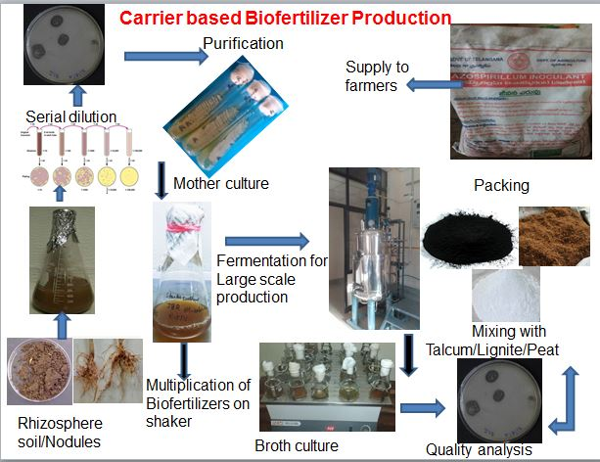

Slide 10
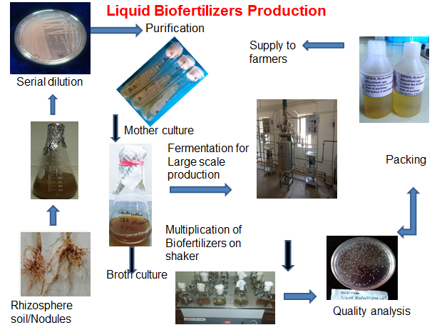

Slide 11
Biofertilizer– efficiency depends on
Near neutral reaction
Moisture
Carbon content
Other essential nutrients essential for sustinance and growth
Azotobacter sp – poor competitor for nutrients in soil.
Sensitive to acidic pH, high salts, temperature > 35ºC.
Fixes 30 kg of N/ha- where organic carbon 1000 kg

Slide 12
How to increase bio fertilizers efficiency?
Seed treatment - Rhizobium + PSB (1:1)
Rhizobium spp 200g +200g PSB+400ml water.
In acidic and alkaline soils-1kg of slacked lime or gypsum powder respectively - coat - wet biofertilizer treated seeds
Low pH soils (4.78-5.56) -Lime amelioration - @ 500kg/ha + 10 tons FYM/ ha
Alkali soils deficient in sulphur- addition of gypsum with biofertilizers (sulphur - source) increased yield

Slide 13
What type of biofertilizers to apply?
For all nonlegume crops
Wheat, rice, maize, bajra, oats, barley, mustard, sesame, niger, onion, potato, sugarcane, cotton, vegetables, fodder crops. Plantation crops (banana, citrus, pomegranate, coconut, coffee, tea, rubber, mulberry)
In light textured soils- sandy loam, loam or sandy type low moisture holding capacity
Azotobacter + PSB (1:1)
In heavy textured soils – clay loam or clay type submerged or waterlogged soils
Azospirilium + PSB (1:1)
In medium loam with moderate moisture holding capacity, pH more acidic
Azotobacter + Azospirillum + PSB (1:1:2)

Slide 14
CROP | DOSE
Pulse crops like moong, urad, arhar, cowpea, lentil, pea, bengal gram, all beans, ground nut, soybean, leucern, berseem and other legume crops | Rhizobium 200 gms + PSB 200 gms/10 kg seed - seed treatment
All non legume crops like wheat, seed sown upland paddy, barley, maize, cotton, sorghum, bhindi, mustard, sunflower, niger etc. and other non legume crops taken by direct seed sowing | Azotobacter 200 gms + PSB 200 gms/10 kg seed - seed treatment

Slide 15
CROP | DOSE
Jute | Azospirillum 200 g + PSB 200 g /10 kg of seed as seed treatment.
Vegetables like tomato, brinjal, chilli, cauliflower, cabbage etc. and other transplanted crops. | Azotobacter 1kg + PSB 1 kg/ one acre as seeding root dip method.
Lowland transplanted paddy. | Azospirillum 2kg + PSB 2kg / one acre as seeding root dip method for 8-12 hours.

Slide 16
CROP | DOSE
Potato, ginger, colocassia, turmeric and jhum paddy | Azotobacter or Azospirillum 4 kg + PSB 4 kg/acre mixed with 100 – 200 kg compost - soil application
Standing plantation crops like tea, coffee, rubber, mulberry and fruit trees. | 2 - 3 kg Azotobacter/Azospirillum + 2-3 kg PSB mixed with 200 kg Compost for one acre and applied as soil treatment. This treatment is to be done 2 to 3 times a year with a gap of 4- 6 months
Sugarcane | 5 kg Acetobacter mixed in sufficient water for setts dipping treatment

Slide 17


