Slide 1
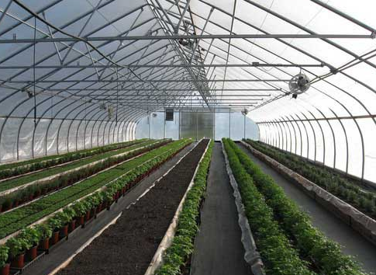
Center for Smart Agriculture Protected cultivation of vegetable crops
Module 4: Artificial media
Session 10: Pasteurization of growing media

Slide 2
Soil mixes used for greenhouse production of potted plants and cut flowers are highly modified mixtures of soil, organic and inorganic materials.
When top soil is included as a portion of the mixture, it is generally combined with other materials to improve the water holding capacity and aeration of the potting soil.
Many greenhouses do not use topsoil as an additive to the soil mixes, but rather use a combination of these organic and inorganic components as an artificial soil mix.

Slide 3
When managed properly as to watering and fertilization practices, these artificial mixes grow crops that are equal to those grown in top soil.
Sterilisation of Growing Media: Sterilisation can be defined as the process of removal or destruction of all forms of microbial life

Slide 4
Methods of Soil Disinfestation: A variety of techniques and agents are available for soil disinfestation.
Among the variety of physical and chemical agents and techniques available, the more commonly used for soil or substrate sterilisation are moist heat, i.e., steam sterilisation and chemicals, i.e., fumigants.

Slide 5
Soil fumigation:
It is a chemical control strategy used independently or in conjunction with cultural and physical control methods to reduce populations of soil organisms.
Soil fumigants can effectively control soil-borne organisms, such as nematodes, fungi, bacteria, insects, weed seeds, and weeds.
Different fumigants have varying effects on the control of these pests.

Slide 6
Some are pest-specific, while others are broad spectrum biocides and kill most soil organisms.
Types of Soil Fumigants:
Soil fumigation uses pesticide formulations that volatilize from a liquid or solid into a gas state.
Soil fumigants are applied to the soil as liquefied gases, volatile liquids, or granules.

Slide 7
Due to the high volatility of these compounds, the fumigant must be incorporated into the soil during or immediately following application.
At or shortly after application, these chemicals volatilize, allowing toxic molecules to move through the air pores in the soil.
Soil pests are killed when they come in contact with a toxic concentration for a long enough exposure period.

Slide 8
For all fumigants, enough concentration and contact time with target pests are required to obtain good results.
Methyl Bromide:
Methyl bromide is a broad-spectrum fumigant that controls many weeds and soil-borne insects, nematodes, fungi, and bacteria. However, it does not adequately control all species

Slide 9
Methyl Bromide and Chloropicrin Mixtures:
Proprietary materials are available that contain both methyl bromide and chloropicrin.
Such combinations are more effective than either material alone in controlling weeds, insects, nematodes, and soil-borne pathogen

Slide 10
Pasteurization of greenhouse plant growing media:
Greenhouse growing medium may contain harmful disease causing organisms, nematodes, insects and weed seeds, so it should be decontaminated by heat treatment or by treating with volatile chemicals like methyl bromide, chloropicrin etc.

Slide 11
Thank You ….

