Slide 1
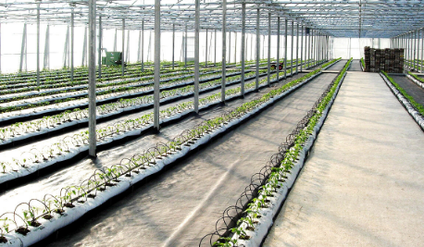
Center for Smart Agriculture Protected cultivation of vegetable crops
Module 5: Nutrient management
Session 12: Fertilizer application methods and general problems of fertigation

Slide 2
Fertilizer Application Methods
Constant feed: Low concentration at every irrigation are much better. This provides continuous supply of nutrient to plant growth and results in steady growth of the plant. Fertilization with each watering is referred as fertigation.

Slide 3
2. Intermittent application:
Liquid fertilizer is applied in regular intervals of weekly, biweekly or even monthly.
The problem with this is wide variability in the availability of fertilizer in the root zone.

Slide 4
Fertilizer injectors :
This device inject small amount of concentrated liquid fertilizer directly into the water lines so that green house crops are fertilized with every watering.

Slide 5
Multiple injectors :
Multiple injectors are necessary when incompatible fertilizers are to be used for fertigation.
Incompatible fertilizers - solid precipitates - change nutrient content , Clogging
These injectors can be of computer controlled H.E. ANDERSON is one of the popular multiple injector

Slide 6
Fertilizer Injectors :
Fertilizer injectors are of two basic types: Those that inject concentrated fertilizer into water lines on the basis of the venturi principle and those that inject using positive displacement
A. Venturi Principle Injectors :
1.Basically these injectors work by means of a pressure difference between the irrigation line and the fertilizer stock tank.

Slide 8
The average ratio of Hozon proportioners is 1:16.
Hozon proportioners are not very precise as the ratio can vary widely depending on the water pressure.
These injectors are inexpensive and are suitable for small areas.
Large amounts of fertilizer application would require huge stock tanks due to its narrow ratio.

Slide 9
These injectors are more expensive than Hozon types, but are very accurate in proportioning fertilizer into irrigation lines regardless of water pressure.
These injectors also have a much broader ratio with 1:100 and 1:200 ratio being the most common.
Thus, stock tanks for large applications areas are of manageable size and these injectors have much larger flow rates.

Slide 10
Anderson injectors are very popular in the greenhouse industry with single and multiple head models.
a. Ratios vary from 1:100 to 1:1000 by means of a dial on the pump head for feeding flexibility.
b. Multihead installations permit feeding several fertilizers simultaneously without mixing This is especially significant for fertilizers that are incompatible (forming precipitates, etc.) when mixed together in concentrated form.
.

Slide 12
Gewa injectors actually inject fertilizer into the irrigation lines by pressure.
a. The fertilizer is contained in a rubber bag inside the metal tank. Water pressure forces the fertilizer out of the bag into the water supply.
b. Care must be taken when filling the bags as they can tear.

Slide 13
General problems of fertigation

Slide 14
Nitrogen :
Nitrogen tends to accumulate at the peripherous of wetted soil volume.
Hence, only roots at the periphery of the wetted zone alone will have enough access to Nitrogen.

Slide 15
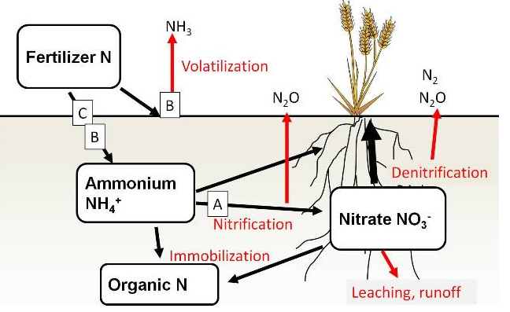
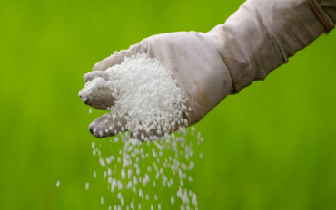
Nitrogen is lost by leaching and denitrification.

Slide 16
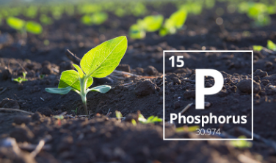
Phosphorous:
It accumulates near emitter and P fixing capacity decides its efficiency.
Low pH near the emitter results in high fixation.

Slide 17
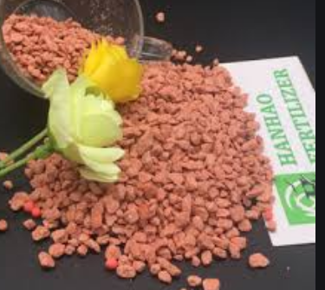
Potassium:
It moves both laterally and downward and does not accumulate near emitter.
Its distribution is more uniform than N&P.

Slide 18
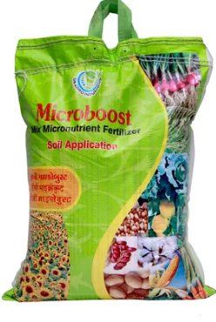
Micronutrients: Excepting boron, all micronutrients accumulates near the emitter if supplied by fertigation

Slide 19
Thank You…

