Slide 1
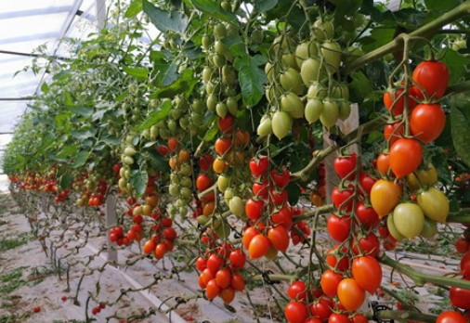
Center for Smart Agriculture Protected cultivation of vegetable crops
Module 7: Crop Management
Session 16: Tomato

Slide 2
Training and Pruning
As greenhouse grown tomatoes are indeterminate in growth habit, they need regular training and pruning right from the few days after transplanting.
Single main stem should be retained in these tomatoes by removing all the side shoots or suckers that develop between leaf petiole and the stem.

Slide 3
Usually, in early stage the shoots are removed by snapping them off, avoiding cutting with knife, blade or scissors, as disease especially the virus (TMV) can be transmitted from one plant to other.
Plants are supported by plastic or binder twine
The plants must be pruned and trellised on regular basis for 10-11 months life cycle of the tomato crop.

Slide 4
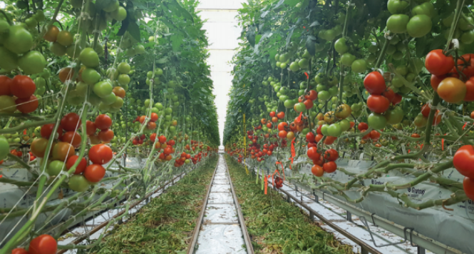
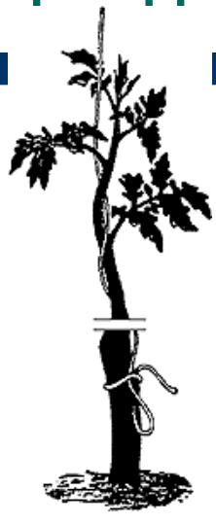
As fruits mature on the lower parts of the vines, pinch off older leaves below fruits

Slide 5
This will provide air circulation, which helps to reduce the incidence of the diseases and opens the vines up for spraying and harvesting.
Removal of excess fruits will also result in larger tomatoes at harvest that can fetch good price.
These tomatoes require pruning of all lateral branches as they develop to encourage a single leader.

Slide 6
Leaning
Due to close or high density plantation all plants may not be exposed to sunlight.
Deficiency of light may result in poor development of fruits due to lack of photosynthetic supply.
To overcome this problem the wires are leaned towards the path creating in a wider space between the rows and exposing them to light.

Slide 7
Lowering
Lowering is practiced when ever the productivity of plant reduces or when ever it reaches the terminal height.
At this stage the wires are loosened to facilitate the plant to lean and sit on the bed.
This facilitates to the light, leaf pruning and removal of sucker shoots, which encourage more flower production

Slide 8
Topping
Six weeks before the anticipated crop termination date, the growing point and small fruit clusters at the top of the plant are removed this operation is called Topping.
Topping is carried out for fast fruit development and increase size of already-set fruit in the lower part of the plant.
Some shoots at the top are left to grow as it helps to avoid risk of sunburn.

Slide 9
Cluster thinning
Tomato produces from one to about 10 flowers per flower cluster.
Under good pollination conditions, about 6 to 8 of these flowers might from fruits.
If too many fruits are allowed to set on a cluster, fruit size, shape, quality and uniformity are sacrificed, therefore tomato clusters should be thinned to provide an optimum number of fruits per cluster.

Slide 10
Pollination
Although tomato is highly self pollinated crop, but aided pollination is needed in the greenhouse grown tomatoes due to limited air movement and high humidity.
If flowers are not too wet due to high humidity in the greenhouse, they will shed pollen satisfactorily, resulting in good fruit set.

Slide 11
However, pollen grains that are too wet become sticky and do not shed from the stamen for transfer to the pistil very well.
Bumble bees are the perfect pollinators, even under environmental stress conditions viz., low and high temperature.

Slide 12
Thank You ….

