Slide 1
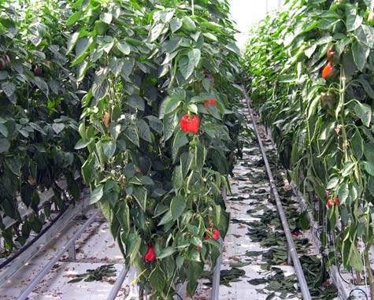
Center for Smart Agriculture Protected cultivation of vegetable crops
Module 7: Crop Management
Session 17: Capsicum & Cucumber

Slide 2
TRAINING AND PRUNING
Pepper plants initially develop single stem and after 9-13 leaves, a terminal flower develops where after main stem divides into two.
Sometimes 3 or 4 shoots develop naturally rather than two.
The terminal flower is not allowed to develop into fruit and it is removed just after appearance.

Slide 3
Two main stems are maintained on each plant after pruning or pinching the other branches by leaving two leaves and one flower at each internode.

Slide 4
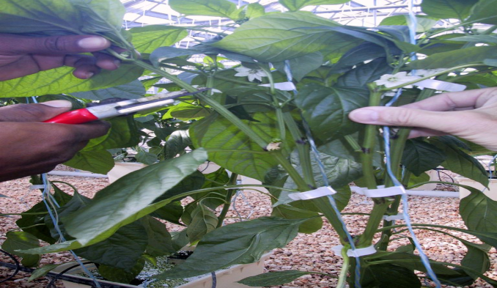
These two stems are trained upon strings to the main wire running on row length at 8-9 feet height.
The stems are clipped with strings using rings or plastic clips.
Training and pruning should be done every three or even two weeks during the period of fast growth.

Slide 5
POLLINATION
SP crop,
CP does take place (honey bees, thrips and other insects is high) which transfer pollen from blossom to blossom while collecting nector.
Pollination is neither markedly improved by using .

Slide 6
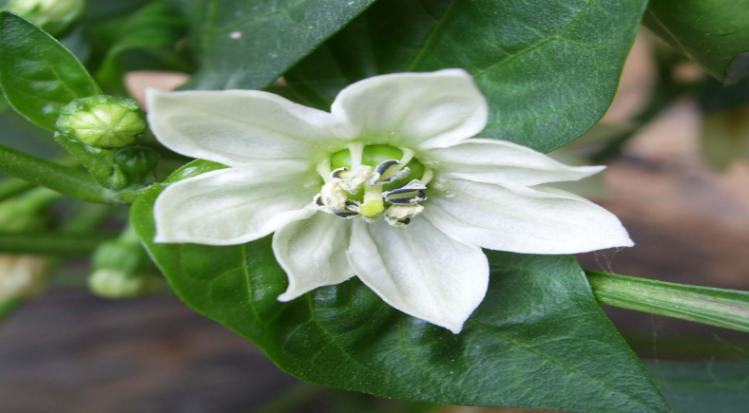
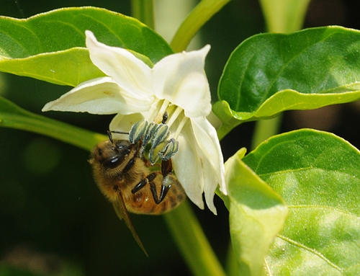
honey or bumble bees fly.
The number of seeds per fruit are, thus, more and fruits enlarge faster due to accumulation of more assimilates

Slide 7
Cucumber Training and Pruning
Several training systems exist for greenhouse cucumber. The basic principle in developing a training system is to uniformly maximize the leaf interception of sunlight throughout the house.
The selection of a system will largely depend on the greenhouse facility, the production system and grower preference.
The most common pruning system for either vertical cordon or V-cordon trained plants is known as the umbrella system.

Slide 8
Umbrella System
This system is straightforward, not too demanding in labor and easily understood.
1. Tie the cucumber plant to a vertical wire, 7 feet tall. Pinch out the growing point at the top.
2. Provide support for all fruit that develops on the lower part of the main stem.
3. Remove all laterals in the leaf axis on the main stem.

Slide 9
4. The top two laterals should be trained over the wire to hang down on either side of the main stem. Allow these to grow to two-thirds of the way down the main stem.
5. When the fruits on the first laterals have been harvested, those laterals should be removed back to a strong shoot, allowing the second laterals to take over . Repeat this process for lateral.
6. This renewal system will maintain productivity.

Slide 10
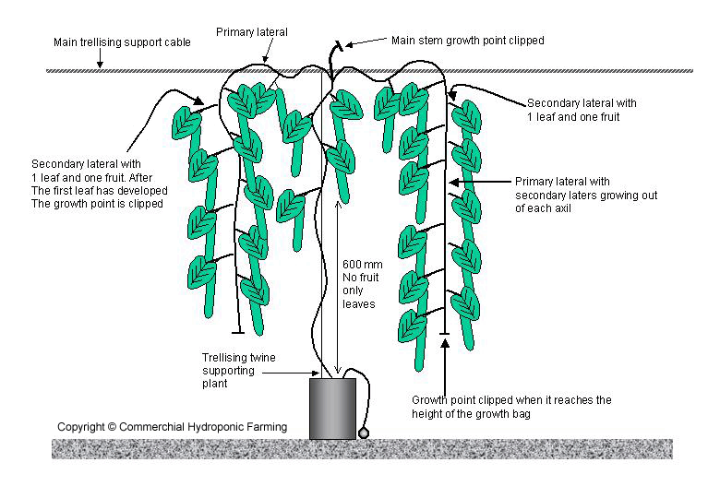

Slide 11
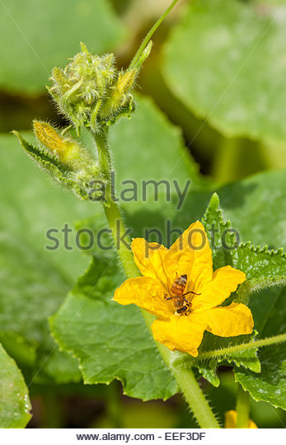
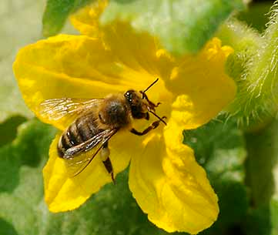
Pollination
For growing gynoecious varieties of slicing cucumber, there is no need of pollination in greenhouse conditions.
Monoecious varieties, however, are dependent upon pollination inside protected structures, which is mainly performed by honeybees.

Slide 12
8 to 10 visits per flowers are required for adequate fruit formation in cucumber.
One beehive (20000 bees per hive) is sufficient for 1000 m² area of greenhouse cultivation of monoecious cultivars to obtain high yield with high quality fruits.
With good crop management of gynoecious culivars, one can harvest 40-45 quintals of cucumber from 1000 m² area with one crop of 3 to 3.5 month duration .

Slide 13
Thank You ….

