Slide 1
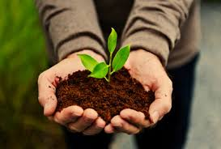
Organic Farming
Module 1: Components of Organic farm and visit to organic farm
Session1: Components of Organic farm and visit to organic farm

Slide 2
Introduction:
Modern agriculture largely depends on the use of fossil fuels based inputs such as chemical fertilizers, pesticides, herbicides and labor saving but energy intensive farm machinery while, application of such high input technologies has undoubtedly increased production and labor efficiency, there is a growing concern about the adverse effects on soil productivity and environmental quality.
The generally accepted organic rules prohibit the use of synthetic chemical fertilizers, pesticides, growth regulators, livestock feed additives and stress on long term soil management. Use local resources for nutrient supply and control of pests and diseases restricting external inputs to the bare minimum.

Slide 3
Objective:
1. To produce food of high nutritional quality
2. To work with natural system rather than seeking to dominate them
3. To encourage and enhance biological cycles within farming system
4. To maintain and increase long term fertility of soil
5. To use, as far as possible, the renewable resources

Slide 4
Contd…
6. To give all livestocks, conditions of life that allow them to perform all aspects of their innate behavior.
7. To avoid all forms of pollution that may result from agricultural techniques
8. To maintain the genetic diversity of agricultural system
9. To allow agricultural producers an adequate returns and satisfaction from their work including safe drinking water.

Slide 5
Characterstics:
1.Maximum but sustainable use of resources
2.Minimal use of off-farm and purchased inputs, only as complementary to local resources.
3.Ensuring the basic biological functions of soil-water-nutrients-human continuum

Slide 6
Contd…
4.Maintaining the diversity of plant and animal species as a basis for ecological balance and economic stability.
5.Creating an alternative overall landscape which gives satisfaction to the local people
6.Increasing crop and animal diversity in the form of poly-cultures, agro forestry systems

Slide 7
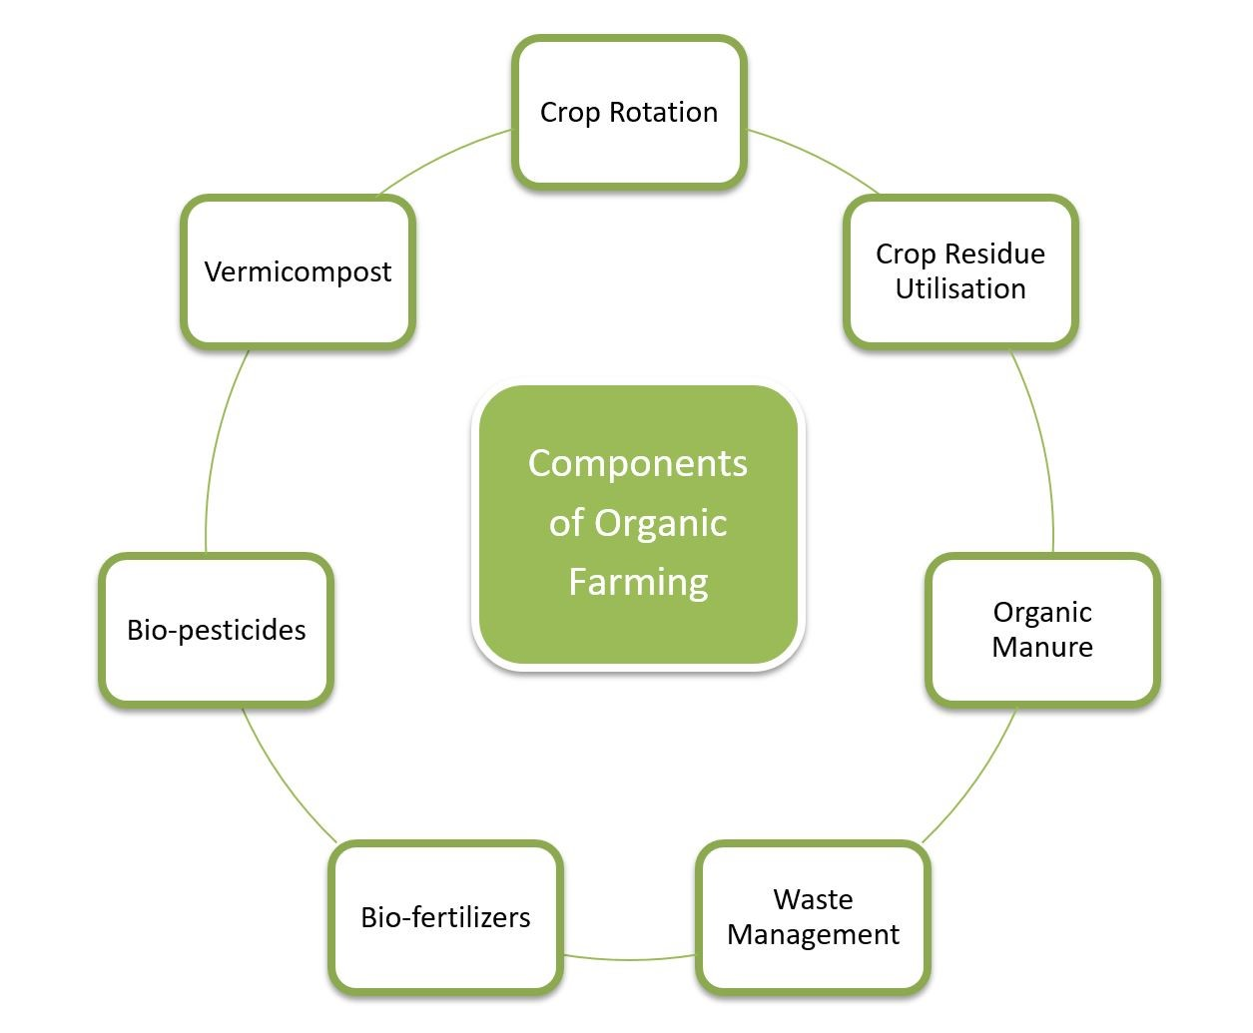
Components of organic farm:

Slide 8


