Slide 1
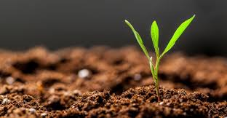
Module 2: Conversion of mineral soil to organic soil
Session1: FIELD PREPARATION and MEASURES OF CONVERSION

Slide 2
Introduction
Successful organic farming requires considerable knowledge on the functioning and the possibilities of management of natural processes.
Farmers who are interested in adopting organic farming practices are recommended to get in contact with farmers in the area, who already practice organic farming to learn from them.

Slide 3
Contd…
To be a good organic farmer important aspects need to be there in mind are;
Collect information
Try out the most promising practices in a small scale
Implement organic practices in whole farm

Slide 4
Procedure
Various measures required to convert a mineral land to organic land are as follows:
1
Mulching
2
Intercropping and choice of robust seed or planting materials
3
Composting and Green manuring

Slide 5
Contd…
4
Organic pest management
5
Inclusion of legume component
6
Bundding and terracing measures

Slide 6
Various conversion requirements for organic farming are as follows:
The establishment of an organic management system and building of soil fertility requires an interim period, called as conversion period.
A farm may be converted through a clear plan of how to proceed with the conversion.
The requirements prescribed under these standards shall be met during the conversion period from start to its conclusion.

Slide 7
Contd…
The start of conversion period may be calculated from the date of first inspection of the operator by the certification body.
A full conversion period shall not be required where de facto requirements prescribed under these standards have been met for several years and where same can be verified on the basis of available documentation.
Twelve months reduction in conversion period could be considered, provided, the documentary proof has been available with the accredited certification body that the requirements prescribed under these standards have been met for a period of minimum 3 years or more.

Slide 8


