Slide 1
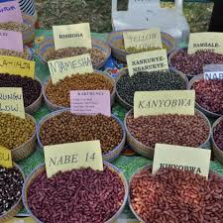
Module 3: SEED: MULTIPLICATION OF ADOPTED AND RESISTANT VARIETIES, CONSERVATION AND CERTIFICATION
Session 1: TYPES OF SEED AND MULTIPLICATION and CONSERVATION TECHNIQUES.SEED TREATMENTS

Slide 2
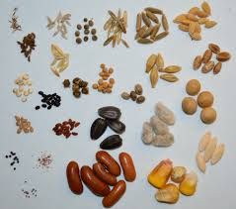
Introduction
SEED:
A seed is an embryonic plant enclosed in a protective outer covering. The formation of the seed is part of the process of reproduction in seed plants, the spermatophytes, including the gymnosperm and angiosperm plants.

Slide 3
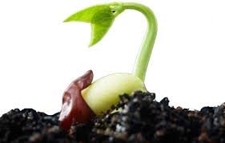
Contd…
Seeds are the product of the ripened ovule , after fertilization by pollen and some growth within the mother plant. The embryo is developed from the zygote and the seed coat from the integuments of the ovule.

Slide 4
Seed multiplication:
After manufacturing of the seed, the next important step is to ensure multiplication and distribution of high-quality seeds, as the quality and quantity of agricultural output of an entire country depend on it.
This process is carried out by the various government as well as private seed manufacturers engaged in hybrid seed production in India.

Slide 5
Contd…
A seed is one of the cheapest yet most essential agricultural input which is quintessential for sustained agriculture.
When a variety of seed is released only a small quantity of the seed is made available with the breeder, which is known as the nucleus seed. The breeder undertakes the process of seed multiplication to produce commercially viable quantities of seed.

Slide 6
Contd…
A new or improved variety of seed is not released unless and until enough true seeds have been produced to make it viable commercially. Multiplication of a seed involves the following steps:
Breeder Seed
Foundation Seed
Registered Seed
Certified Seed

Slide 7
Breeders Seed:
Known as the progeny of nucleus seed, breeder seed production is usually accomplished in a single stage, but if required due to circumstances such as greater demand or low seed multiplication rate, it can be produced in two different stages.
A breeder can be anybody, an individual, a University, Government or a company. There are certain standards that have been set for breeder’s seed in terms of moisture content (less than 12%), physical purity (98% or more) and genetic purity (99% or more). After completion of this stage, seeds are stored in clearly labeled bags with white color tags.

Slide 8
Foundation Seed:
After completion of the breeder stage, next comes the foundation seed stage. This process can also be completed in two stages with genetic purity of more than 99.5%.
These seeds can be produced on seed multiplication farms belonging to the state government or Agri universities or other government farms in addition to private seed companies.

Slide 9
Registered Seed:
NSC (National seeds corporation) offers guidance and technical advice to progressive farmers as well as registered seed growers to produce registered seed from foundation seeds which are genetically pure.
In order to ensure genetic purity, seed certifying agencies conduct regular inspections and field tests. Once completed, the seeds are stored in a bag with a purple label.

Slide 10
Certified Seed:
Certified seed is the progeny of foundation or registered seeds. It is known as certified seed because it has been labeled certified by rating agencies as suitable to raise a good crop.
Progressive farmers play a major role in its production and ensure adherence to the established practices for seed production. They need to be genetically pure and are stored in bags with blue labels.

Slide 11
SEED CONSERVATION:
METHODS OF CONSERVATION:
1
In-situ conservation
2
Ex-situ conservation

Slide 12
In-situ conservation:
It is on site conservation or the conservation of genetic resources in natural population of plant, such as forest genetic resources in natural populations of tree species.
It is the process of protecting an endangered plant in its natural habit , either by protecting or clearing up the habit itself ,or by defending the species from predators.

Slide 13
Ex-situ conservation:
Those plant species that have recalcitrant seeds or do not produce seeds readily are conserved in field gene banks.
In field gene banks, germplasm is maintain in the form of plants as a permanent living collection.
Field gene banks are often established to maintain working collections of living plants for experimental purposes.

Slide 14


