Slide 1

Module 2: SOP Of Using Drone
Session 5:
* RPAS Physical Checks
* GCS tablet and RC Transmitter Health checks

Slide 2
RPAS Physical Checks
Check the mechanical integrity of the following
Check all parts are in good condition, replace aged or broken parts before flight a Check for rust at Arm joints and arm locking latches
Check atomizer mounts for debonding
Check Motor mounting for loose screws
Check motor quick lock adapter screws and spring condition
Check tightness GPS mast mount screws Check tightness of Centre hub access plate screws
Check tightness of atomizer mount screws
Check landing gear and tank are firmly in place Check for loose fittings in plumbing system

Slide 3
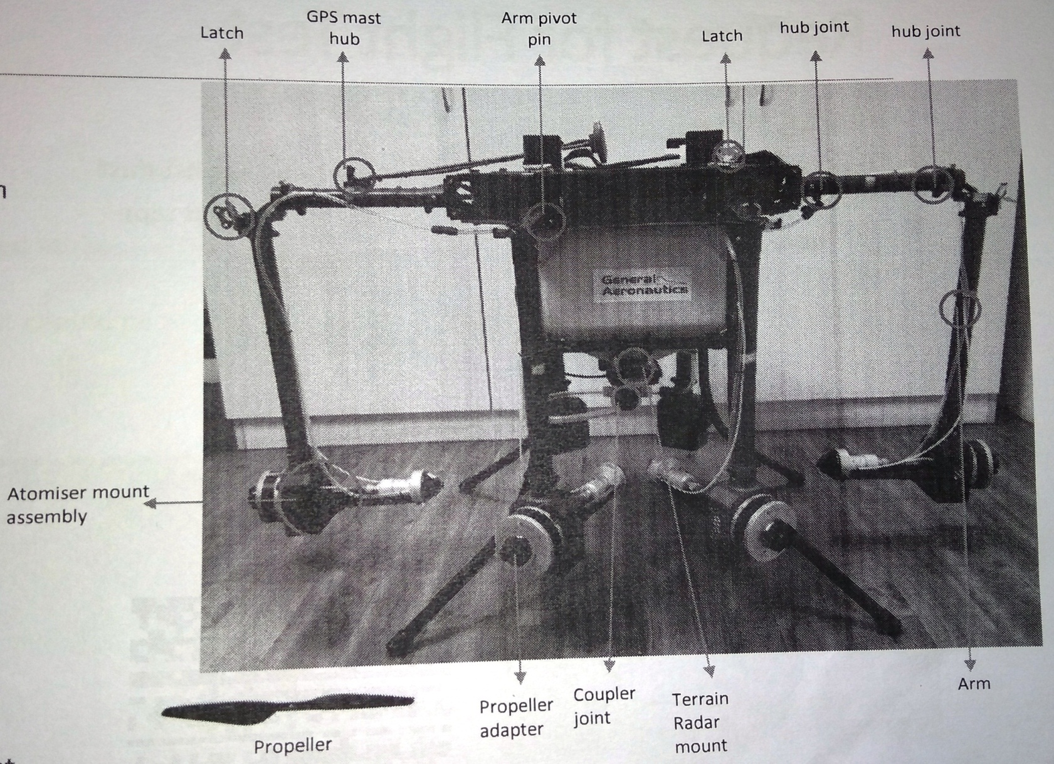

Slide 4
Check the pump mount housing
Check the terrain radar mount housing .
Check battery mount and battery strap rigidity
Check propellers are in good condition and adapters are intact
Check nothing is obstructing motors rotation

Slide 5
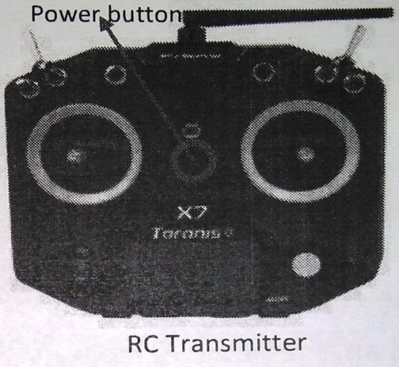
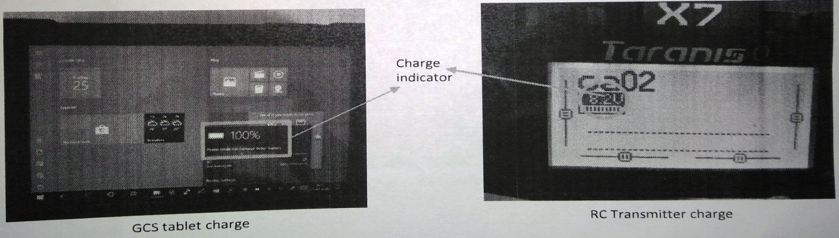
GCS tablet and RC Transmitter Health checks
GCS tablet charge should be >90%

Slide 6
Power-on RC transmitter by pressing the power button provided at the center of the transmitter as shown in the figure
RC transmitter charge will be displayed on the top left corner, it should be > 7.9 V

Slide 7
Thank you…

