Slide 1
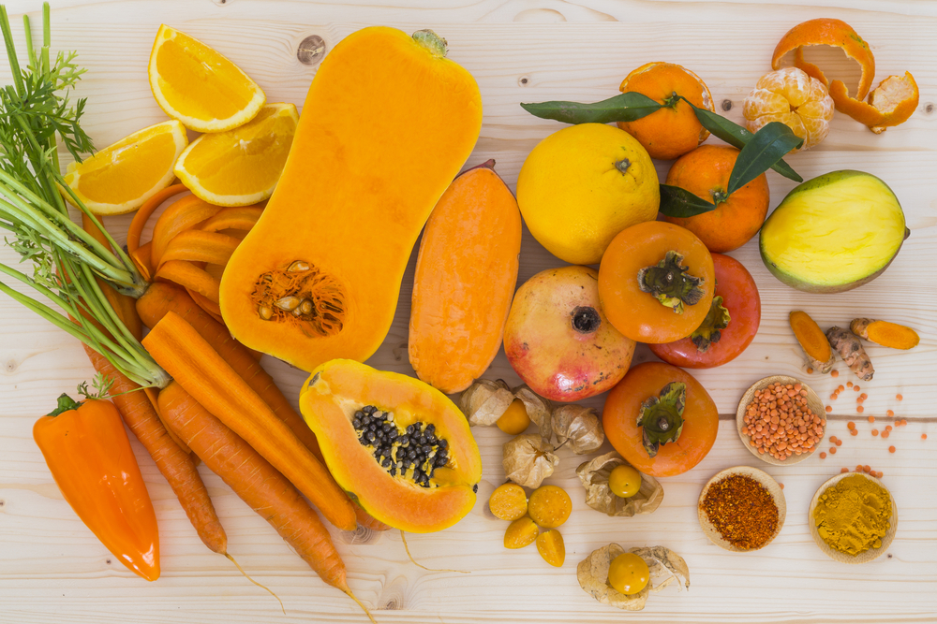
CAROTENOIDS

Slide 2
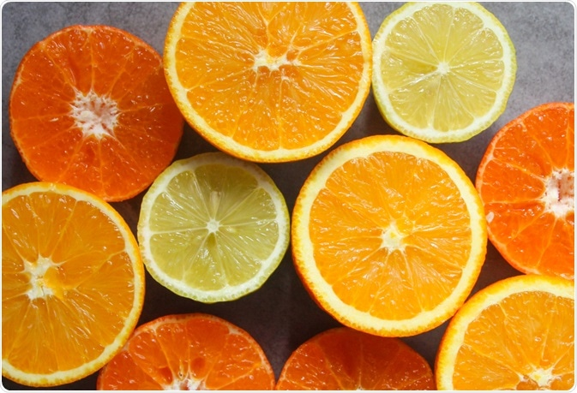
CAROTENOIDS
Carotenoids are plant pigments responsible for bright red, yellow and orange hues in many fruits and vegetables. These pigments play an important role in plant health. People who eat foods containing carotenoids get protective health benefits as well.

Slide 3
CAROTENOIDS
Carotenoids also act as antioxidants in the human body. They have strong cancer-fighting properties, according to the Physicians Committee for Responsible Medicine. Some carotenoids are converted by the body to vitamin A, which is essential to vision and normal growth and development. Carotenoids also have anti-inflammatory and immune system benefits and are sometimes associated with cardiovascular disease prevention.

Slide 4
The Carotenoid family
There are more than 600 types of carotenoids. The most common ones in the Western diet, and the most studied, are alpha-carotene, beta-carotene, beta-cryptoxanthin, lutein, zeaxanthin and lycopene, according to the Linus Pauling Institute.
There are two broad classifications of carotenoids: carotenes and xanthophylls, said Premkumar. The difference between the two groups is chemical: xanthophylls contain oxygen, while carotenes are hydrocarbons and do not contain oxygen. Also, the two absorb different wavelengths of light during a plant’s photosynthesis process, so xanthophylls are more yellow while carotenes are orange.

Slide 5
Most common carotenoids include
alpha carotene
beta carotene
beta cryptoxanthin
lutein
zeaxanthin
lycopene

Slide 6
Foods rich in carotenoids include:
Yams
Kale
Spinach
Watermelon
Cantaloupe
Bell peppers
Tomatoes
Carrots
Mangoes
Oranges

Slide 7
Types of Carotenoids
alpha carotene.
beta carotene.
beta cryptoxanthin.
lutein.
zeaxanthin.
lycopene

Slide 8
How do carotenoids work?
Carotenoids are fat-soluble compounds, meaning they are best absorbed with fit. Unlike some protein-rich foods and vegetables, cooking and chopping carotenoid-rich foods increase the strength of the nutrients when they enter the bloodstream.
Carotenoids are classified into two main groups: xanthophylls and carotenes.

Slide 9
How do carotenoids work?
Both types of carotenoids have antioxidan properties. In addition, some carotenoids can be converted into vitamin A, an essential component for human health and growth.
These provitamin A carotenoids include alpha carotene, beta carotene, and beta cryptoxanthin. Non-provitamin A carotenoids include lutein, zeaxanthin, and lycopene

Slide 10
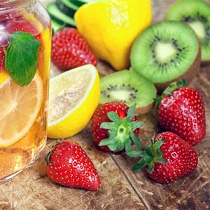
Foods that naturally contain carotenoids include:
Carrots
Mangoes
Tomatoes
Sweet potatoes
Spinach
Apricots
Tangerines
Plantain
Turnip greens

Slide 11
Carotenoids in Cardiovascular
Pathophysiology of many chronic and acute conditions, especially of CVD, is explained by inflammation and oxidative stress. Apart from sex, age, and genetic factors which cannot be modified, lifestyle and dietary intervention can be considered as new important means of prevention and treatment of cardiovascular risk factors. Whilst it would be beneficial not only to practice regular physical exercise, quit smoking, and reduce sodium and cholesterol , a higher dietary introduction or supplementation of antioxidant compounds, such as polyphenols, vitamins, and carotenoids would also be beneficial.

Slide 12
Carotenoids in Cardiovascular
Numerous evidences confirmed that carotenoids possess antioxidant biological properties due to their chemical structure and interaction with biological membranes. In particular, fucoxanthin, astaxanthin, lycopene, and lutein are strong FRs, quenchers of ROS, and NOS, so that their antioxidant and antinflammatory activity may help against cardiovascular risk factors such as markers of inflammation, hyperlipidemia, hypertension, insulin resistance, and obesity.

Slide 13
Carotenoids in Cardiovascular
Consequent improvements in blood pressure baseline levels, reduction of inflammation, and correction of dyslipidemias can lead to an improvement of cardiovascular health. Further in-depth efforts in this sense could be studied to define a preventive and therapeutic strategy in order to reduce the risk of developing CVD, with promising applications and no side effects

Slide 14
The increased intake of fruit and vegetables is associated with lower mortality from all causes and with protective effects against CVD [19–21].
Great importance is attributed to the lifestyle improvement: abolition of tobacco use, increase in physical activity and the assumption of a healthy diet, based on high consumption of monounsaturated fats, fruit (rich in vitamins), vegetable fibres, olive oil, and cereals [22–24].

Slide 15
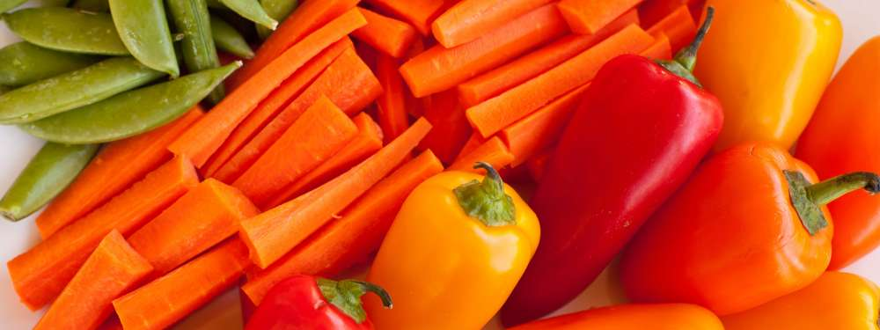
It has been demonstrated that higher serum levels of carotenoids were associated with decreased risk of elevated serum NT-pro BNP levels, suggesting a role in preventing cardiac overload; moreover, high plasma levels of β-cryptoxanthin and lutein were associated with lower risk of acute myocardial infarction.

Slide 16
Several researchers have analyzed the influence of evaluated as an increase of intima-media thickness of the common carotid artery (CCA-IMT) in middle-aged men, while in healthy subjects an independent inverse relationship between serum levels of lycopene and brachial-ankle pulse wave velocity was found, considered as a marker of arterial stiffness [27, 28]. A recent 7-year follow-up study shows that high plasma levels of carotenoids protect against early vascular alterations assessed by CCA-IMT: changes in IMT was inversely associated with concentrations of lycopene, α-carotene, and β-carotene.

Slide 17
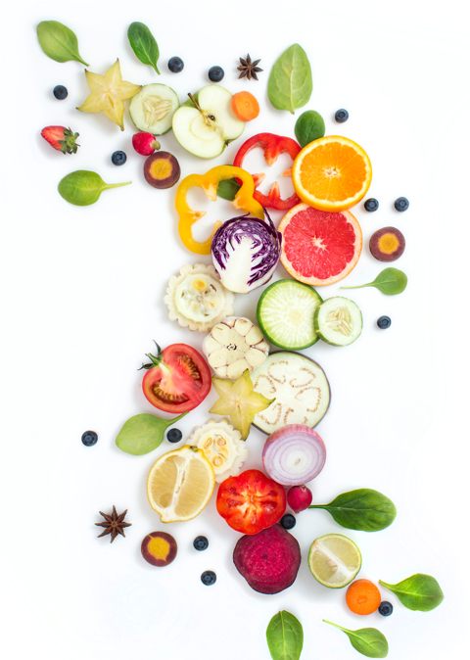
Patients with coronary artery disease showed to have lower plasma levels of lutein, zeaxanthin, β-cryptoxanthin, α-carotene, β-carotene, and lycopene compared to healthy subjects; moreover, the reduced levels of lutein, zeaxanthin, and β-cryptoxanthin were associated with smoking, high body mass index, and low high-density lipoprotein cholesterol (HDL-C)

