Slide 1
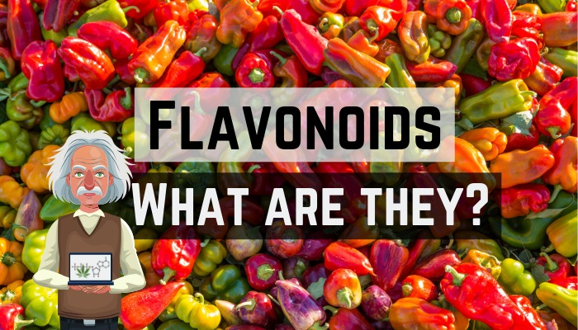

Slide 2

Currently, metabolic diseases are the main public health problem. Obesity is a metabolic imbalance that leads to insulin resistance, hyperinsulinemia, dyslipidemia, hypertension, and proinflammatory and prothrombotic states that can trigger type 2 diabetes as well as cardiovascular diseases. Obesity is the excess of adipose tissue and is considered a risk factor to develop metabolic syndrome.

Slide 3

The obesogenic environment that is lived promotes the search for specific solutions that help to control, eradicate, or minimize the negative results in health, making use of the properties of flavonoids, as important sources of antioxidants, with anti-inflammatory, antithrombotic, and antihypertensive effects. Given the above, the objective of this chapter is to highlight the effects of flavonoids on the modulation of lipolysis and lipogenesis altered by a hyperlipidic diet.

Slide 4
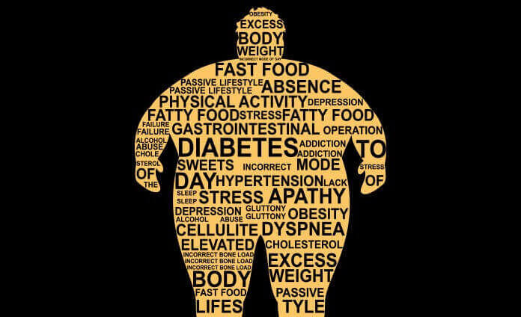
Obesity is a major health problem worldwide. It is the result of the combination of genetic factors, inadequate nutrition, and lack of regular physical activity.

Slide 5
The ingestion of a diet of high energy density is the main cause of visceral or central obesity, since the excess energy is stored in adipocytes, which increase in size and number, or both, especially the visceral ones, producing an increase in the rate of lipolysis, which, in turn, stimulates the secretion of cytokines by the infiltration of leukocytes, macrophages generating inflammation in the adipocytes, and leads to proinflammatory state, insulin resistance, and endothelial dysfunction. Thus, adipose tissue dysfunction represents the etiopathogenic mechanism in the development of cardiovascular disease, type 2 diabetes, and renal disease initiated by visceral obesity.

Slide 6
Types of Flavones
Flavones: These include luteolin and apigenin.
Anthocyanidins: These include malvidin, pelargondin, peoidin and cyanidin. ...
Flavonones: These include hesperetin, eriodictyol and naringenin. ...
Isoflavones: This subgroup includes genistein, glycitein and daidzein

Slide 7
Obesity
Nowadays, obesity is a world-class nutritional problem, reporting that around 1.9 billion adults (18 and older) were overweight, of which 600 million were obese, according to World Health Organization statistics in 2014. The scientific evidence describes obesity as a chronic disease, influenced by many factors including physiological and molecular mechanisms, environment and genetic susceptibility.

Slide 8
Obesity
Thus, one of the main strategies in the prevention and treatment of obesity is the achievement of a negative energy balance, based on changes in lifestyle (including diet and physical activity). Unfortunately, dietary interventions are not usually long-term lasting and sometimes another treatment appears necessary as a coadjuvant in the integral management of obesity. In this context, recently, it has been growing interest on biocompounds such as flavonoids that can exert biological properties including antiobesity effects.

Slide 9
Flavonoid in Obesity
Most Flavonoid are found naturally as glycosides (conjugated with one or more glucose residues). When they are ingested, some of them can be absorbed in the small intestine or partially metabolized in the colon by the gut microbiota. If they are absorbed, most of them lose the glucoside and are modified in different metabolites that can be found in body fluids or tissues. These metabolites may have different biological activities than the initial compounds. Finally, Flavonoid are metabolized in the liver as a process that allows to detoxify and facilitate the elimination by urine. The circulating Flavonoid in blood can be transported to different tissues and metabolized to exert biological functions.

Slide 10
Flavonoid in Obesity
There is scientific evidence underlying the antiobesity effects of Flavonoid through different mechanisms such as regulation of food intake and energy homeostasis, the inhibition of fat digestion decreasing fat absorption, and the regulation of metabolic turnover of substrates and thermogenesis. In addition, Flavonoid are widely recognized for their antioxidant and anti-inflammatory properties.

Slide 11
Flavonoids can have an effect at the molecular level through the regulation of gene expression involved in metabolic pathways such as adipogenesis, lipolysis, novo lipogenesis, and therefore influencing the prevention of diseases such as obesity. In addition, epigenetics has recently emerged as a new tool in the study of antiobesity effect of flavonoids. In general, the most common epigenetic modifications involve acetylation and methylation of histone residues. The hiperacetylation induces an upregulation, while the hipoacetylation generally downregulate the gene expression. On the other hand, DNA methylation is associated with down regulated genes. Finally, recently it has been proven that flavonoids can affect the expression profile or function of miRNAs.

Slide 12

Moreover, one of the new mechanisms studied to prevent and control obesity is the modulation of the intestinal microbiota through the flavonoids. The human microbiome consists of more than 10²³ bacterial cells throughout the digestive tract, finding around 160 different species per person and identifying more than 1500 different species.

Slide 13

The intestinal microbiota is metabolically adaptable and in this sense, scientific evidence has demonstrated the positive influence of flavonoids on bacterial growth and metabolism, thus representing a relevant mechanisms in the treatment of obesity.

