Slide 1
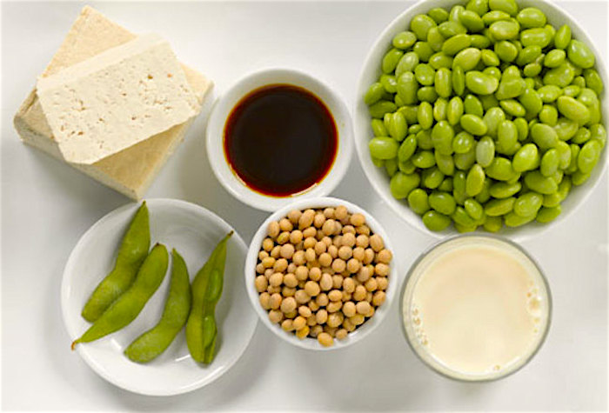
ISOFLAVONES

Slide 2
Isoflavones
Isoflavones are polyphenolic compounds that possess both estrogen-agonist and estrogen-antagonist properties.
Isoflavones are a class of phytoestrogens — plant-derived compounds with estrogenic activity. Soybeans and soy products are the richest sources of isoflavones in the human diet.

Slide 3
Isoflavones
Higher intakes of soy foods early in life may decrease the risk of breast cancer in adulthood. There is currently little clinical evidence that taking soy isoflavone supplements decreases the risk of incident and recurrent breast cancer.
To date, randomized controlled trials examining the effect of soy isoflavones on bone mineral density in postmenopausal women have produced mixed results. Potential benefits of soy isoflavones as an alternative to bone-sparing treatments in women undergoing menopause remain to be determined.

Slide 4
Isoflavones
Isoflavones are polyphenolic compounds that possess both estrogen-agonist and estrogen-antagonist properties . For this reason, they are classified as phytoestrogens —plant-derived compounds with estrogenic activity. Isoflavones are the major flavonoids found in legumes, particularly soybeans. In soybeans, isoflavones are present as glycosides, i.e., bound to a sugar molecule. Digestion or fermentation of soybeans or soy products results in the release of the sugar molecule from the isoflavone glycoside, leaving an isoflavone aglycone. Soy isoflavone glycosides include genistin, daidzin, and glycitin, while the aglycones are called genistein, daidzein, and glycitein

Slide 5
Chemistry and metabolism of isoflavones
Isoflavones (IFs) are yellow pigments derived from 3-phenyl-benzopyrone (3-phenyl-chromone) structure. They are found in plants mostly as biologically inactive glycosides: 7-O-β-D-glycosides, 6″-O-acetyl-7-O-β-D-glucosides, and 6″-O-malonyl-7-O-β-D-glycosides.
They are hydrolyzed into bioactive aglycones by both intestinal mucosa and bacterial β-glucosidases from the gut microbiota. Only these forms are absorbed into systemic circulation directly or after subsequent metabolism in the bowel by intestinal bacteria

Slide 6
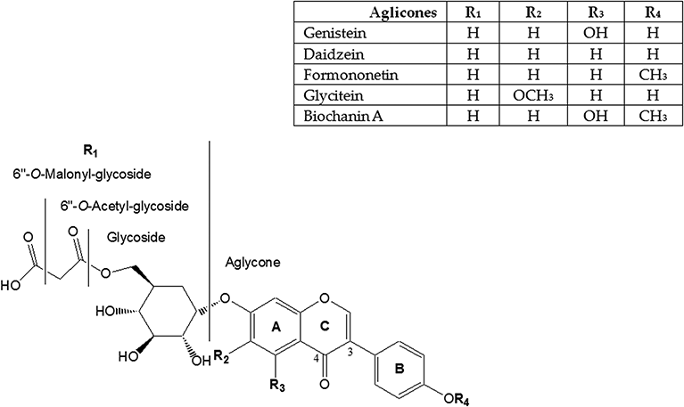

Slide 7
Mechanism of estrogen-like action of isoflavones
According to the xenohormesis theory, plants synthesize phytochemicals to withstand and adapt under stress. Indeed, isoflavone biosynthesis depends on the environmental conditions in which the plant grows and is stimulated by stress.

Slide 8
Mechanism of estrogen-like action of isoflavones
The stress-induced plant compounds have the ability to upregulate stress adaptive pathways in animals and humans. In the body, the biological effects of isoflavones are exercised by modulating pathways mediated by estrogen receptors (ERs) or various key enzymes involved in cellular signaling or metabolism and antioxidant potential.

Slide 9
Soy in the Diet
In Asia, where soy is eaten as a regular staple, the rate of heart disease, breast cancer, and prostate cancer is lower than in the U.S. But many Asians ingest soy differently than in Western countries.
For example, Asians notoriously eat much larger quantities of soy daily. It’s also common in the East to eat fermented forms of soy, including miso, tempeh, and tamari. It is thought that fermentation helps with the digestion of soy and may even promote the body’s ability to absorb isoflavones.

Slide 10
Many health experts feel that eating fermented soy in moderation may:
Increase bone density
Help to prevent breast and uterine cancers
Lower the incidence of prostate cancer
Lower bad cholesterol levels
Improve mental functioning
Reduce muscle soreness (particularly after exercise)

Slide 11
Possible Side Effects
Most of the side effects of isoflavones are associated with long-term use of supplements and not from dietary sources such as soy products. But epidemiological (the branch of medicine dealing with the incidence and control of disease) data have shown that there is a link between long term soy consumption and Kawasaki disease (KD), and that soy isoflavones are involved in the development of the disease.

Slide 12
Possible Side Effects
Most of the side effects of isoflavones are associated with long-term use of supplements and not from dietary sources such as soy products. But epidemiological (the branch of medicine dealing with the incidence and control of disease) data have shown that there is a link between long term soy consumption and Kawasaki disease (KD), and that soy isoflavones are involved in the development of the disease.

Slide 13
Breast cancer cell growth has been linked with long-term exposure to genistein, resulting in what is called “soy protein isolate-induced tumors and advanced growth phenotypes.”
Animal studies have shown that evidence of the isoflavone genistein may have adverse effects on the developing female reproductive tract.
When ingested on a short-term basis (up to six months in duration) soy is considered possibly safe.

Slide 14
Common side effects may include:
GI upset
Constipation, bloating and nausea
Allergic reactions (involving rash, itching, and in severe instances, anaphylaxis)
Loss of appetite

Slide 15
Dosage and Preparation
For postmenopausal women: A supplement with least 54 mg of genistein (a soy isoflavone) per day is suggested for hot flashes.
For IBS: A supplement of 40 mg of isoflavones per day for six weeks
For protection against osteoporosis: A supplement of 80 mg per day of soy isoflavones was associated with a dosage that reduced bone loss in postmenopausal women (protecting against osteoporosis).

Slide 16
Isoflavones in cardiovascular diseases
Since the early 1940s, scientists have examined the effect of soy protein on blood cholesterol concentrations. Although studies in animals have suggested that soy protein lowers blood cholesterol concentrations, similar studies in humans have yielded less consistent results. The presence or absence of the soybean isoflavone fraction may be a confounding factor. This fraction, consisting primarily of genistein, daidzein and glycetein, has been shown to have a hypocholesterolemic effect in animals and humans.

Slide 17
Isoflavones in cardiovascular diseases
Potential mechanisms by which soy protein and/or isoflavones induce lowering of blood cholesterol concentrations include thyroid status, bile acid balance and the estrogenic effects of genistein and daidzein. Some studies have suggested that isoflavones exhibit antioxidant properties and have favorable effects on arterial compliance. In addition to the aforementioned potential beneficial effects, the increased consumption of products containing soy protein may displace foods relatively high in saturated fat and cholesterol from the diet and hence have an indirect blood cholesterol–lowering effect.

Slide 18
Isoflavones in cardiovascular diseases
Large prospective cohort studies, mainly in Asian populations, investigating whether habitual soy food/isoflavone consumption is related to the incidence of cardiovascula disease (CVD), including coronary hear disease (CHD), ischemic stroke, and myocardial infarction, have found mixed results.

Slide 19
Isoflavones in cardiovascular diseases
In the Japan Public Health Center-based Study (mean follow-up, 13.5 years), consumption of soy foods was associated with a reduced risk of stroke in Japanese women (ages, 40 to 59 years) — but not in men. In this cohort, the highest versus lowest quintile of soy isoflavone intakes was found to be associated with a 65% lower risk of ischemic stroke and a 63% lower risk of myocardial infarction in women.

Slide 20
Isoflavones in cardiovascular diseases
Isoflavones are the group of chemical substances and sub class of phytoestrogens, these are present in legumes such as soybean, clover, kudzu and beverages, especially soybean rich in isoflavone content. Commonly available isoflavones are genistein, daidzein, formononetin and glycitein have nutritional and therapeutic value because of their estrogenic and antiestrogenic action. Epidemiological studies showing that increased intake of isoflavones reduce the hazard of cardiac problems, menopausal symptoms, osteoporosis and cancer.

