Slide 1
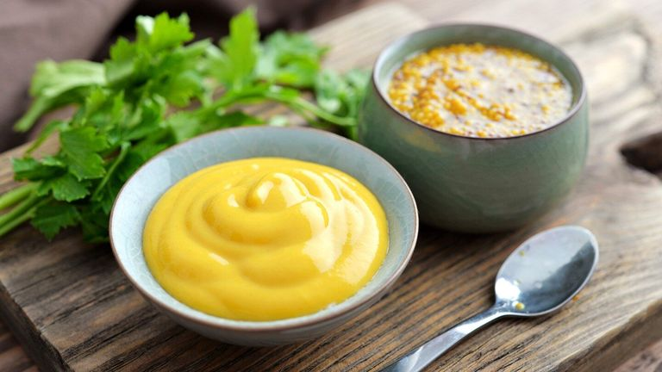
MUSTURD

Slide 2
Derivatives of the mustard constituent allyl isothiocyanate form the basis for toxic agents such as mustard gases and antineoplastic drugs (eg, bendamustine). Mustard is used as a food flavoring, for forage, as an emetic, and diuretic, as well as a topical treatment for inflammatory conditions such as arthritis and rheumatism.

Slide 3
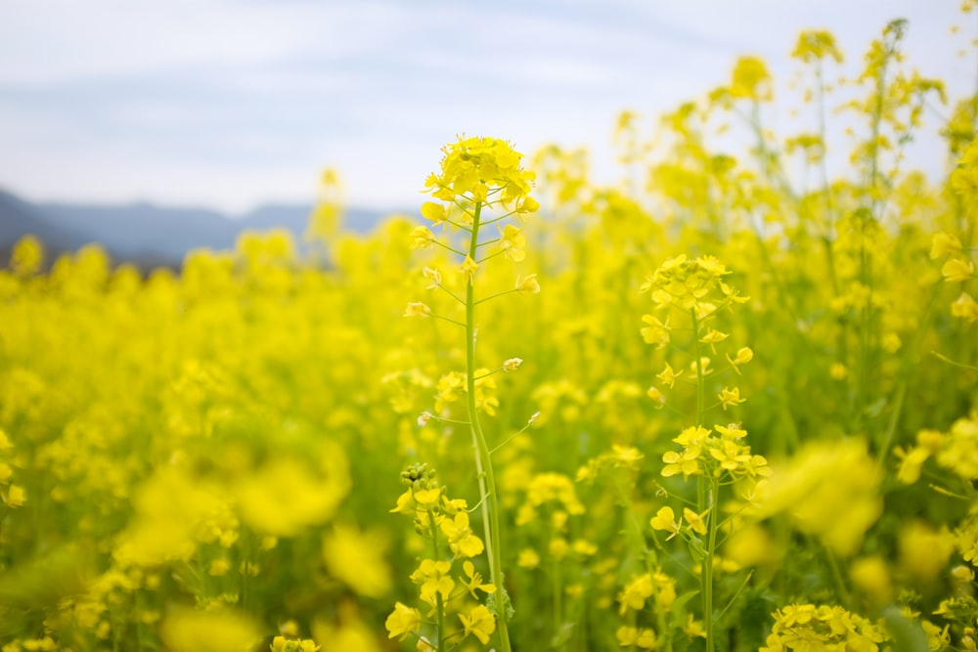
Mustard also has potential pharmacological effects in cardiovascular disease, cancer, and diabetes; however, there are limited clinical trials to support its use for any indication.

Slide 4
DOSING
Limited clinical trials are available to guide dosage. Patients with suspected acute myocardial infarction received mustard oil 2.9 g/day orally.

Slide 5
CONTRAINDICATIONS
None well documented. Avoid use in patients who are hypersensitive to mustard or related plant species. Topical mustard oil should not be used for massaging newborn infants

Slide 6
PREGNANCY/LACTATION
Information regarding safety and efficacy in pregnancy and lactation is lacking. Avoid dosages higher than those found in food.

Slide 7
HISTORY
The history of mustard goes back many centuries to the time of the Gautama Buddha (∼600 BC), when Kisa Gotami, a young mother who had lost her young son, was asked by him to get a handful of mustard seeds from a house where no relative had died, in order to see reality (Rhys Davids and Norman, 1989). Mustard was also used by the Romans in more recent history (Man and Weir, 2010).

Slide 8
USES AND PHARMACOLOGY
There have been numerous phytochemical investigations on mustard seed; however, few clinical trials exist to support a clinical application of mustard seed oil. Derivatives of allyl isothiocyanate have formed the basis for toxic agents such as mustard gases and antineoplastic drugs (eg, bendamustine).

Slide 9
DOSING
Limited clinical trials are available to guide dosage. Numerous commercially available products contain mustard in capsule, powder, and tablet forms.
Patients with suspected acute MI received mustard oil 2.9 g/day orally.
A study in humans determined that the major urinary metabolite of allyl isothiocyanate is excreted within 8 hours. A dose-dependent excretion of the metabolite was observed.

Slide 10
DIABETES MELLITUS:
Diabetes mellitus is characterized by abnormally high levels of sugar (glucose) in the blood.
When the amount of glucose in the blood increases, e.g., after a meal, it triggers the release of the hormone insulin from the pancreas. Insulin stimulates muscle and fat cells to remove glucose from the blood and stimulates the liver to metabolize glucose, causing the blood sugar level to decrease to normal levels.

Slide 11
Mustard leaves may be helpful for those with diabetes. A study published in the Journal of Nutritional Science and Vitaminology demonstrated that mustard seed may be beneficial in reducing the damage caused by oxidative stress associated with this chronic disease. Another study published in the Environmental and Molecular Mutagenesis examined the administration of mustard oil, in vivo, and found it can help in reducing the levels of blood sugar in the body more effectively than medication alone. It aids in stimulating glucose metabolism as well.

Slide 12
Glucoraphanin works by breaking fat down in the body, preventing it from clogging the arteries. Of particular interest is its glucoraphanin content. Research suggests the plant chemical, glucoraphanin, may protect the body against heart disease and some types of cancer.

Slide 13
Leaves of the mustard plant also have tremendous cholesterol-lowering power. A study published in the Nutrition Research has shown that cruciferous vegetables, in particular, mustard greens have an amazing ability to bind bile acids in the digestive tract which facilitate easy excretion of these acids from the body. The bile acids usually comprise of cholesterol, so ultimately the binding process helps in reducing the cholesterol levels of the body.

Slide 14
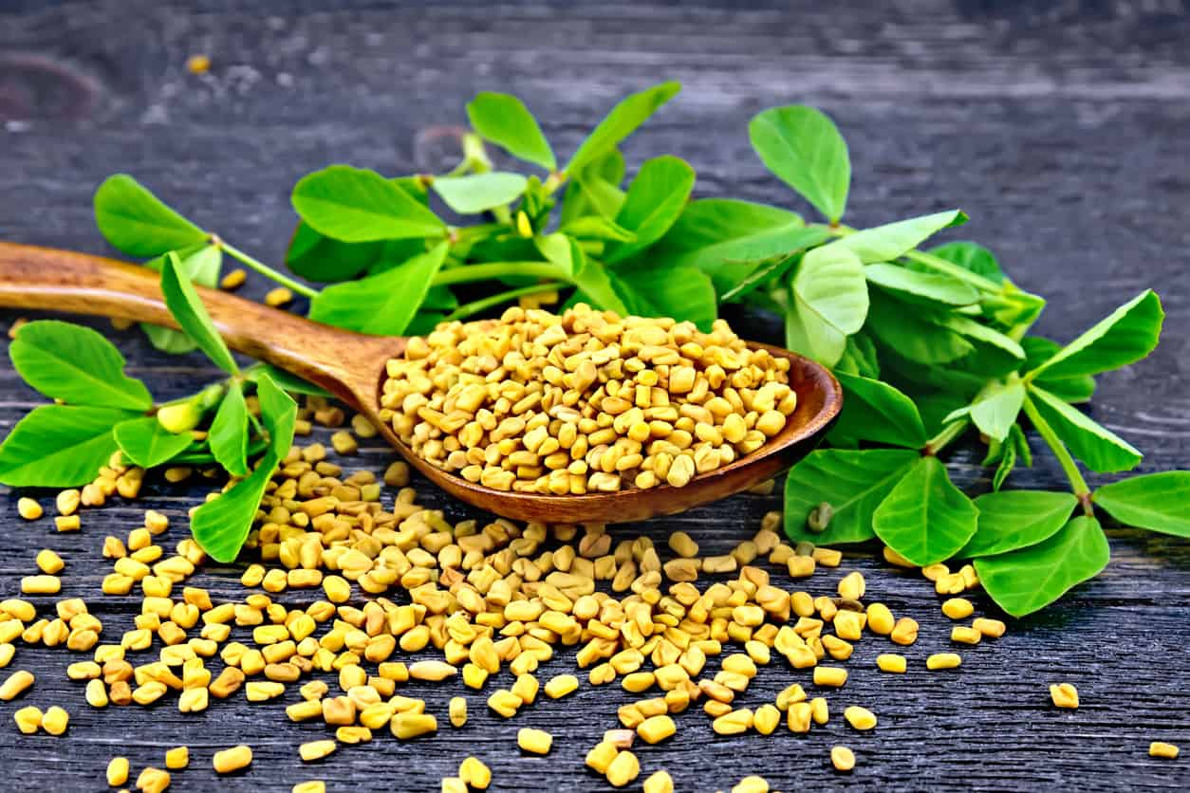
Another noteworthy fact here is that the steamed version of mustard green has better bile acid-binding as compared to the raw version. So steam them lightly, and maybe, add little-roasted cumin, salt, and pepper and enjoy.

Slide 15
Mustard seeds are one such ingredient that you can add to your food if you aim to lose weight. The tiny seeds have bold flavours, which keep your taste buds happy and the nutrient content in it help you stay on track. Here is how mustard seeds can help you get in shape.

Slide 16
Mustard seeds are known to give relief from the number of migraine attacks you get. - Mustard seeds are very rich in calcium, manganese, omega 3 fatty acids, iron, zinc, protein and dietary fiber — include them in your diet. - For people who suffer from a bad appetite, here’s something that will be really helpful.

