Slide 1
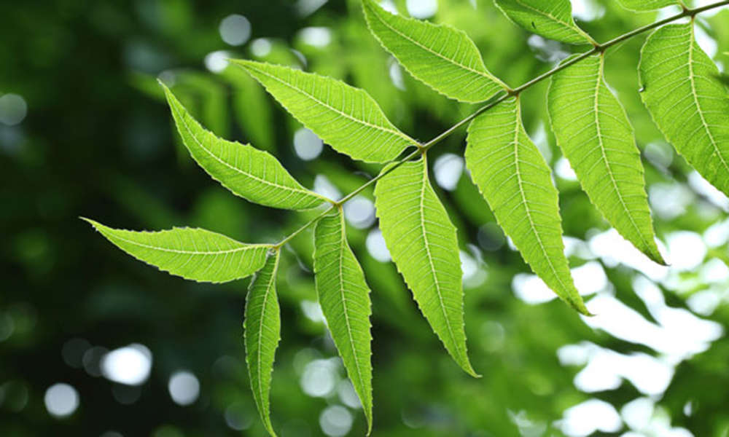
NEEM LEAVES FOR DIABETIC MANAGEMENT

Slide 2
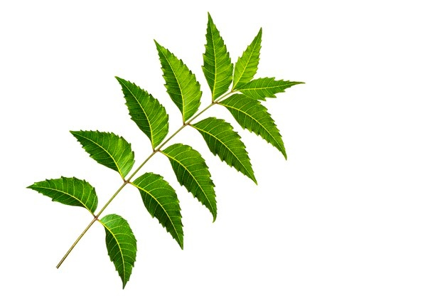
CLASSIFICATION
Common Name – Neem
Botanical Name – Azadirachta Indica
Kingdom – Plantae
Division – Magnoliophyta
Class – Magnolio psida
Order – Sapindales
Genus – Azadirachta
Species – A. indica
Family – Meliaceae

Slide 3
Azadirachta indica, also known as Neem and Indian
Lilac is a tree in the mahogany family Meliaceae.
It is one of two species in the genus Azadirachta and
is native to India and the Indian subcontinent
Including Nepal, Pakistan, Bangladesh, and Sri
Lanka.
It typically is grown in tropical and semi-tropical
Regions. Neem trees now also grow in islands located
In the southern part of Iran. Its fruits and seeds are the
source of neem oil.

Slide 4
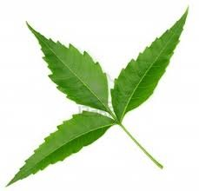
NEEM
Neem is a plant known for its medicinal benefitsand is even worshipped in some parts of India. Neem is a popular ingredient in food, skin care products, hair care products. Neem has a slightly bitter taste but is known to have great benefits. For diabetic people, neem can be really helpful in controlling diabetes.

Slide 5
Neem is a fast-growing tree that can reach a height of 15–20 m, rarely to 35–40 m. It is evergreen, but in severe drought it may shed most or nearly all of its leaves. The branches are wide spread. It blossoms in spring with the small white flowers. It has a straight trunk. Its bark is hard rough and scaly, fissured even in small trees. The color of the bark is brown grayish. The leaves are alternate and consist of several leaflets with serrated edges. Its flowers are small and white in color. The olive like edible fruit is oval, round and thin skinned.

Slide 6
MEDICINAL USE
Neem is a fast-growing tree that can reach a height of 15–20 m, rarely to 35–40 m. It is evergreen, but in severe drought it may shed most or nearly all of its leaves. The branches are wide spread. It blossoms in spring with the small white flowers. It has a straight trunk. Its bark is hard rough and scaly, fissured even in small trees. The color of the bark is brown grayish. The leaves are alternate and consist of several leaflets with serrated edges. Its flowers are small and white in color. The olive like edible fruit is oval, round and thin skinned.

Slide 7
NEEM IN DIABETES
Some studies have shown that compounds found in neem can be beneficial in controlling type 2 diabetes. A study published in the Indian Journal of Physiology and Pharmacology found that neem may also be helpful in preventing the onset of the disease. While more research is required to scientifically certify that neem can help in reducing blood sugar levels, most medical professionals and anecdotal evidence are in favour of the herb.
Neem is also rich in antioxidants, flavonoids, triterpenoid, anti-viral compounds, glycosides, etc. which help in managing blood sugar levels. A study in the journal Studies on Ethno-Medicine found that neem leaf powder could help control diabetic symptoms on non-insulin dependent male diabetics too.

Slide 8
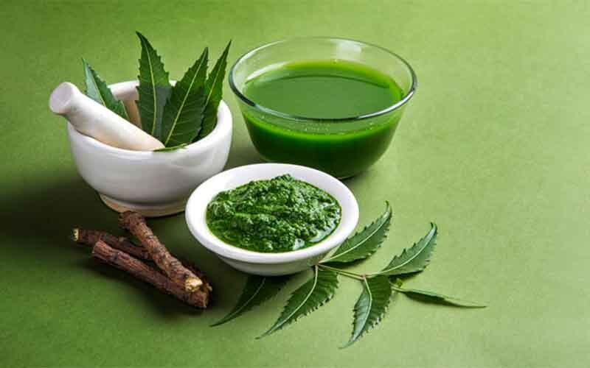
How to consume Neem if you are diabetic?
While the choice totally depends on you, you can either make neem sharbat or chew a few neem leaves every day, to get the best benefits from the herb for diabetes.

Slide 9
To make neem water or sharbat, boil a few neem leaves in water and you will notice that they will soon start turning soft, and the water will get a deep green colour. Strain the leaves and store the water, and drink it twice a day. To consume neem leaves by chewing, just wash the leaves and chew them and swallow. Drinking the mixture is still easier than chewing the leaves, as the taste of neem leaves is bitter, but it really depends on how you prefer to reap the benefits from the plant.

Slide 10
HYPOGLYCEMIC EFFECT
Hypoglycemic effect was observed with Azadirachta indica when given as a leaf extract and seed oil, in normal as well as diabetic rabbits. The effect, however, was more pronounced in diabetic animals in which administration for 4 weeks after alloxan induced diabetes, significantly reduced blood glucose levels. Hypoglycaemic effect was comparable to that of glibenclamide. Pretreatment with A. indica leaf extract or seed oil administration, started 2 weeks prior to alloxan, partially prevented the rise in blood glucose levels as compared to control diabetic animals. The data suggests that A. indica could be of benefit in diabetes mellitus in controlling the blood sugar or may also be helpful in preventing or delaying the onset of the disease.

