Slide 1

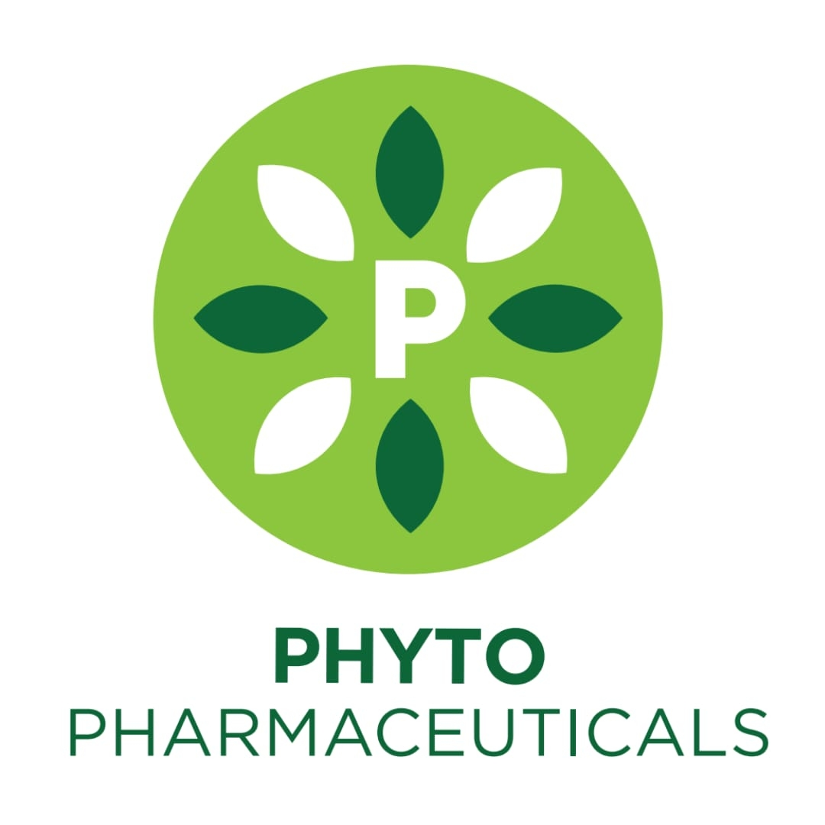
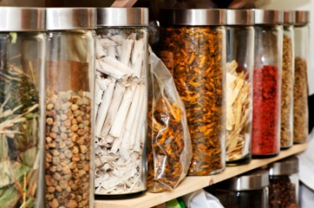

Slide 2
INTRODUCTION
Phytopharmaceuticals are herbal medicines whose efficacy is down to one or several plant substances or active ingredients. They have been used for treating diseases since time immemorial. This traditional knowledge is still the basis for many medicinal products made from plants or parts thereof. Herbal medicines have been produced in Baden-Württemberg for many generations.
Phytopharmaceuticals are medicines with pure active substances that come from plants or parts of plants.

Slide 3
Plants produce an incredible variety of natural compounds. it is therefore not surprising that humans make use of this huge diversity. Historical sources show that the use of medicinal plants goes way back to the bronze age. Europe has a culture of using medicinal plants that starts with hildegard von bingen, continues with friedrich sertürner who was the first to isolate morphine in pure form and ends with the modern-day production of herbal medicines.
HISTORY

Slide 4

EXAMPLES
The crude drugs are subjected to a suitable method of extractionand purification for the isolation of phytopharmaceuticals, which could be incorporated as active ingredients in the modern system of medicine.
1. The anthracene glycosides such as sennosides are extracted in the from of their stable calcium salts from the leaves and pods of senna.
2. The indole alkaloids such as ergometrine and ergotamine are commercially extracted as their salts from the fungus of ergot, known as Claviceps purpurea
3. Caffeine is exctrated from tea or teawaste, where as nuxvomica seeds serve as the raw material for the extraction of strychnine.

Slide 5

EXAMPLES
4. The antihypertensive and tranquilising agent reserpine is commercially obtained from the roots and rhizomes of Rauwolfia serpentina.
5. Other tropane alkaloids l-hyoscyamine and atropine are obtained form Atropa belladona and Datura metal .
6. Isoquinoline alkaloids such as morphine, papaverine, codeine and thebaine are extracted from opium, latex obtained from poppy capsules.
7. The alkaloids quinine and quinidine are commercially obtained from the bark of different cinchona species.
8. pilocarpine nitrate, a life saving drug useful in treatment of glaucoma, is extracted from leaves of Pilocarpus jaborandi

Slide 6
EXAMPLES
9. A number of essential oils and their chemicals used as medicinal and flavouring agent are obtained from plants sources. Examples volatile oils of peppermint, spearmint, clove, eucalyptus, ginger, citronella, thyme and vetiver.
10. Citral from lemon grass oil, is itself used in perfumery and soaps .
11. Spices are usually more diversified than the perfume principles containing not only terpenes, from dill, caraway, fennel, celery etc. But also aromatic aldehydes, phenols and sulphur compunds.

Slide 7

OBJECTIVES
To impart knowledge on basic principles of Herbal Drug Science.
To teach different levels of Pharmacognosy, from Sources of Drugs and Pharmaceuticals to isolation of phytopharmaceuticals and their evaluation.
To create awareness on advanced techniques of Drug development from natural sources and Research by conducting Live Demonstrations and Audio-Visual presentations.
To create awareness on Lab safety Precautions, Handling techniques, Hazardous crude drugs usage and their proper disposal for maintaining Clean and Green environment.
To involve Experiential Learning by conducting laboratory experiments to the students.

Slide 8
FUNCTIONS
Phytochemicals plays a vital role in preventing oxidative damage.
Phenolics play a vital role in plant physiology, providing to resistance to microbes, insects, pigments, odor and flavor.
Polyphenolic compounds mainly flavonoids have potential therapeutic value as antioxidant and anti-inflammatory agents for prevention of cardio vascular disease.

Slide 9

OBJECTIVES
5. Plants have shown varying degree of hypoglycemic and antihyperglycemic activity
6. Consumption of green tea helps kidneys to process toxins and waste products more efficiently.

Slide 10
EVALUATION
TESTS FOR ALKALOIDS
Most alkaloids are precipitated from neutral or slightly acidic solution by
Dragendorff's reagent (solution of potassium bismuth iodide)orange coloured precipitate.
Mayer's reagent (potassioum mercuric iodide solution) Cream coloured precipitate.
Wagner’s reagent (iodine in potassium iodide) red-brown precipitate
Hagers reagent (picric acid) yellow precipitate
Caffeine does not precipitate
The murexide test is an analytical technique to identify the presence of caffeine and other purine derivatives in a sample. The sample is then evaporated to dryness and the resulting residue is exposed to ammonia vapour. ... Purine alkaloids produce a pink color in this test

Slide 11

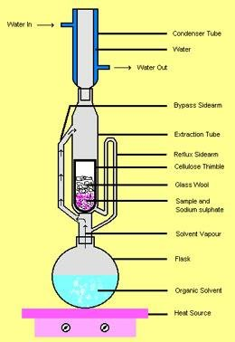
ISOLATION OF GLYCOSIDES
The finely powdered plant part is extracted with water or alcohol in soxhlet apparatus. the concentration of extract gives crude glycoside which is further purified using suitable solvent according to chemical nature and properties of glycoside

Slide 12
CHEMICAL TESTS FOR CARDIAC GLYCOSIDES
1. Baljet Test: T.S of digitalis leaves + sodium picrate solution= yellow to orange colour due to aglycone or glycoside
2. Legal Test : Alcoholic extract of drug + equal volume water and 0.5 ml strong lead acetate solution. Shake and filtered. Filtrat extracted with equal volume of chloroform. Chloroform extract evaporated to dryness and dried residue was dissolved in 2 ml pyridine+ 2 ml sodium nitroprusside + sodium hydroxide solution ( to make alkaline).pink colour due to glycoside or aglycone moiety.
Drug + Pyridine + Sod.nitroprusside (Made alkaline)
Pink to Red color
due to glycoside or aglycone moiety.

Slide 13
Anthraquinone Glycosides
1 Borntrager,s test
To 1 gm of drug add 5-10 ml of dil HCl, boil on water bath for 10 min and filter. Filtrate then extracted with CCl4/ benzene and add equal amount of ammonia solution to filtrate and shake. Ammonical layer becomes pink or red due to presence of anthraquinone.
2 .Modified Borntrager,s test
To 1 gm drug add 5 ml dil HCl + 5 ml ferric chloride( 5%w/v). As some plant contains anthracene aglycone in a reduced form, if ferric chloride is used during the extraction, oxidation to anthroquinones takes place, which shows response to the Borntrager's test. Boil on water bath for 10 min, cool , filter. Filtrate then extracted with CCl4/benzene and add equal volume of ammonia solution. Pinkor red colour forms due to anthraquinone .

Slide 14
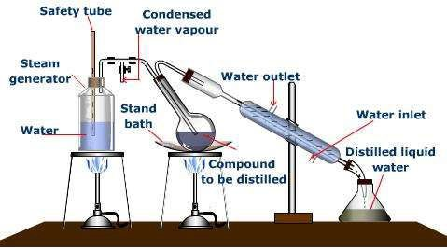
TERPENOIDS
Chemical methods: Treating the essential oil with some chemical agents like(sodium bi sulphite, phthalic anhydride etc.)
Physical methods:
Fractional distillation method Gas chromatography method

Slide 15
RESINS
Method – A
Powdered drug
Extract the resin with alcohol
Filter
Concentrate
Concentrate extract an excess of water, shake
Resins get precipitate

Slide 16
extraction or isolation methods
Method – B
Powdered drug containing oleo-resin, percolate the powdered drug with non-polar solvent (e.g. acetone, chloroform)
Non-polar solvent
Steam distillation
Oleo-resin
Volatile oils (e.g. Rosin

Slide 17
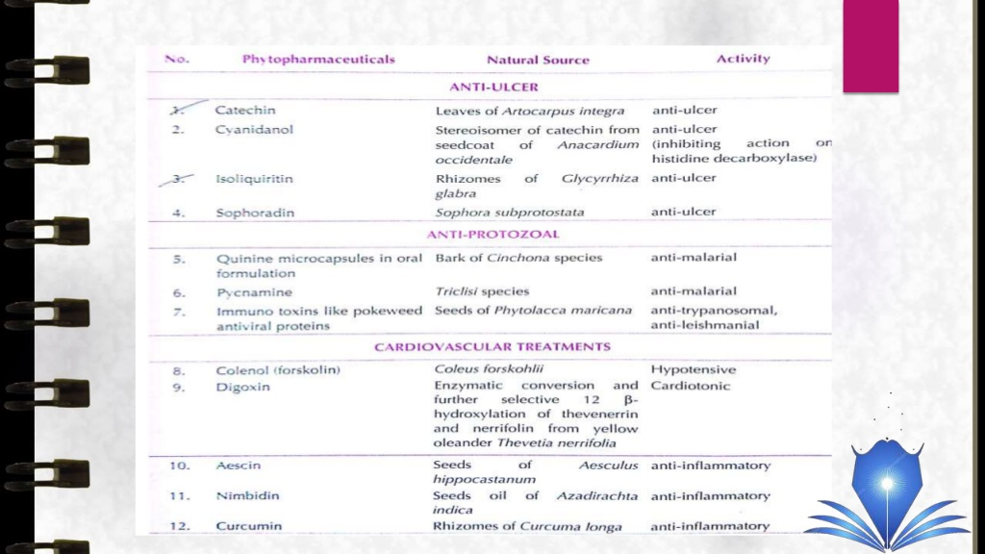
CLASSES OF PHYTOCHEMICALS

Slide 18
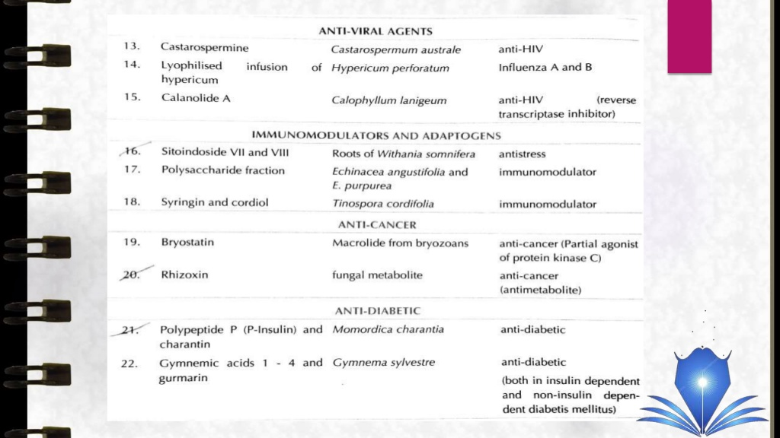
CLASSES OF PHYTOCHEMICALS

