Slide 1
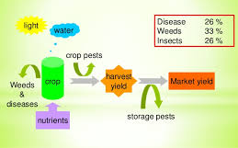
Management: Water, Nutrient, Weed, Pest and Disease

Slide 2
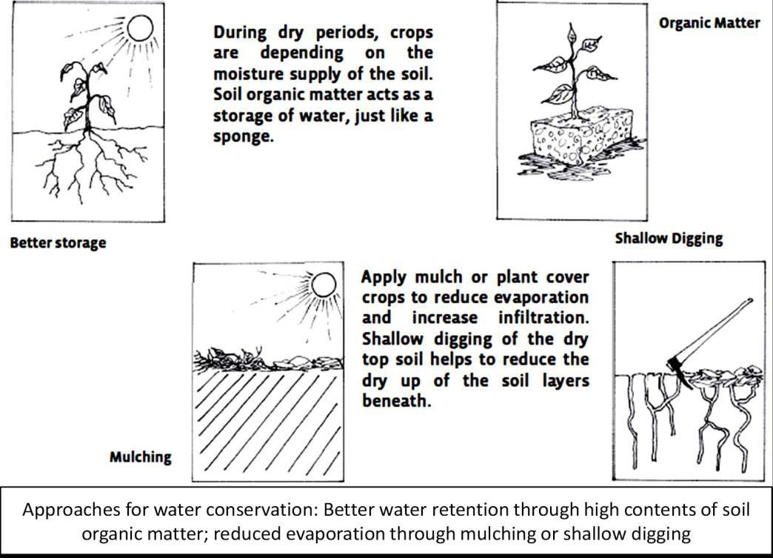
Approaches for water conservation

Slide 3
Harvesting Water 1.Increasing infiltration
During strong rains, only apart of the water infiltrates into the soil. A considerable part flows away as surface runoff, thus being lost for the crop. In order to get as much of the available rainwater into the soil, the infiltration of rain water needs to be increased.

Slide 4
2. Planting Pits
Planting pits(known as zai in Burkina Faso and tassa in Niger)are hand dug circular holes which collect water and store it for use by the crop. Each pit is about 20cm across and 20cm deep. After planting, the holes are left partly open so they collect water. Leave the soil covered, and add compost or fertilizer to the pits to increase their fertility.

Slide 5
3. Contour Bunds and Catchment Strips
Increase with low rainfall, there may not be enough water to grow a crop over the whole area. On gentle slopes(less than 3%), one possibility is to use contour bunds and catchment strips. Catchment strips are areas where no crops are planted.
4. Road Catchments
Water from roads–and from other unproductive areas such as paths and home stead compounds–can be channeled on to fields.

Slide 6
Half-Moon Micro Catchments
Half moon micro catchments are small, semi circular earth bunds. They are quite common on the desert margins of the Sahel, where they are called “demilunes”. Thehalf-moons catch water flowing down a slope. Crops such as sorghum, millet and cowpeas can be planted in the lower portion of the half moons.

Slide 7
DripIrrigation System
The major factors that determine the necessity of irrigation are the selection of crops and an appropriate cropping system.
Deep rooting crops can extract water from deeper layers of soil and hence they are less sensitive to temporary droughts.
With the help of irrigation, many crops can now a days be grown out side their typical agro-climatic region.

Slide 8
One promising option are drip irrigation systems. From a central tank, water is distributed through thin perforated pipes directly to the single crop plants.
There is a continuous but very light flow of water, thus allowing sufficient time to infiltrate in the root zone of the crops.
In this way, a minimum of water is lost and the soil is not negatively affected.
Theestablishmentofdripirrigationsystemscanbequitecostly.However,somefarmershave developed low-cost drip irrigation systems from locally available materials.

Slide 9
The establishment of drip irrigation systems can be quite costly. some farmers have developed low-cost drip irrigation systems from locally available materials.
Whatever irrigation system the farmer chooses, he will reach higher efficiency if it is combined with accompanying measures for improving the soil structure and the water retention of the soil, as described above.
What ever irrigation system the farmer chooses, he will reach higher efficiency ifit is combined with accompanying measures for improving the soil structure and the water retention of the soil, as described above.

Slide 10
Nutrient management
The input and output of plant nutrients must be monitored through a soil testing program, to ensure that nutrient depletion does not take place.
Improvement in agricultural sustainability requires, alongside effective water and crop management, the optimal use and management of soil fertility and soil physical properties.
Both rely on soil biological process and soil biodiversity.

Slide 11
Weed Management
Preventive Measures
Choice of crops and varieties
Mulching
Living green cover
Crop rotation
Intercropping
Sowing time and density
Balanced fertilization
Soil cultivation methods
Pasturing

Slide 12
BiologicalControl of Weeds
The soil borne fungus Fusarium oxysporum(different is olates from Burkina Faso, Maliand Niger) is very effective in reducing the witch weed(Strigaher monthica and S.asiatica) in different cereal crops, leading to yield increases in scientific trials.
Mechanical Control
Manual weeding is probably the most important one. Asit’s very labour intensive, reducing weed density as much as possible in the field will bring less work later on and should there. There are different tools to dig, cut and up rooting the weeds; hand, ox-drawn and tractor-drawn tools.

Slide 13
Pest and disease
management Prevention practices and monitoring
Some important preventive crop protection measures are the following ones:
Selection of clean seed and planting material:
Useof suitable cropping systems
Use of balanced nutrient management: E.g. Balanced potassium supply contributes to the prevention of fungi and bacterial infections
Input of organic matter

Slide 14
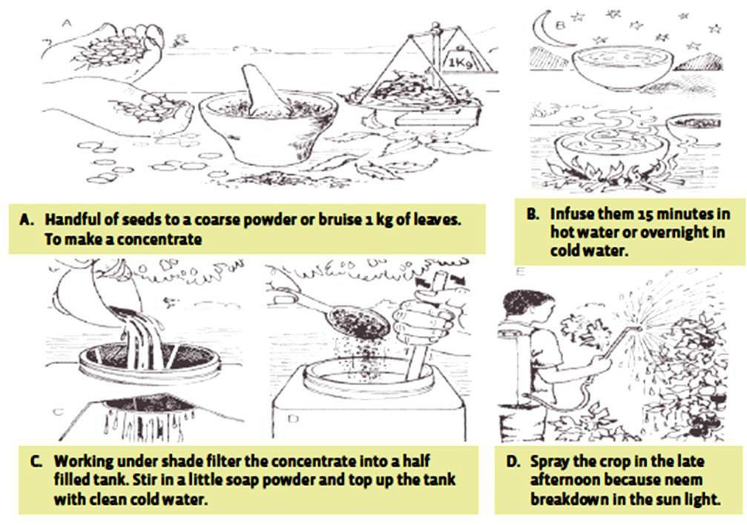
Natural pesticides
Neem

Slide 15
Pyrethrum: Pyrethrins are insecticidal chemicals extracted from the dried pyrethrum flower. The flower heads are processed in to a powder to make a dust. This dust can be used directly or infused in to water to make as pray. Pyrethrins cause immediate paralysis to most insects. Low doses do not kill but have a “knock down” effect. Stronger doses kill.
Chilli pepper: To make the chilli extract grind 200g of chillies into a fine dust, boil it in 4L water, add another 4L of water and a few drops of liquid soap.This mixture can be sprayed against aphids, ants, small caterpillars ands nails.

Slide 16
Garlic: Garlic is non-selective, has a broad-spectrum effect and can kill beneficial insects as well. There fore, it should be used with caution.
Recommendations to farmers on preparation of garlic pesticides: To make the garlic extract, grind or chop 100g garlic in t0, 5L of water. Allow mixture to stand for 24hours, add, 5L of water and stir in liquid soap. Dilute at 1:20 with water and spray in the evening. To improve efficacy, chilli extract can be added.

