Slide 1


Slide 2
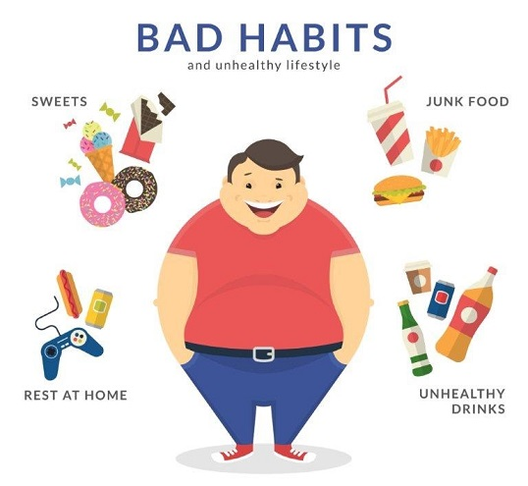
Medically obesity is a condition characterized by the excessive accumulation and storage of fat in the body leading to reduced life expectancy and/or increased health problems. Obesity affects not just appearance of a person but disease processes as well.

Slide 3
Obesity
Pharmacological approaches to control obesity have become a prime priority. Due to unclear etiology, the cure of obesity is difficult and challenging. Current trends for obesity management involve multiple pharmacological strategies including blocking nutrient absorption, modulating fat metabolism, regulating adipose signals and modulating the satiety centers.

Slide 4
Obesity
Although a few medications are available to control obesity yet most of them have been withdrawn due to their hazardous side effects. To seek safer remedies now many natural products are being recommended for curing obesity in most Asian countries. Currently approved medicines for treatment of obesity can be divided into two major classes; (i) Orlistat, which reduces fat absorption through inhibition of pancreatic lipase and (ii) Subutramine which is an anorectic or appetite suppressant

Slide 5

Plant products such as saponins, flavonoids, phenols and alkaloids possess anti-obesity properties. Presence of multiple-phytochemical combinations in plant drugs may result in synergistic effect by their action on multiple molecular targets, thus offering advantages over treatments which often use a single constituent.

Slide 6
Obesity is a chronic condition and a major risk factor for cardiovascular disease (CVD) and type 2 diabetes. Overweight or obese people have a greater probability than normal-weight people for developing metabolic syndrome, a condition characterized by high blood pressure, insulin resistance and dyslipidemias (high levels of total cholesterol, triglycerides and LDL and low levels of HDL)

Slide 7
Obesity during pregnancy may cause congenital malformations, such as neural tube effects, hypertension and gestational diabetes. In addition to these conditions, obesity also increases the risk of polycystic ovary disease, ischemic stroke, sleep apnea, gallbladder disease, gastro esophageal reflux, osteoarthritis, colon cancer, postmenopausal breast cancer and psychological disorders, such as depression.

Slide 8
Terpenoids in Obesity
Any intervention aimed at treating obesity should also focus on how to restore balance of energy intake and energy expenditure. In a simplified form, these interventions could be divided into three classes: i) change in lifestyle; ii) pharmacological interventions and iii) surgical treatment. The first treatment option to lose weight is an energy reduced diet and regular physical movement.

Slide 9
Terpenoids in Obesity
Increased physical movement can be used to balance energy expenditure by increasing the quantity of energy a body uses. Walking, cycling, swimming and aerobics are variety of exercises which are really effective and easy to implement. Unfortunately, for obesity treatment there is no ‘magic pill’. Orlistat is the hydrogenated derivative of lipstatin, which inhibits gastrointestinal lipase. This medicine acts in the lumen of the gut where it blocks the movement of gastrointestinal lipase

Slide 10
Terpenoids in Obesity
Orlistat is also associated with high incidence of side effect(s) which includes steatorrhea, flatulence and fecal incontinence. Sibutramine is a serotonin and noradrenaline inhibitor but it may cause an increase in blood pressure. It acts mainly as an appetite suppressant. Bariatric or Weight Loss Surgery (WLS) was formerly classified as restrictive, malabsorptive or a combination of both. Sleeve gastrectomy, Roux-en-Y gastric bypass and laparoscopic adjustable gastric banding are generally used surgical procedures . Some disadvantages of these procedures are long-term complications such as anemia and malnutrition in the subjects

