Slide 1
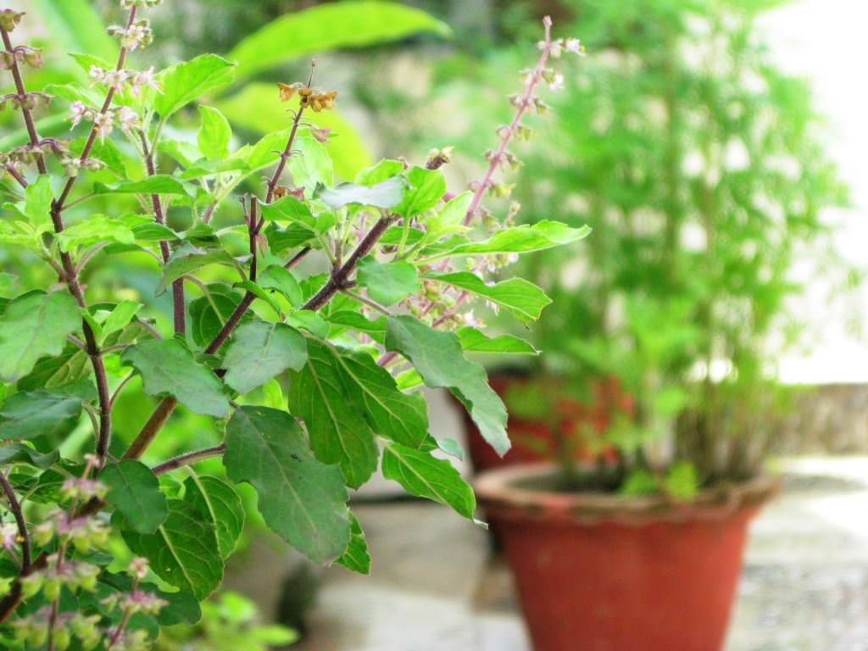
TULSI LEAVES

Slide 2
Closely related to culinary basil, tulsi (Ocimum sanctum, a.k.a. holy basil) is a medicinal herb used in Ayurveda that is native to India and Southeast Asia. Tulsi is considered an adaptogenic herb, meaning it can help adapt the body to stress and boost energy. In alternative medicine, tulsi is typically used for anxiety, stress, and fatigue, and may be used in herbal formulations to help treat asthma, bronchitis, colds, and the flu.

Slide 3
Physical Description
The holy basil plant is a small annual or short-lived perennial shrub, up to 1 metre (3.3 feet) in height. The stems are hairy and bear simple toothed or entire leaves oppositely along the stem. The fragrant leaves are green or purple, depending on the variety. The small purple or white tubular flowers have green or purple sepals and are borne in terminal spikes. The fruits are nutlets and produce numerous seeds.

Slide 4
HEALTH BENEFITS
Eugenol: A terpene with pain-relieving properties
Ursolic and rosmarinic acid: Compounds with antioxidant, anti-inflammatory, and anti-aging properties
Apigenin: A flavonoid that helps the body removes waste at the cellular level
Lutein: An antioxidant carotenoid important for eye health
Ocimumosides A and B: Compounds that reduce stress and balance the neurotransmitters serotonin and dopamine

Slide 5
Tulsi has a special place in Ayurveda as well as the home of Hindus in India. It is considered sacred by Hindus and worshipped by them. Three main types of Tulsi are seen growing in India:
Bright green leaves called Ram Tulsi
Purplish green leaves called Krishna Tulsi
Common wild Vana Tulsi.

Slide 6
Research-Backed Benefits of Tulsi are
Natural Immunity Booster
Reduces Fever (antipyretic) & Pain(analgesic)
Reduces Cold, Cough & Other Respiratory Disorders
Reduces Stress & Blood Pressure
Anti-cancer properties
Good for Heart Health
Good for Diabetes Patients

Slide 7
Useful in Kidney stones & Gouty Arthritis
Useful in Gastrointestinal Disorders
Good for Skin & Hair
Acts as an Insect Repellent

Slide 8
From the leaves to the seed, holy basil is considered a tonic for the body, mind, and spirit. Different parts of the plant are recommended for treating different conditions:
Use its fresh flowers for bronchitis
Use the leaves and seeds, with black pepper, for malaria.
Use the whole plant for diarrhea, nausea, and vomiting
Use the pill and ointment form for eczema.
Use an alcohol extract for stomach ulcers and eye diseases.
Use an essential oil made from the leaves for insect bites.

Slide 9
Many studies support the use of the entire plant of holy basil for human use and its therapeutic value. The nutritional valueTrusted Source is also high, as it contains:
vitamin A and C
calcium
zinc
iron
chlorophyll

Slide 10
The leaves, stems and seeds of the tulsi plant are edible and are used in numerous Indian delicacies. Not only does the leaf adds flavour to the dishes, but is said to preserve and enhance the properties of the food. It has anti-inflammatory properties that can prove to be a cure to various diseases. While it has been a celebrated herb since time immemorial, tulsi is said to manage diabetes. Diabetes is a major lifestyle disease is prevalent in the country. It is marked by fluctuations in blood sugar levels in the body. Most health experts vouch for holy basil to stabilise blood sugar levels; thanks to the many health promoting properties it offers.

Slide 11
Tulsi leaves are known as elixir of life because of their diverse healing properties. From warding off some of the most common ailments, strengthening immunity, to fighting bacterial & viral infections-the benefits of tulsi are multifarious. This herb is said to improve pancreatic beta-cell function and insulin secretion, and further increases the uptake of glucose by muscle cells. As per a study conducted by Nottingham University, the researchers involved 60 people with type-2 who continued their usual medication throughout the trial.

Slide 12
USE OF TULSI IN DIABETES
Half lot took 250mg capsules of holy basil per day for up to 90 days. Significantly greater improvements in glucose control occurred in those taking tulsi plus their usual medications. Spikes in blood glucose levels after eating also improved significantly. Tulsi leaves are said to have hypoglycaemic properties, which lower blood sugar levels and help prevent complications of diabetes.

Slide 13
USE OF TULSI IN DIABETES
Ocimum sanctum whole plant methanol extract is antidiabetic in nature due to the presence of different types of active phytochemicals, which may have different mechanism of action. The combination of these phytochemicals, therefore, might be beneficial as hypoglycemic agents. The O. sanctum plant extract might be considered a

Slide 14
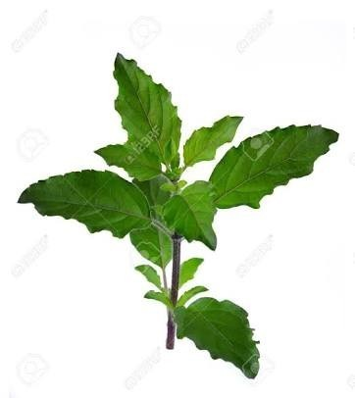
USE OF TULSI IN DIABETES
a safe supplementary therapy for long- term and effective management of diabetic patients.

