Slide 1
Seed production
Contents
Introduction to seed production
Seed as basic input in agriculture
Seed development in cultivated plants
Seed quality concept and importance of genetic purity in seed production.

Slide 2
Terminologies used in hybrid seed production
Seed: “Seed is a plant part having living embryo that have a capacity to produce identical plant and used for raising seed crops or commercial crop”.
Hybrid Seed: The seed (the F1 generation) produced from a cross between genetically dissimilar parents and the hybrid vigour or heterosis is the absolute phenomenon where expression of the characteristics such as growth related traits, flowering and yield fall outside the range of its parents with superiority.
Germination: Ability of a seed when planted under normal sowing condition to give rise to a normal seedling and developing into new plants.
Sowing: Sowing is the process of placing or planting seeds to the soil so they may grow. In sowing, generally little soil is placed over the seeds and sowing can be hand sowing or by machines.

Slide 3
Production of genetically pure and otherwise good quality pedigree seed is an exacting task requiring high technical skill and comparatively heavy financial investment. During seed production strict attention must be given to the maintenance of genetic purity and other qualities of seed. Seed production must be carried out under standardized and well-organized conditions.
SEED PRODUCTION
Importance of seed production:
Multiplication of superior varieties
Availability of superior varieties to masses
Maintenance of genetic purity
Supply of high quality seeds
Seeds have high germination status
Seeds having high vigour and viability status
Maintaining excellent health status of seed
Securing high crop yields and income level to farmers

Slide 4
Seed production in cultivated plants
It basically depends up on the followings
The existing variety of the plant
Nutritional supplement
Environmental factors
Pollinating behavior
Weed management
Insect peat and disease attack

Slide 5
Seed production-Key issues
Weather related
Drought/Express and untimely rains
Seed discoloration
Rain damage
Germination Issues
Disease and insect problem
Operation related
Sowing time
Rouging time
Harvesting stage
Post harvest operations
Mechanical cleaning-threshing/harvesting
Drying/bagging
Gunny bags lot marking
Dispatch
Field related
Wrong field selection
Isolation
Poor crop management
Wrong nicking
Disease and insect problems
Quality related
Off-types
Pollen shedders
Volunteers
Mechanical mixtures-during threshing/harvesting
Harvest moisture
People related
Unskilled seed producer’s
Production Cost
Procurement price

Slide 6
FACTORS RESPONSIBLE FOR LOSS OF GENETIC PURITY
(kadam ., 1942)
Developmental Variation
Mechanical Mixtures
Mutations
Natural Crossing
Genetic drift
Minor Genetic Variation
Selective influence of Diseases
Techniques of the Breeder
Breakdown of male sterility
Improper / defective seed certification System

Slide 7
Important safeguards for maintenance of genetic purity
Control of seed source/ Use of approved seed only in seed multiplications
Inspection and approval of fields prior to planting
Providing adequate isolation to prevent contaminations
Seed multiplication outside their normal cultivation area
Roguing of seed fields at critical stages
Periodic testing of varieties for genetic purity
Certification of seed crops to maintain genetic purity and quality of seed
Frequent field visits and monitoring during all operations
Grow out test

Slide 8
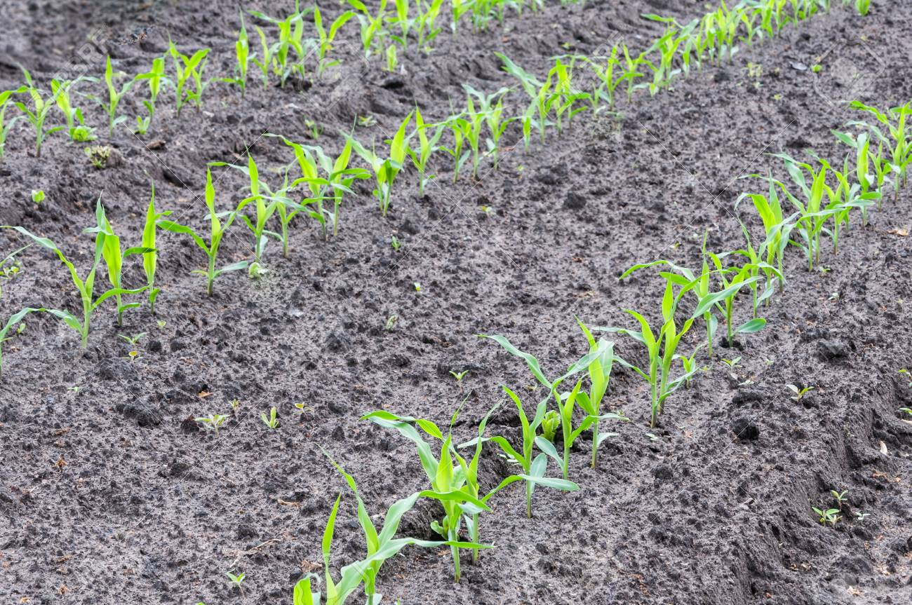
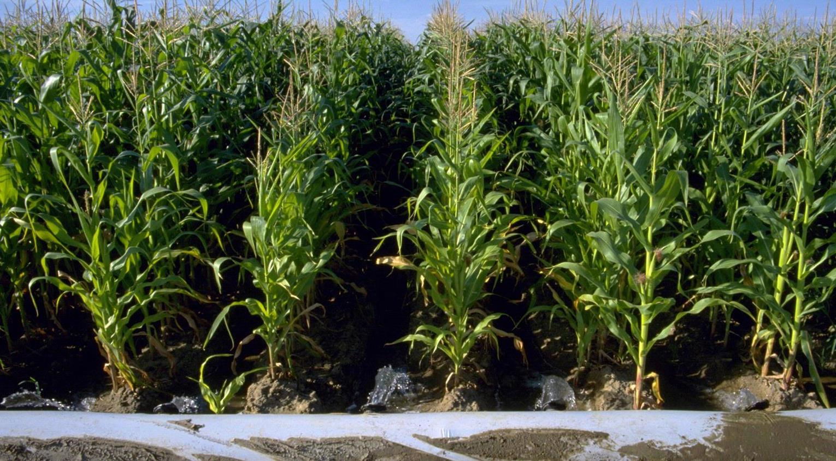
Grow out test
Conducted to determine genetic purity of a seed lot wherever it is prerequisite for grant of the certificate and also on the seed lots where a doubt has been arisen about the genetic purity. The grow-out test can be complemented by certain laboratory tests.
Source: https://www.google.com/search?q=maize+seedlings+in+field&tbm=isch&ved=2ahUKEwjHrf_jg6XvAhWZ5HMBHbiBD0cQ2-cCegQIABAA&oq=maize+seedlings+in+field&gs_lcp=CgNpbWcQAzoHCAAQsQMQQzoECAAQQzoCCAA6BggAEAUQHjoGCAAQCBAeOgQIABAYOgQIABAeUOMpWMZ2YNh8aAFwAHgAgAH8AYgBmSaSAQYwLjE4LjeYAQCgAQGqAQtnd3Mtd2l6LWltZ8ABAQ&sclient=img&ei=Al5IYMekN5nJz7sPuIO-uAQ&bih=635&biw=1366#imgrc=r9KqDLluJo-bPM

Slide 9
Key deliverables of efficient seed production technology
Highest order of seed quality in terms of genetic purity, seed vigour and germination
Maximization of seed yield per unit area
Reduction of production cost per kg of seed
Freedom from inert matter, weed seed and other crops seed as per prescribed standards
Freedom from seed-borne diseases
Timely availability of seed to customers

Slide 10
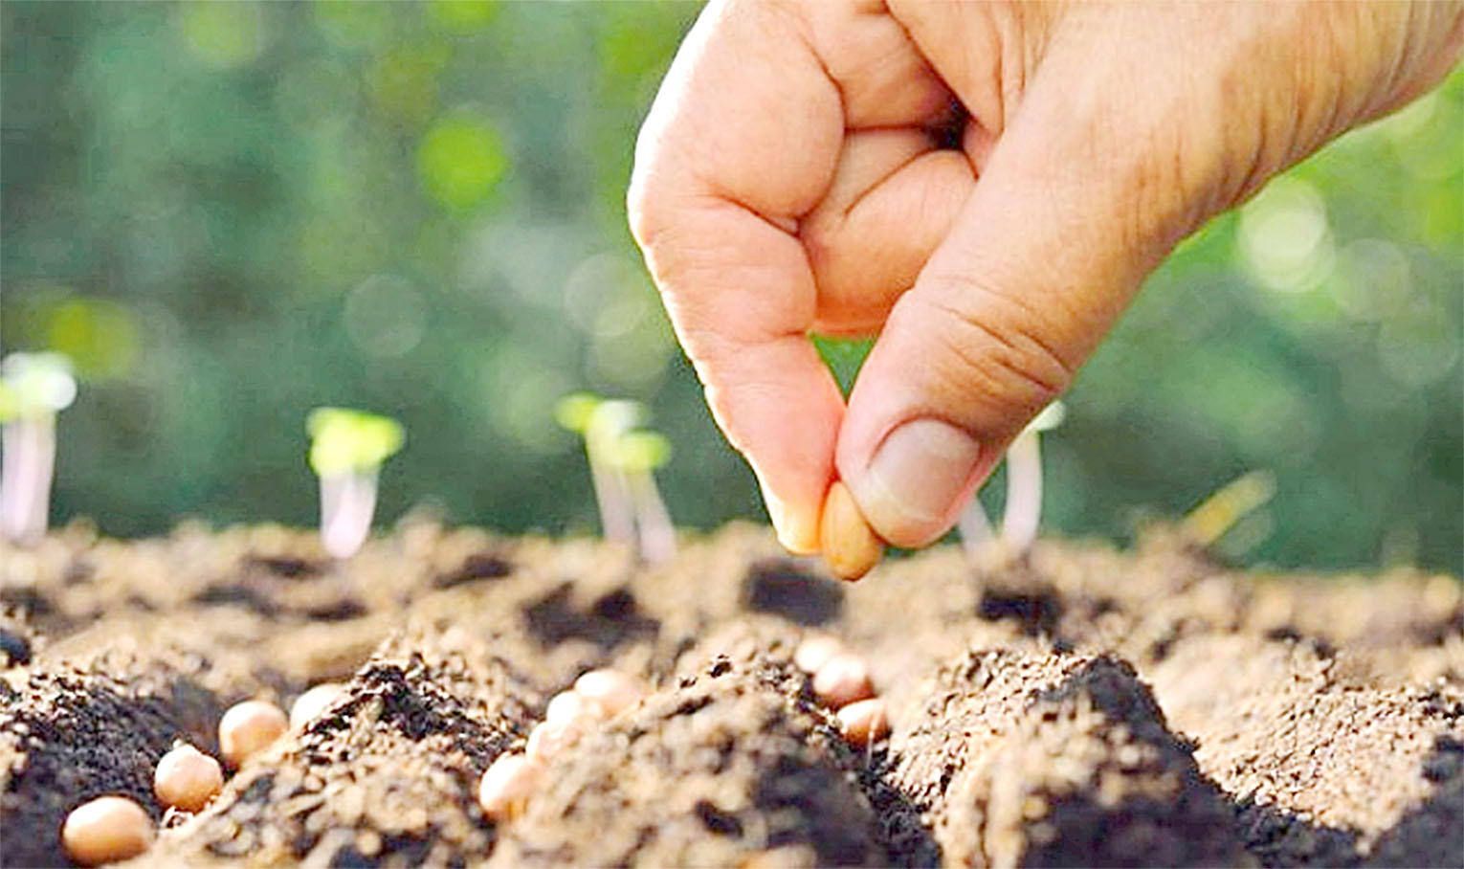
Thank You

