Slide 1
Mode of pollination and reproduction in crop plants

Slide 2
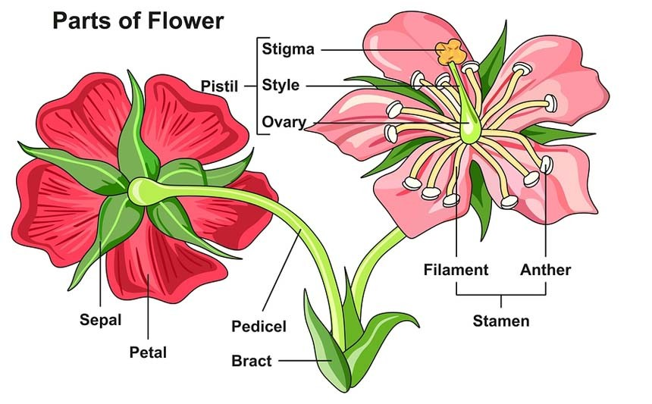

Slide 3
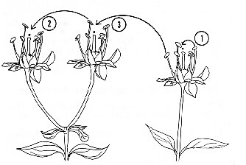
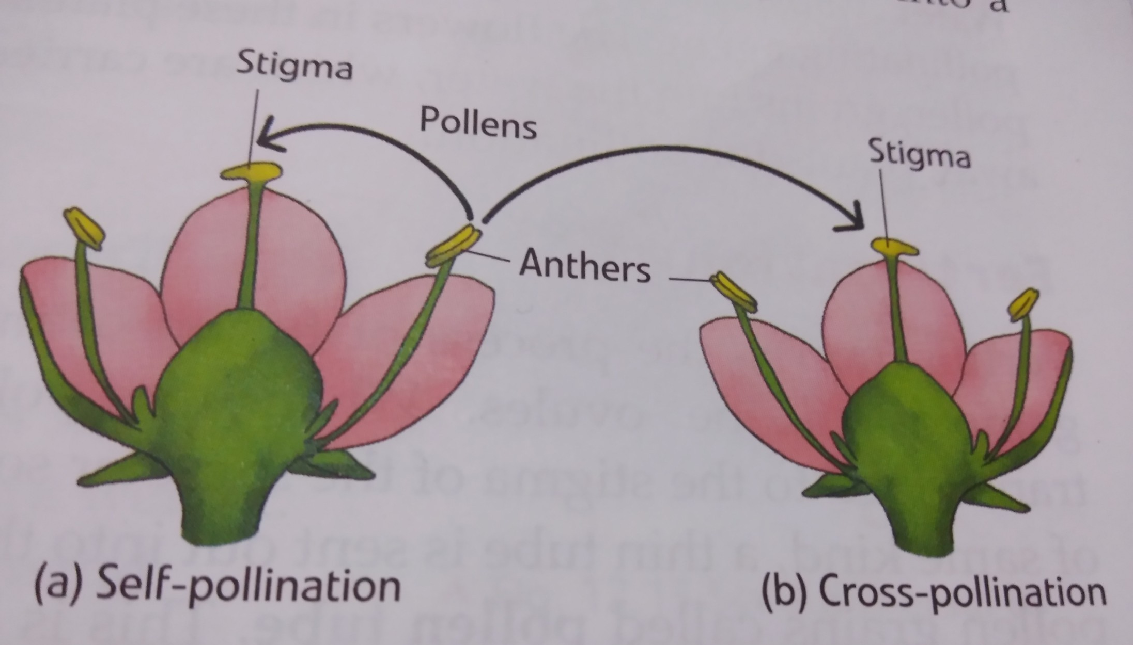
Self Pollination
Geitonogamy (from Greek geiton (γείτων) = neighbor + gamein (γαμεῖν) = to marry) is a type of self-pollination. In flowering plants, pollen is transferred from a flower to another flower on the same plant, and in animal pollinated systems this is accomplished by a pollinator visiting multiple flowers on the same plant.
1- Homogamy, 2- Geitonogamy, 3- Heterogamy

Slide 4
Mechanism promoting self-pollination
Bisexuality: Presence of male and female organs in the same flower is known as bisexuality. The presence of bisexual flowers is a must for self pollination. All the self pollinated plants have hermaphrodite flowers.
Homogamy: Maturation of anthers and stigma of a flower at the same time is called homogamy. As a rule, homogamy is essential for self-pollination.
Cleistogamy: When pollination and fertilization occur in unopened flower bud, it is known as cleistogamy. It ensures self pollination and prevents cross pollination. Cleistogamy has been reported in some varieties of wheat, barley, oats and several other grass species.
Chasmogamy: Opening of flowers only after the completion of pollination is known as chasmogamy. This also promotes self pollination and is found in crops like wheat, barley, rice and oats.

Slide 5
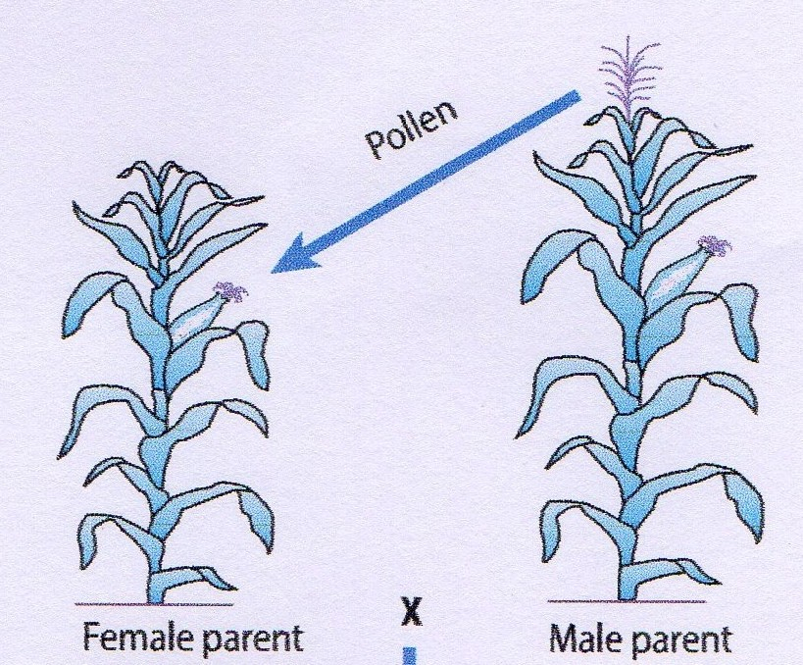
Cross Pollination

Slide 6
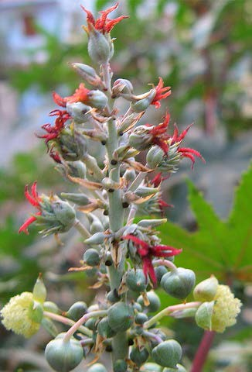
Mechanisms promoting cross pollination
Dicliny : Dicliny or unisexuality is a condition in which the flowers are either staminate (male) or pistillate (female).
Monoecy: Staminate and pistillate flowers occur in the same plant, either in the same inflorescence, e.g., Castor, mango and coconut, or in separate inflorescences, chestnut, strawberries, rubber, grapes and cassava.
Dioecy: The male and female flowers are present on different plants, i.e., the plants in such species are either male or female, e.g., papaya, date, hemp, asparagus, and spinach.
Staminate flower
Pistillate flower

Slide 7
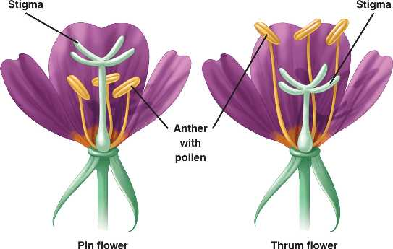
2. Dichogamy:
Stamens and pistils of hermaphrodite flowers may mature at different times facilitating cross pollination is refered as dichogamy.
Protogyny: In crop species like bajra, pistils mature before stamens.
Protandry: In crops like Maize and sugarbeets, stamens mature before pistils.
A combination of two or more of the above mechanisms may occur in some specie. This improves the efficiency of the system in promoting cross-pollination. For example, Maize exhibits both monoecy and protandry.
Heterostyly: When styles and filaments in a
Flower are of different lengths, it is called
heterostyly. It promotes cross pollination,
such as linseed and Primula.
Pin and Thrum flowers of Primula

Slide 8
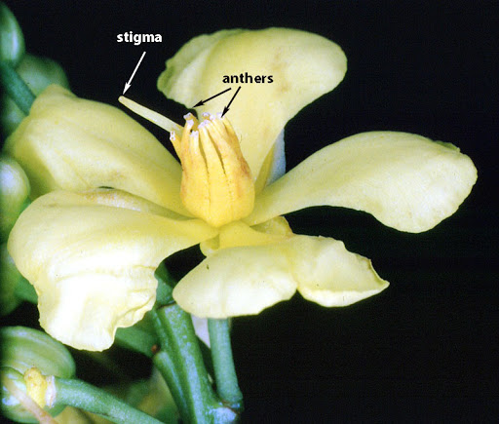
5. Herkogamy.
Hinderance to self-pollination due to some physical barriers such as presence of hyline membrane around the anther is known as herkogamy.
Such membrane does not allow the dehiscence of pollen and prevents self-pollination such as in alfalfa.
In Lucerne or alfalfa, stigmas are covered with a waxy film. The stigma does not become receptive until this waxy film is broken.
The waxy membrane is broken by the visit of honey bees which also effect cross-pollination

Slide 9
Self-Incompatibility. It refers to the failure of pollen from a flower to fertilize the same flower or other flowers on the same plant.
Male Sterility. Male sterility refers to the absence of functional pollen grains in otherwise hermaphrodite flowers. Male sterility is not common is natural populations. But it is of great value in experimental populations, particularly in the production of hybrid seed.
Category of Allogamous Sp. | Species
Seed propagated | Corn, Pearl millet, Rye, Alfalfa, Radish, Cabbage, Sunflower, Sugarbeet, Castor, Red clover, White clover, Safflower, Spinach, Onion, Garlic, Turnip, Squash, Muskmelon, Watermelon, Cucumber, Pumpkin, Kenaf, Oilpalm, Carrot, Coconut, Papaya, etc.
Vegetatively propagated | Sugarcane, Coffee, Cocoa, Tea, Apple, Pears, Peaches, Cherries, grapes, Almond Strawberries, Pine apple, Banana, Cashew, Irish, Cassava, Taro, Rubber, etc.
Often cross pollinated | Sorghum, Cotton, Triticale, Pigeonpea, Tobacco

Slide 10
HYBRID SEED PRODUCTION
TECHNOLOGIES

Slide 11
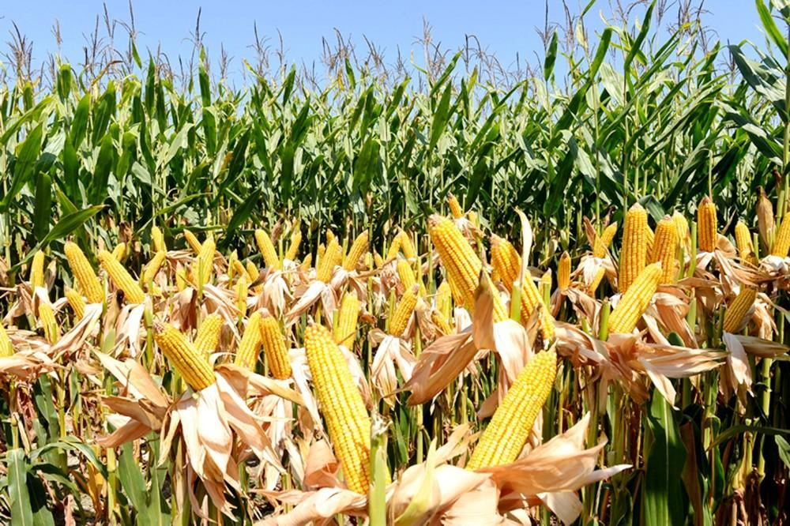
Seed formed by cross pollination on female parent hybrid seed. Performance of hybrid is better than the parents and other varieties because of heterosis. Heterosis, hybrid vigour, or outbreeding enhancement, is the improved or increased function of any biological quality in a hybrid offspring. An offspring exhibits heterosis if its traits are enhanced as a result of mixing the genetic contributions of its parents.
HYBRID SEED
Important features
Hybrid is produced by crossing between two genetically dissimilar parents.
In self pollinated crops, it is difficult to cross but in cross pollinated crops it is easier
Pollen from male parent (Pollen parent) will pollinate, fertilize and set seeds in female (seed parent) to produce F₁ hybrid seeds.

Slide 12
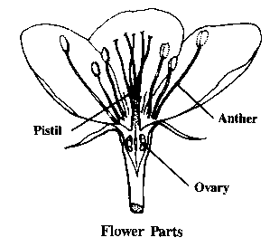
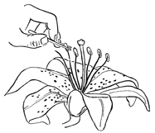
PARENTS
Parents for hybrid seed production programme are selected on the basis of specific combining ability and heterosis.
Female Parent known as seed parent
Male parent designated as pollinator
Flower of most of the crop plants is hermaphrodite in nature i.e., both male and female part are present in the same flower
To check the self pollination and enhance cross pollination male part of the flower has to be removed. This process is known as emasculation

Slide 13
General procedure of Hybrid seed production
After emasculation pollen from desired male parent is collected and dusted on the female part of the emasculated flower. This process is known as pollination.
The seed thus formed on the female plant i.e., emasculated flower is hybrid seed
To produce hybrid seed hand emasculation and pollination is not economical and feasible in all the crops.
Therefore the technique has been developed in which the male part of the flower remain sterile due to genetic alteration
Due to male sterility neither self-pollination is possible nor emasculation is required
Pollen from male parent to female parent is transferred by air or by insect

Slide 14
Commercial hybrid seed production
Commercial hybrid seed production demands crossing technique which is easy and also economic to maintain parental lines. Only few crossing mechanisms have been adopted for commercial hybrid seed production they are;
Hand emasculation and pollination
Self-incompatibility
Dicliny : monoecious and dioecious
Male sterility
These techniques are specific to crop floral biology and flowering behaviour

Slide 15
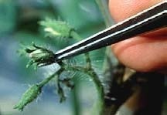
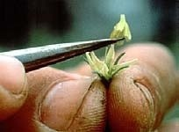
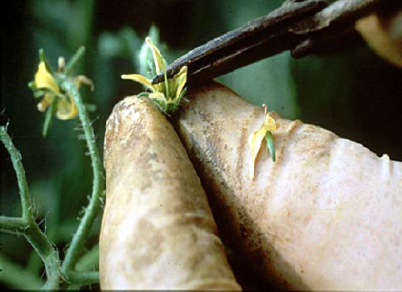
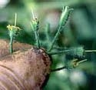
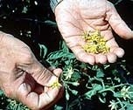
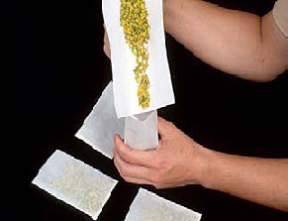
Removal of anther cone
Hand emasculation and pollination
Selection of flower
Removal of corolla
Emasculated flower
Collected flower
Male flower

Slide 16
Requisites of hybrid seed production
Breeders responsibilities
Develop inbred lines
Identification of specific parental lines
Develop system for pollen control
Major problems for breeders & producers
Maintenance of parental lines
Separation of male and female reproductive organs
Pollination
Basic procedures for hybrid seed production
Development and identification for parental lines
Multiplication of parental lines
Crossing between parental lines and production of F₁

Slide 17
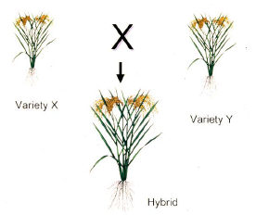
4. Characteristics of parental lines.
Female Parent | Male Parent
High seed yield | Good pollen production
Good seed characteristics | long shedding period
Male sterility | Plant height
Lodging resistant | Fertility restoration

Slide 18
Hybrids are popular in
Maize, Pearl millet, Cotton, Pigeon pea, Safflower, Sorghum, Rice, Sunflower, Castor
Nucleus and Breeder’s seed production:
Seed of both seed and pollinator parents are multiplied at nucleus and breeder’s seed stage.
Foundation seed production:
Seed production of seed and pollinator parent required for hybrid seed production programme is known as foundation seed programme
Certified seed production:
Hybrid seed production by registered growers under the supervision of seed certification officer is known as certified seed programme

Slide 19
A, B and R lines
Breeder Seed
Foundation Seed
A and R lines
Certified Seed
Hybrid seed

Slide 20
Selection of field:
For seed production programme of hybrids and their parents selected field should be free from volunteer plants.
Isolation:
In order to maintain the genetic purity of the parent or hybrid seed, cross contamination should be avoided by maintaining the isolation distance from the field of
Other varieties of the same crop
seed production of other hybrid of the same crop
Seed production programme of same hybrid not conforming the seed certification standards.
Modification of isolation distance is not allowed for hybrid seed production programme except maize.

Slide 21
Planting ratio:
Planting ratio refers to the number of rows of the male parent of that of the female parent, in the hybrid seed production plot.
Appropriate line ratio of seed and pollinator parents
It depends on: nature of pollination, amount of pollen shed, mode of pollination, pollen viability, stigma receptivity, wind velocity, density and movement of vector; height of the pollinator and agronomical management.
It differs from crop to crop, genotype to genotype and place to place.
First and last row should preferably be of pollinator.
row should be across the wind direction.

Slide 22
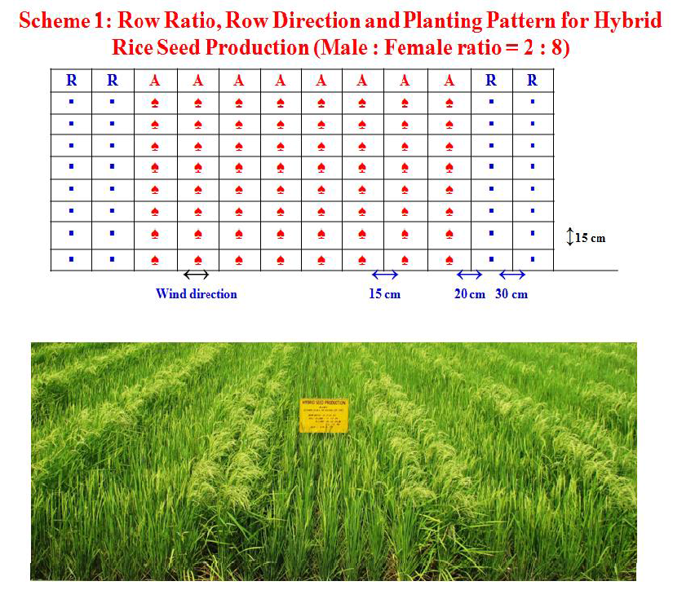

Slide 23
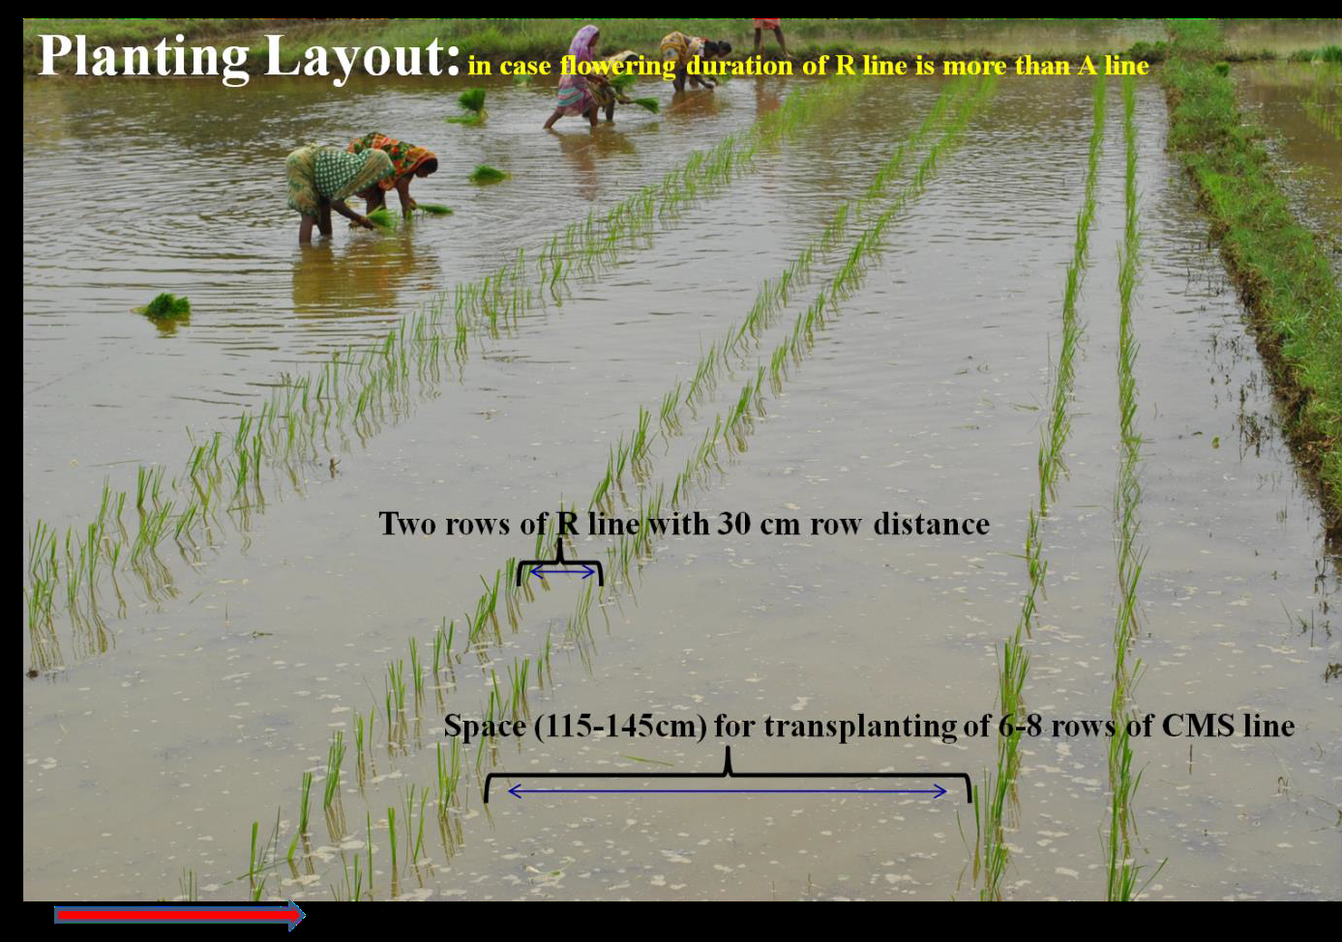

Slide 24
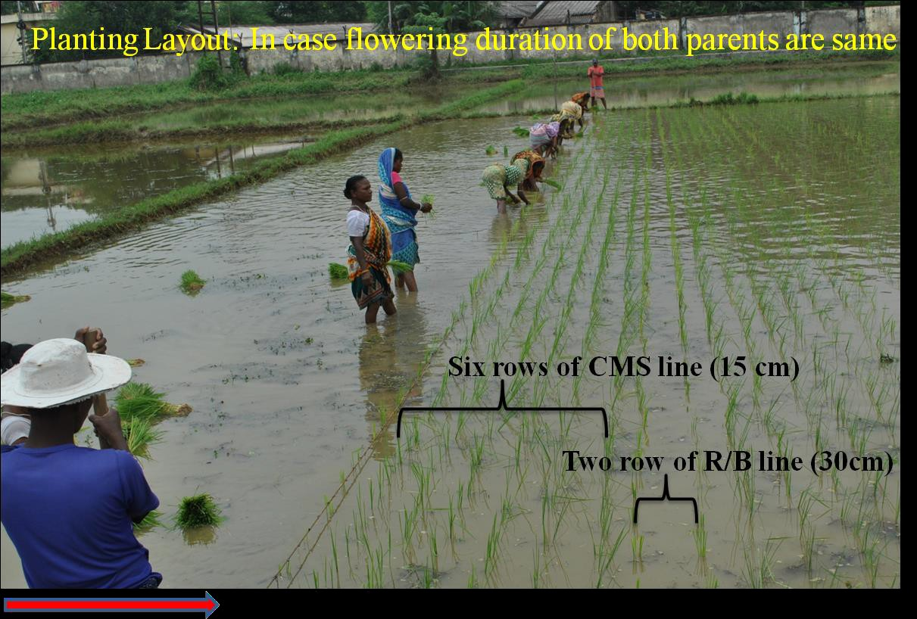

Slide 25
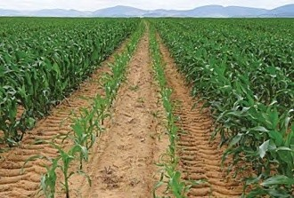
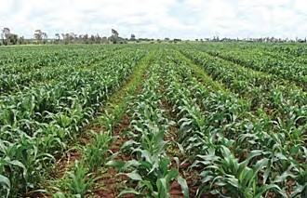
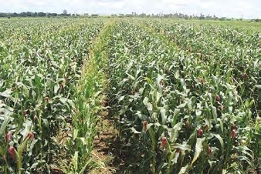
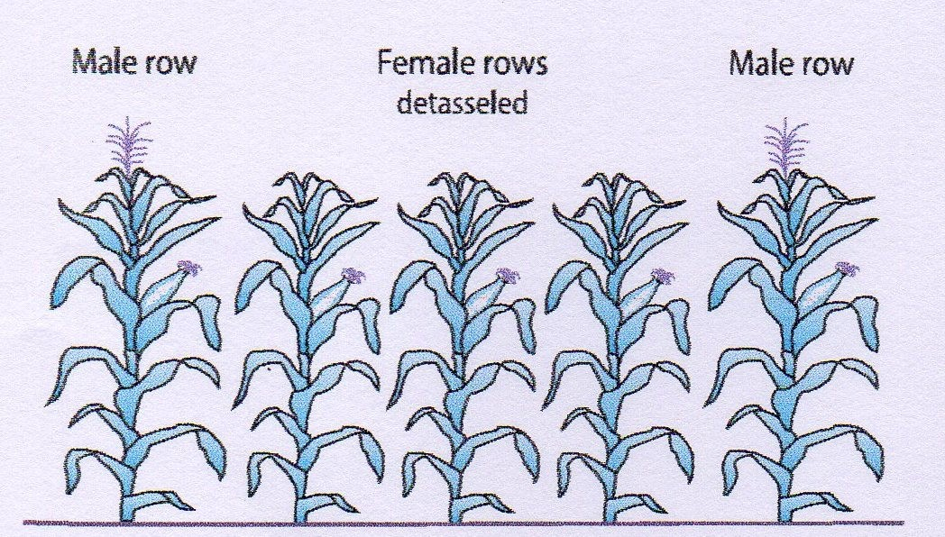
Photographs showing the distinct male and female plant rows at different crop stages, from early vegetative to flowering.

Slide 26
Nicking:
The synchrony in flowering of seed and pollinator parent is termed as nicking.
Required for high yield Influenced by
Genetic constitution
Climatic conditions
Agronomical practices
It varies from parent to parent and place to place. And can be achieved by following;
Staggering
Mainly by early sowing of late flowering parent.
The seed setting of hybrid and ‘A’ line seed production programme can be increased significantly by Supplementary pollination Mainly by hand or other devices.

Slide 27
Pollen shedder :
Plants of seed parent in monoecious or male sterile system showing male fertility in complete plant / inflorescence or partially in some part of the inflorescence / plant are considered as pollen shedder and partial pollen shedders, respectively.
Roguing :
Off-type from both pollen and seed parent Field should be visited every alternate day.
Plants infected with seed borne diseases should be rogued out regularly upto physiological maturity

Slide 28
Supplementary pollination:
Rice is self- pollinated crop and hence there is need for supplementary pollination for enhancing out-crossing. In this operation, the pollen parent plants are shaken which helps in shedding and dispersal of pollen grains over the A line.
This can be done either by rope pulling or by shaking the pollen parent with the help of two bamboo sticks.
The first supplementary pollination should be done at peak anthesis time when 30 to 40 % of the spikelets are open and anthers are fully exserted.
This process is repeated three to four times during the day at an interval of 30 minutes. This process should be done for 7-10 days during flowering period.

Slide 29
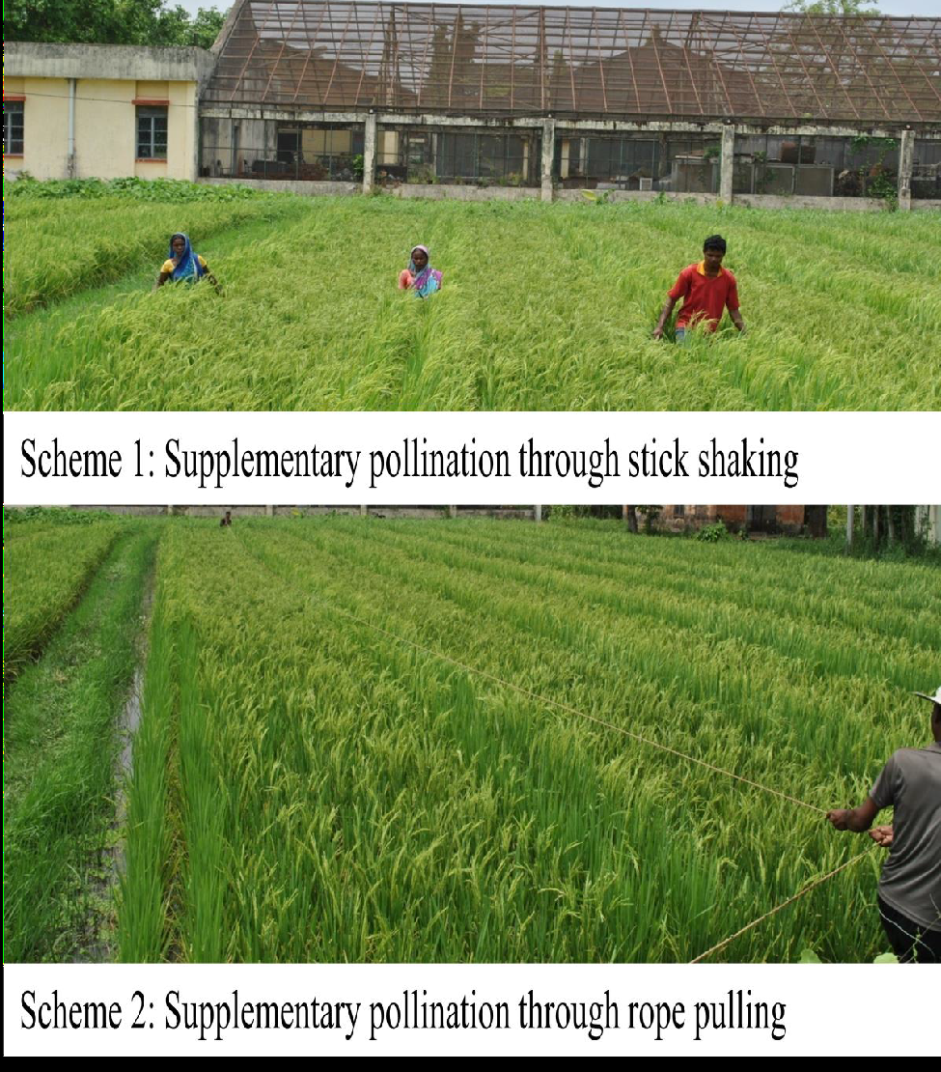
Supplementary pollination

Slide 30
Types of contamination
Presence of B line in A line called as pollen shedders
Presence of A line in B line called as off type
Presence of R line in B line called as rogue
Presence of B line in R line called as rogue
Pollen shedders and off type cause physical contamination, whereas, rogue cause physical and genetical contamination.

Slide 31
Field inspection:
Field inspector inspects the foundation and certified seed production programme atleast four times.
Out of these four inspections
1st is made before flowering
2nd and 3rd during flowering
4th at physiological maturity
to verify
Isolation distance
Planting ratio
Planting pattern
Off-types
Pollen shedder
Objectionable weed plants
Incidence of objectionable seed borne diseases
True nature of the parents.

Slide 32
Harvesting, threshing and processing:
In order to have high seed purity utmost care should be taken while harvesting female (seed) and R line. First, the male parent (pollen parent or R line) should be harvested, followed by the female parent. Also, the threshing should be done separately, if possible on separate threshing floors. After drying, the seed should be bagged with labels both inside and outside the bags.
Seed testing:
The submitted sample is tested for verification of seed standard Genetic purity is verified by
ODV
GOT test

Slide 33
Popular Hybrids in crops
Paddy : JRH-4, JRH-5, JRH-8, JRH-15, JRH-17, JRH- 21, JRH-25 Pigeonpea : ICPH-2671, ICPH-1050
Castor : JCH-1, JCH-2, DCH 519, DCH 177, DCH 32, GCH 4, GCH 5, GCH 6, RCH 1, PCH 1, TMVCH 1
Maize : JMH-1, JMH-2, HQM-1, HQM-5
Bajara : KVH 108, JVH 905, MPMH 17, 86 M 89, 86 M 86, RHB 173,HHB 223
Cotton: DCH 32, H 8, G Cot Hyb. 10, Banni BT , WHH 09 BT, RCH 2 BT, JKH 1, JKH 3

Slide 34
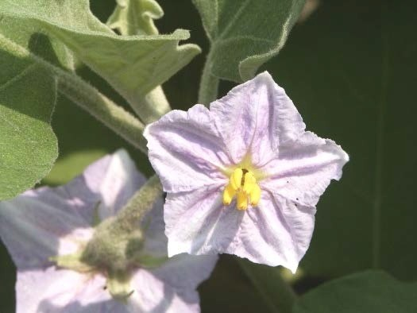
Thank You

