Slide 1
MALE STERILITY AND SELF INCOMPATIBILITY SYSTEM IN HYBRID SEED PRODUCTION

Slide 2
Self Incompatibility:
Self-incompatibility is a mechanism which avoids self fertilization through recognition of self pollen in or on stigma on the female pistil.
But when pollen from other plant carried by wind or insects are accepted and sets seeds.
Dicliny:
Monoecious: Flowers are unisexual and are present at different position on the same plant e.g. cucumber. Terminal flowers are male flower. In the middle of the plant is female favouring cross-pollination.
Dioecious: male flowers and female flowers are in different plant. So called as male plant and female plant.

Slide 3
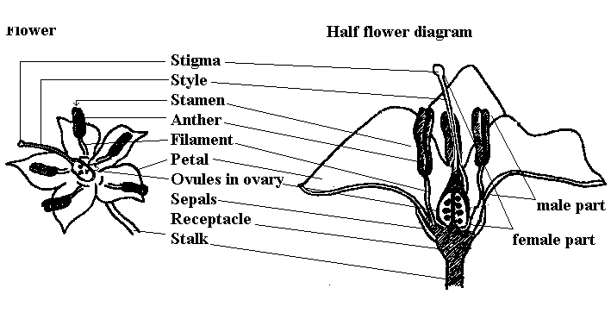
Floral structure of a bisexual flower

Slide 4
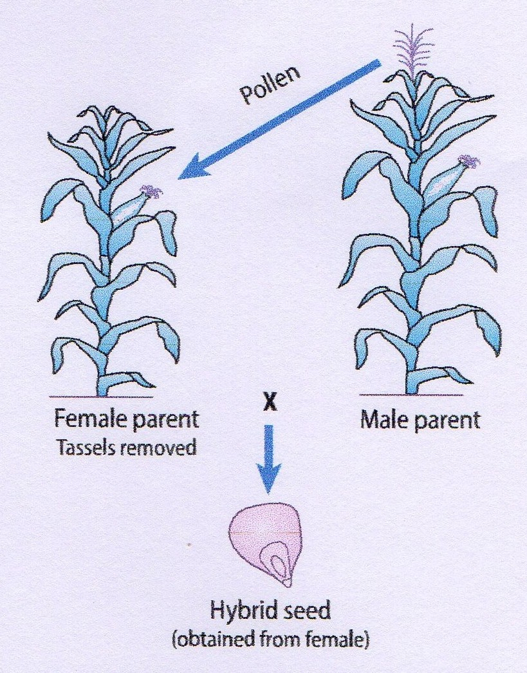
Hybrid maize seed is produced by using designated female and male parents, removing the tassels from the female plants before silk emergence and allowing male plants to provide the pollen for fertilizing the silks.
By the process of self incompatibility male anther was unable to fertilize the female part hence getting a female part become so easy for the hybridization programme.
Once the plant become female potent and free from its male pollen now a breeder can go for artificial out-crossing to ensure the hybrid seed development.

Slide 5
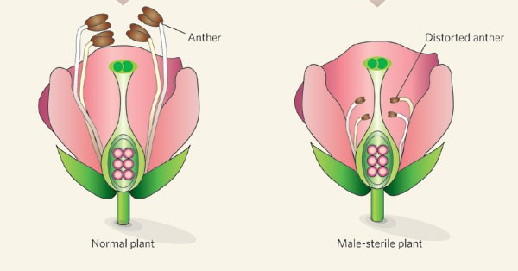
Male Sterility
Hybrid production requires a female plant in which no viable male gametes are borne.
Emasculation is done to make a plant devoid of pollen so that it is made female.
Another simple way to establish a female line for hybrid seed production is to identify or create a line that is unable to produce viable pollen.
This male sterile line is therefore unable to self- pollinate and seed formation is dependent upon pollen from the male line.

Slide 6
Contd…
In hermaphrodite flowers pollens are non-functional or inactive or sterile while, female gametes functions normally.
Male sterility can be either genetic or cytoplasmic or cytoplasmic-genetic. This prevents autogamy and permits crosspollination.
In hybrid seed production process female is a male sterile line crossed with male fertility restorer line to get F₁ hybrid.

Slide 7
At presently three line method, using cytoplasmic male sterility system, In this system, three lines (parents) are involved in hybrid seed production.
These parents are:
a) A line: It is cytoplasmic male sterile line which is used as female parent in hybrid seed production. It is maintained by crossing with the B line (maintainer line). Both these lines are iso-genic having homozygous recessive nuclear genes conferring male sterility, differing only in cytoplasm which is sterile (S) in A line and fertile (F) in its maintainer, the B line.

Slide 8
Seed of A line is produced by making cross between A X B
A line
B line
msms
msms
msms
A line

Slide 9
B line: It is iso-genic to A line and is used as pollen parent to maintain male sterility in A line. This line is maintained by growing in isolation, at least 5 m away from any rice variety.
R line: This is also called as fertility restorer or pollinator line. This is used in hybrid seed production by growing along-with A line in a standard row ratio. It is also maintained by growing in isolation, at least 5 m away from any rice variety.
Gametocide: In order to overcome the hand emasculation and pollination some chemicals are spread on seed parent to make them male sterile by killing their male gametes. These chemicals are known as chemical hybridizing agents.
Ex. FW -450 or Mendok, Maleic hydrazide (MH), Coumarin

Slide 10
Seed of R line is produced by selfing (male fertile) Seed of B line is produced by selfing (male fertile)
Restorer
MsMs
B line
msms
MsMs
Restorer
msms
B line

Slide 11
Hybrid seed is produced by making cross between A X R
A line
Restorer
msms
MsMs
Msms
Hybrid

Slide 12
B line
Restorer
A line
MsMs
msms
msms
Msms
msms
Hybrid
A line
msms
B line
MsMs
Restorer

Slide 13
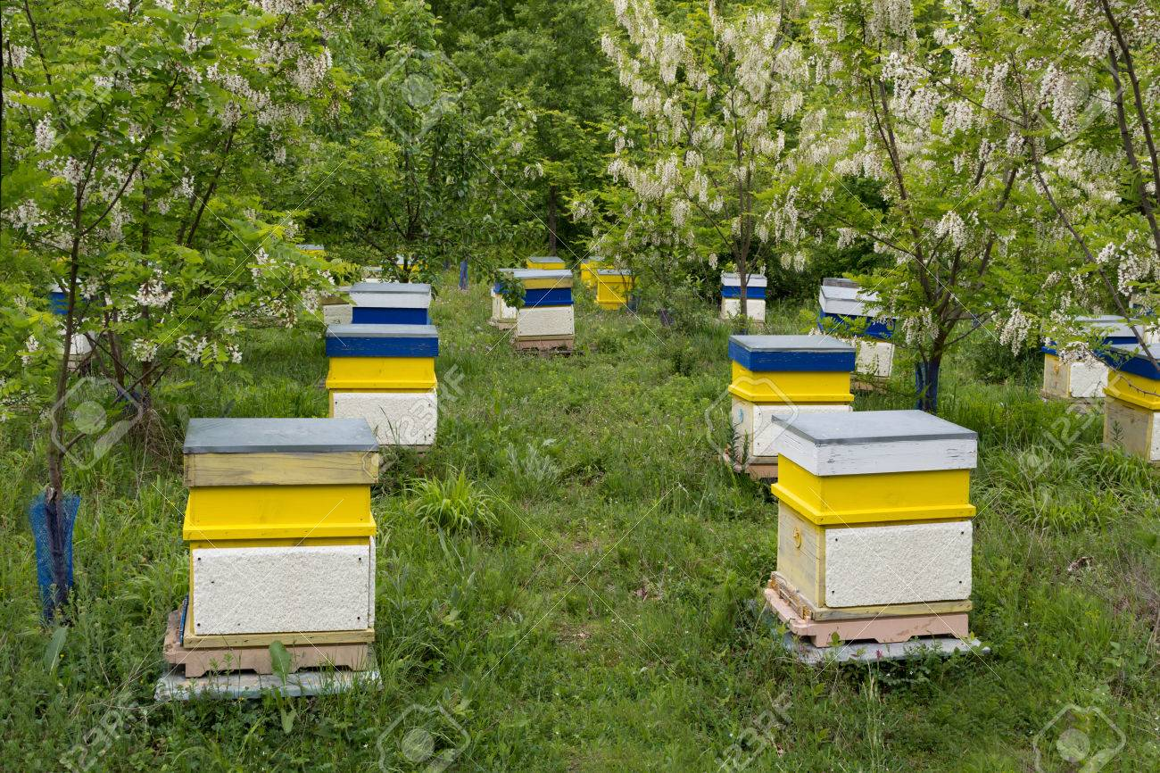
Pollinators and their management
Pollination is one of the most important mechanism in the maintenance and promotion of bio-diversity and in general life on Earth. Many ecosystems, including many agro-ecosystems, depend on pollinator diversity to maintain overall biological diversity.
Pollination also benefits society by increasing food security and improving livelihoods.
Pollinators are extremely diverse,
with more than 20,000 pollinating
bee species and numerous other insects
and vertebrate pollinators.
Installation of Bee hives near the
field source to save bee’s energy.

Slide 14
Contd..
Migrate colonies near field at 10 percent flowering and colonies should be 3/ha for Italian bee and 5/ha for Indian honey bee. A young mated queen with sufficient pollen and honey storage must be accommodated.
It is now apparent that the pulses and oilseeds, fruits and orchard crops including vegetables heavily depends on bees for their pollination.
This is also true for seed production of vegetables like onion, cabbage, cauliflower, tobacco, sun hemp, Alfa Alfa and clovers. The number of colonies of honey bees required per hectare very much depends on the strength of foraging bees in the colony, the crops and prevailing weather conditions.
The optimum number of colonies of average strength may range from 3 to 9 colonies per hectare, since the bees usually forage within a radius of about 1 to 2 km to harvest their nectar and pollen loads and then return to their own hive.

Slide 15
Main role of pollinators
It increases yield in terms of seed yield and fruit yield in many crops
It improves quality of fruits and seeds
Bee pollination increases oil content of seeds in sunflower
Bee pollination is a must in some self incompatible crops for seed set. Cross-pollination of lucerne is vital to ensure that the maximum quantity and quality of seed achieved.
Cross-pollination is said to contribute about 89% of the seed yield
Wild pollinators visiting crops can increase the effectiveness of pollination and thus the yield and quantity of crop production.
Profiles of practices that can affect the diversity and abundance of wild pollinators visiting crops give options for farmers and land managers to promote wild pollinators at different scales of management.

Slide 16
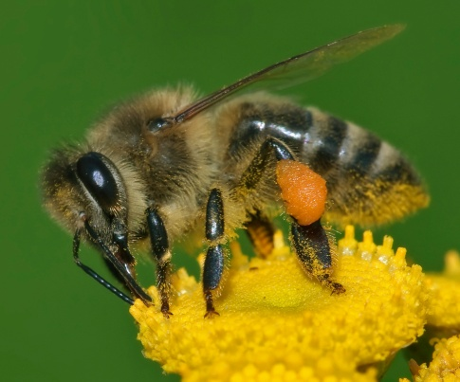
Important features of flower which aid Honey bee pollination
Colour of the flower
Structure of the flower
Good quality nectar
High concentration of sugars in flowers
Production of abundant pollen
Factors influencing pollination efficiency
Rain fall
Temperature: 16⁰ C to 41⁰ C
Wind velocity: Below 15 miles/hr
Apis mellifera is generally preferred because of following reasons
Adoptability
Easy handling
Slow swarming
Tolerance to human management
Honey making habit increases pollination

Slide 17
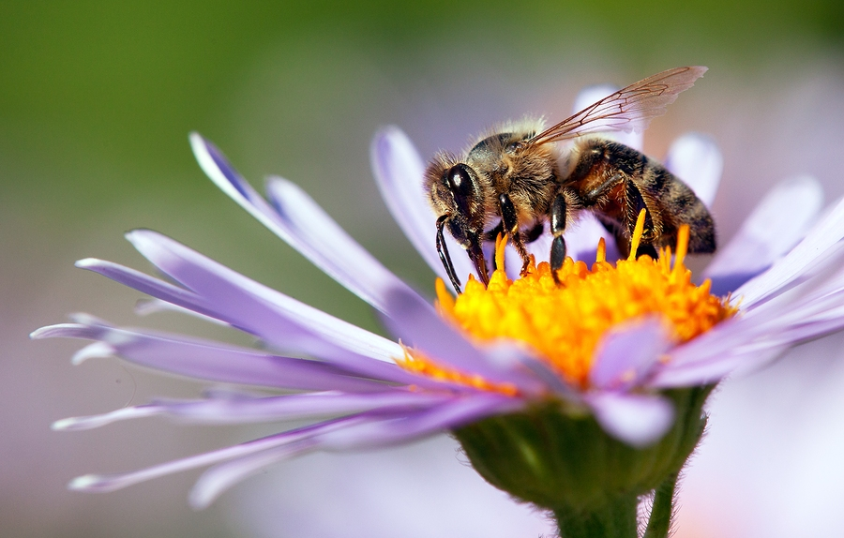
Thank You

