Slide 1
Biochemical Tests For Genetic Purity

Slide 2
CONTENTS
Introduction
Need for genetic purity testing
Various tests for genetic purity-Phenol test for Wheat and Rice
KOH bleach test for Sorghum
Sodium hydroxide test for Wheat
Peroxidase activity test for Soyabean
Modified Phenol test for Wheat

Slide 3
INTRODUCTION
So basically genetic purity refers to the trueness to the type or degree of contamination caused by the undesired genetic varieties. Deterioration could be caused to genetic purity due to various factors which are Mechanical mixture, Mutations , Developmental variations, Natural crossing etc.

Slide 4
NEED FOR GENETIC PURITY TESTING
To increase crop production at national level.
To increase farmers income and standards of living.
For DUS test
Quality control for grain processing

Slide 5
PHENOL COLOUR TEST
Varieties of cereals particularly wheat ,rice and sorghum are verified Through involvement of the enzyme tyrosinase using phenol as a substance (walls,1965)
Seed treated with fungicide are rinsed with methanol prior to soaking.
Seeds are placed in a beaker and immersed in distilled water.
Two sheets of filter paper are arranged in petriplate,seeds are arranged on filter paper.
1% solution of carbolic acid applied in each petriplate with help of pipette till ¾ th part of seed is covered.

Slide 6
After carbolic acid application ,petriplate covered with lid to avoid evaporation.
The petriplate us placed in incubator for a required period at specific temperature.
Seeds are observed for development of colour and it’s intensity to distinguish the genetic impure seed.
Intensity of the colour developed on the seed is observed as no reaction (-)deep olive(+), lights brown (++), brown (+++)and black (++++).
Seed pure at genetic level express similar intensity of colour in response to the test.Similarly any seed showing variation in expression indicates genetic impurity.

Slide 7
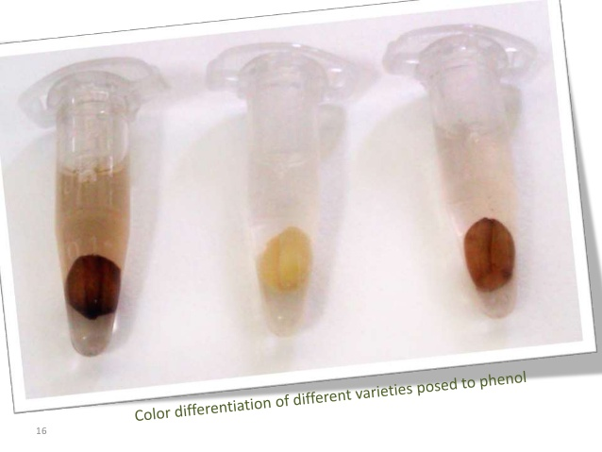

Slide 8
KOH BLEACH TEST
This test is mainly performed for estimating genetic purity for sorghum crop.
The presence or absence of a darkly pigmented testa can be used to differentiate sorghum cultivars. The dark pigment is tannic acid.
Steps-Prepare 1:5(w/v) solution of KOH and fresh bleach (5.25%NaOCl)
Put seeds in glass container and completely cover with KOH bleach solution.
Soak the seeds with brown seed coats for 10min and seeds with white coat for 5 min.
Gently rinse with tap water then air dried it.
Record number of dark and light seeds and they are examined for presence of dark pigmented tannic acid.

Slide 9
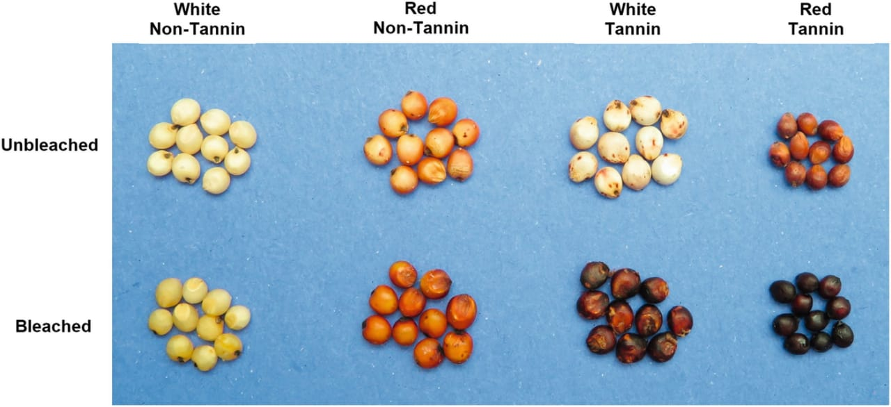

Slide 10
Sodium hydroxide test for wheat
A chemical test used to distinguish between red and white wheat in situations where it is difficult to distinguish between the two types (i.e. when seeds have been weather-damaged, treated, or are simply hard to distinguish by the naked eye).
Procedure- 100 seeds were soaked in three replications in 5%NaOH solution for one hour at room temperature.
Changes in the colour of seeds are observed after one hour .
Based on the colour intensity of seed Genotypes were classified into three groups which is dark brown, light brown and brown

Slide 11
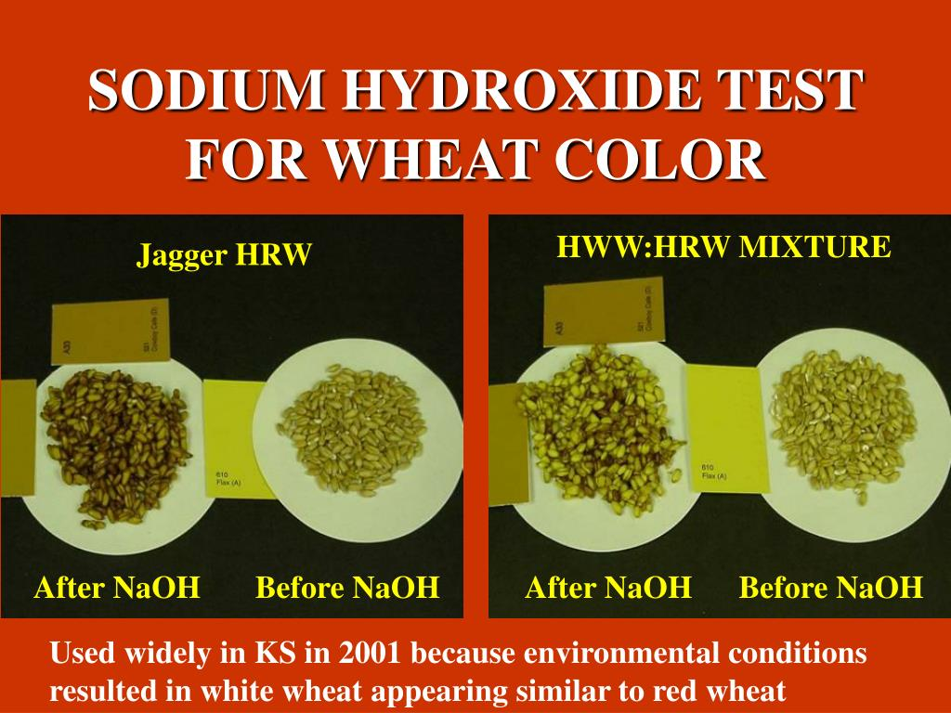

Slide 12
Peroxidase test for Soyabean
This test is approved for DUS testing of soyabean.
Presence or absence of peroxidase enzyme in seeds of crop from family leguminaceae is under genetic control therefore, variety may be verified bases on variation in the expression with the reaction of Hydrogen peroxide (Buttery and Buzzell,1968)
Procedure-Remove seed coats and place in separate test tubes
Add 0.5-1.0 ml of 0.5% guaicol & wait for 10 minutes
Then add 0.1 ml of 0.1% Hydrogen peroxide solution to each tube.
If the solution turns dark reddish brown - +ve reaction
If solution remain clear- --ve reaction

Slide 13
Modified Phenol test
Modified phenol test was followed as described by Banerjee and Chandra (1977).
Procedure- 50 seeds were taken and soaked in 0.4 % solution of Copper sulphate for adding Cupric ions and another set in 0.6 % Sodium carbonate for adding sodium ions for 4 hrs.
Then the seeds were placed in 2%phenol solution after removing from both the solutions overnight.
Based on the colour development in both the Tests groups were made and classified in to three groups dark brown, brown and reddish brown colour in Copper sulphate soaked seed while it is classified into three groups brown, dark brown and strong brown for Sodium carbonate soaked seeds.

Slide 14
Biochemical test | Crop
Fluorescent test | Oat
Phenol colour test | Wheat, rice and Sorghum
Sodium hydroxide test | Wheat
KOH bleach test | Sorghum
KOH test | Wild rice
Peroxidase activity test | Soyabean
Copper sulphate ammonia test | Melilotus alba
Seedling colour | Cereals, soyabean and pigeonpea
Reaction of seedling root to UV light | Rye
Ammonium fluorescent test | Festuca rubra and f. ovine
Amylose content in endosperm | Rice
Gelatinization temperature | Rice
Aroma in decorticated seed | Rice
Erucic acid content in the seeds | Rapeseed
Glucosinolate in seed | Rapeseed and mustard
Oil content | Rapeseed, mustard and sesame
HCl test | Faba bean and phaseolus vulgaris
Lugols test for lupine | Lupine

