Slide 1


1

Slide 2
Mapping:
It is the representation of information using special relationships
Mapping methods
Linkage mapping: measures recombination between markers and the unknown gene (linkage)
Association mapping: measure correlation between marker alleles and allele in a population (linkage disequilibrium)

Slide 3
Genome Wide Association Study
Aim to identify which regions (or SNPs) in the genome are associated with disease or certain phenotype.
Design:
  Identify population structure
  Select case subjects (those with disease)
  Select control subjects (healthy)
  Genotype a million SNPs for each subject
  Determine which SNP is associated.
Encoded data
Ranking SNPs

Slide 4
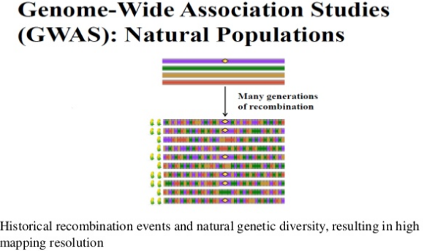

Slide 5
Why genome wide association mapping?
Genome wide association study
New tool
Resolve trait variation at sequence level
Identifying novel and superior allele
Fine mapping
Natural diversity
Identify multiple for QTL

Slide 6

Calculate the odd ratio
If 2 events are considered
odds of A and B is
OR = Odds(A)/Odds(B) = (A)/(~A) / (B)/(~B)
Symmetry in odds ratio
OR = Odds(D|G=1)/Odds(D|G=0) =
= Odds(G|D=1)/Odds(G|D=0).

Slide 7
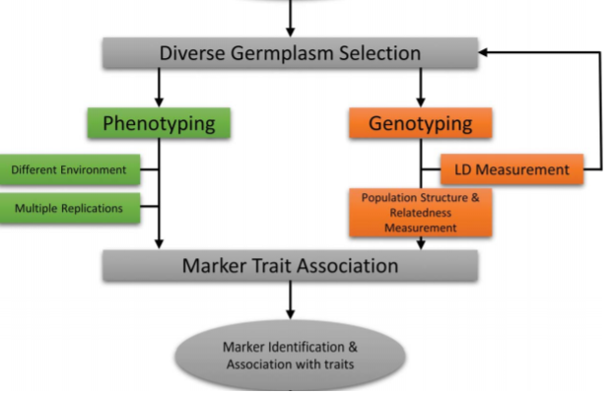
Genome Wide Association mapping
Nadeem et al.,2017

Slide 8
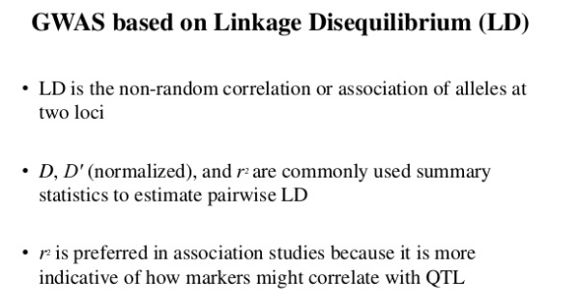

Slide 9
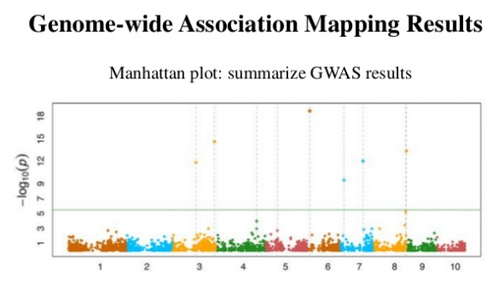
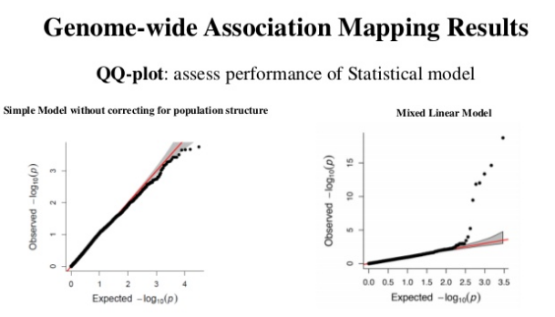

Slide 10
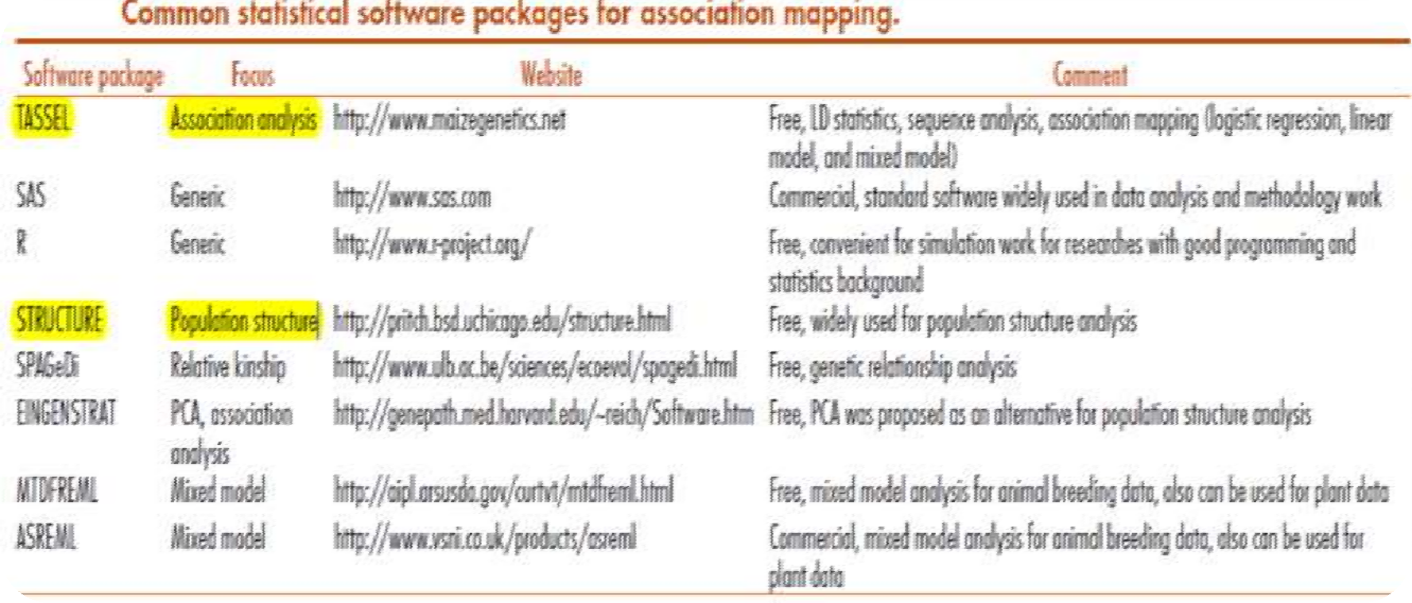
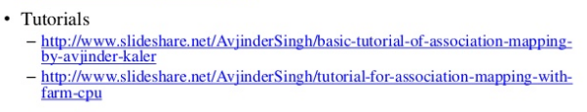
Software Used for calculation of GWAS
“Graphical overview of linkage disequilibrium” (GOLD) to depict the structure and pattern of LD.
“Trait Analysis by aSSociation, Evolution and Linkage” (TASSEL) and PowerMarker

Slide 11

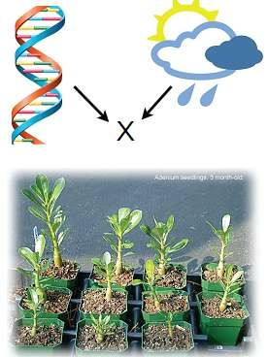
Basic biology
Understand the makeup of molecular pathways.
Dissect the genetic component of molecular variation.
Genotype environmental interaction.
Breeding
Mining of markers causal for phenotype.
to assist in breeding decisions.
Maximization of yield, pathogen resistance etc.

Slide 12
Advantages:
Biological pathway of the trait does not have to be known.
Discovering novel candidate genes.
Encourages collaborative consortia.
Rules out specific genetic association.
Provides more robust data.
Identifies the mutations explaining few percent of phenotypic variant.

Slide 13
Limitations:
Results need replication in independent samples in different population.
A large study of population is required, detects association not causation.
Identifies specific location not complete gene.
Focus on common variants and many associated variants are not causal.
Detect any variant(>5%) in a population.
Cost of each DNA sample and pooling them.
Unavailability of funding agencies.

Slide 14


