Slide 1
Seed germination, seed treatment and packing

Slide 2
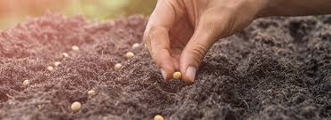
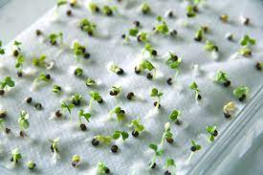
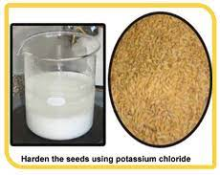
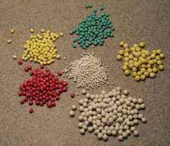
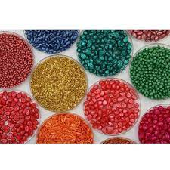
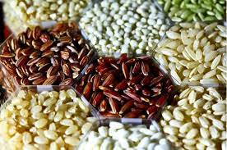
Seed germination
Seed in sand/ top of sand
Seed germination, seed treatment and packing
Seed treatment
Top of the paper/between the paper
Seed hardening
Seed pelleting
Seed priming
Seed infusion
Seed coating
Seed fortification
Seed hardening
Seed pelleting
Seed coating
Seed fortification

Slide 3
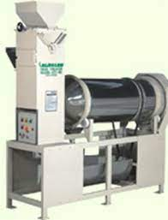
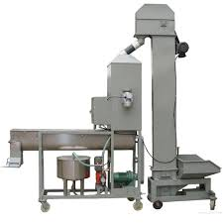
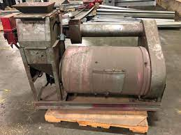
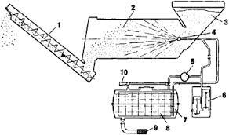
Seed treating equipments
Dust treater
Slurry Seed treater
Panogen Seed treater
Mist-O-Matic Seed treater
Slurry seed treater
Dust treater
Panogen seed treater
Mist-O-Matic Seed treater

Slide 4
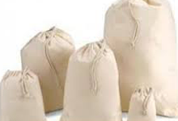
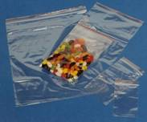
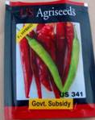
Seed packing
Demand forecasts
Moisture previous
Moisture impervious
Moisture resistant
Sale promotional activities
Seed marketing
Marketing structure
Moisture previous
Post- sales service
Arrangement for storage of seeds
Moisture impervious
Moisture resistant

