Slide 1
MEDIUM OF DIFFERENT STRUCTURES FOR SEED STORAGE

Slide 2
IMPROVED RURAL - LEVEL STORAGE STRUCTURES
1) Bitumen/ coal tar drum
2) Hapur bin/ Kothis
3) Udaipur bin
4) Stone bin
5) Bamboo bin
6) Baked clay bin
7) PKV bin
8) The "Pusa" bin.
9) Pusa Cubicle
10) Pusa Kothar
11) Metal bins

Slide 3
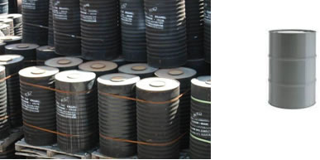
BITUMEN/ COAL TAR DRUM
1. Bitumen/ coal tar drum
An alternate model of metal bin, low cost with similar technical performance.
These bins are of 520 mm dia and 900 mm height. They can store 1.5 q of wheat and 1.2q of Bengal gram.
It was developed at the Central Institute of Agricultural Engineering (CIAE) and compares very well with other metal structures.

Slide 4
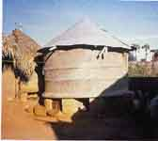
HAPUR BIN/ KOTHIS
2. Hapur bin/ Kothis
The Indian Grain Storage Institute, which is engaged in the development and dissemination of advances in storage technology to users, has developed metal bins for domestic storage of food grains
Circular bins of 2, 5, 7.2 and 200-100kg ( 10 q) capacities and have potential to meet requirements of even large farmers.

Slide 5
UDAIPUR BIN
3. Udaipur bin
These bins are made out of used coal tar drums.
These can stock 1.3 q of wheat and maize.
These bins can be made to have more airtight lid if the drum outlet end is given small cut to unload the bitumen.
These bins are suitable for storing of food grains for short duration and can be adopted by small farmers.

Slide 6
4. Stone bin
Stone bin (Chittore bin) is made of locally available 40 mm thick stone slabs with dimensions of 680 mm x 1200 mm with square cross-section.
The inlet and outlet are made of asbestos. This bin has a capacity of 3.8 q.
5. Bamboo bin
These bins are made of two walls of bamboo with polythene lining in between and have varying capacities.
These bins are suitable for short – duration storage and can be adopted by small and marginal farmers.

Slide 7
BAMBOO BIN
6. Baked clay bin
Baked clay bin of 7q capacity (paddy) is made of 16 burnt rings jointed by mud plaster; cement mortar and cow dung coatings one after another.
The ends of the rings are made in such a manner that they fit into each other.
These rings are kept on a polythene sheet covered and plastered platform of brick mansory and cement sand mortar.
An outlet is provided for the discharge of the grain.
The top is covered with a mild steel lid. Because of the low cost and good performance these are particularly useful for small and marginal farmers.
Do not store their produce for longer duration.

Slide 8
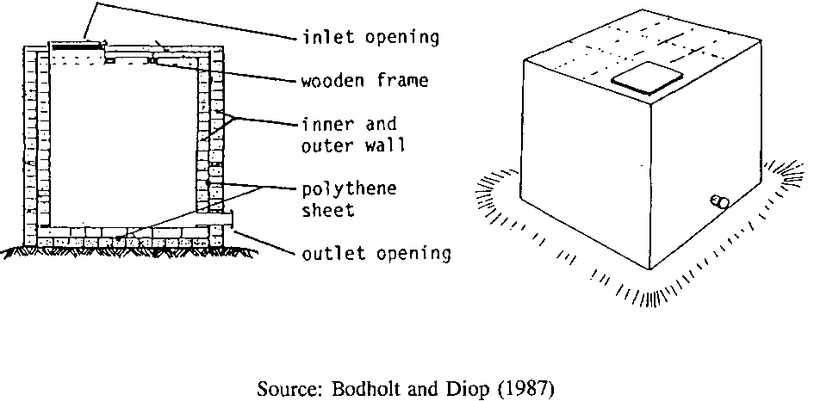
PUSA BIN (IARI)
8.The Pusa binP
Developed by the Indian Agricultural Research Institute (I.A.R.I.); they are rectangular in shape and have a capacity of 1 to 3 tonnes.
The "Pusa" bin has been widely adopted in India, and has been demonstrated in some African countries. It gives good results when loaded with well dried grain
.

Slide 9
This is a room like structure ( 3.95 x 3.15 x 2.60 m), a modification of Pusa bin to provide large storage capacity of 24 tonnes on a platform of 3.73 m x 2.93 m x 0.07 m is made with unburnt bricks on a concrete floor (except 22 cm of outer sides with burnt bricks).
A polyethylene sheet is placed on this platform and another platform of similar dimension is made with unburnt bricks.
The 22 cm thick inner walls are constructed upto 2.6 m height. A wooden frame of 1.89m x 1.06 m for door is fixed in the front side of 3.95 m wall.
The roof can be made by wooden beam placed at 15 cm distance and covered with unburnt bricks.

Slide 10
PUSA KOTHAR
10. Pusa Kothar
Presently storage is practiced in small compartments of a room (5.3 m x 2 m x 4 m) called kothar.
The roof is constructed with the help of wooden poles and mud slabs, leaving near the front wall three filling holes each of 0.5 m x 0.5 m size.
Two out lets of G.I. sheets of 15 cm dia. and 30 cm length are fitted at the floor wall on the front side.

Slide 11
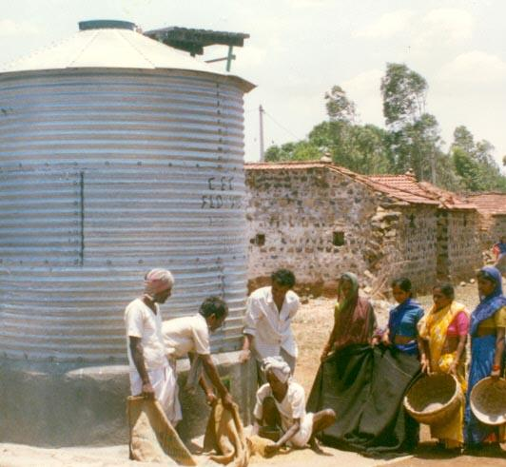
11. Metal bins
Bins made of steel, Aluminium R.C.C are used for storage of grains outside the house.
These bins are fire and moisture proof.
The bins have long durability and produced on commercial scale.
The capacity ranges from 1 to 10 tonnes. Silos are huge bins made with steel/ aluminium or concrete.
Usually steel and aluminium bins are circular in shape.
The capacity of silo ranges from 500 to 4000 tonnes. A silo has facilities for loading and unloading grains.

Slide 12
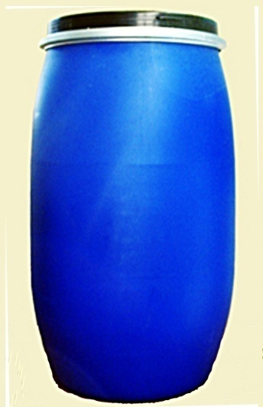
ALTERNATIVE STORAGE TECHNOLOGY AT FARM/VILLAGE LEVEL
Metal or Plastic Drums
Drums are often used as storage containers in the house and serve notably for the storage of cereal seeds and pulses.
Plastic drums are used intact or after having the upper part cut off to facilitate loading and unloading. Otherwise, plastic lends itself poorly to adaptation because it is relatively weak: at most, a lockable outlet can be added. If the lid is tight fitting and the drum is completely filled with grain, any insects present will deplete the oxygen in the drum and die.

Slide 13
Metal drums can be adapted for domestic grain storage in a similar way. A removable lid permits easy loading; but it is also possible to weld half of the lid to the rim of the drum, and provide a riveted hinge on the remaining half of the lid so that it alone can be opened.
Fitted with a padlock, such a modified drum is more secure. To make a store of greater capacity, two metal drums can be welded together end to end and fitted out as described above. Well modified and/or fitted with gaskets, metal drums can also be made airtight.

Slide 14
Inaccessible to rodents, efficient against insects, sealed against entry of water, drums make excellent grain containers. However, they should be protected from direct sunshine and other sources of heat to avoid condensation by being located in shaded and well ventilated places.

Slide 15
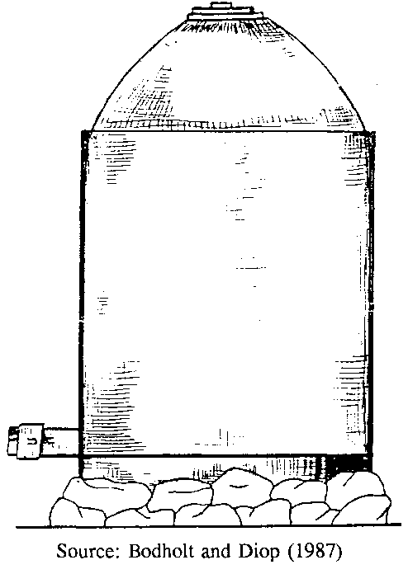
Alternative Solid Wall Bins
(i) The "Burkino" silo
Based on a traditional dome shaped type of bin, this silo is constructed with stabilised earth bricks. Various models and capacities are available.
The base is made of stabilised earth resting on the ground or on concrete pillars. The dome-shaped roof is also made of stabilised earth bricks, using special wooden formers. The technique of making a dome-shaped roof is not easy to master, and usually has to be done by skilled masons. A variant has been developed with the roof resting upon a wooden frame, which can be erected by unskilled farmers

Slide 16
(ii) The "USAID" silo
This silo is based on the "Burkino" silo and examples have been erected in Nigeria; holding one tonne of maize grain, the silo rests on stone or concrete pillars supporting a reinforced concrete slab 1.5 metres in diameter. The walls are made of stabilised earth bricks and are plastered inside and out with cement reinforced with chicken wire mesh. The top is dome shaped with a central round opening, and covered with a cone-shaped earthen cap. This is plastered with cement, and rests on bamboos or on a metallic drum base. An outlet door, consisting of a 15 x 30 cm plate 1.5 mm thick which is smeared with grease for easy sliding, is let into the base concrete slab.

Slide 17
(iii) Concrete/cement silos
Such silos are 'cement rich', and often include other materials which normally have to be imported into developing countries. Therefore they are potentially (and usually) expensive structures, which can be seriously considered only when improvements to traditional storage bins cannot be practically applied. Their redeeming feature, given that they are properly constructed and used, is that they are robust and should give many years of satisfactory service.

Slide 18
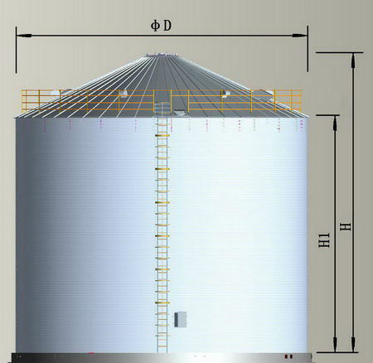
(v) Metal Silos
Economically valid for storing large quantities (over 25 tonnes), metal silos are often regarded as too costly for small scale storage. Nevertheless certain projects have been successful in introducing small metal silos, of 0.4 to 10 tonne capacity, at farm/village level in developing countries.

Slide 19
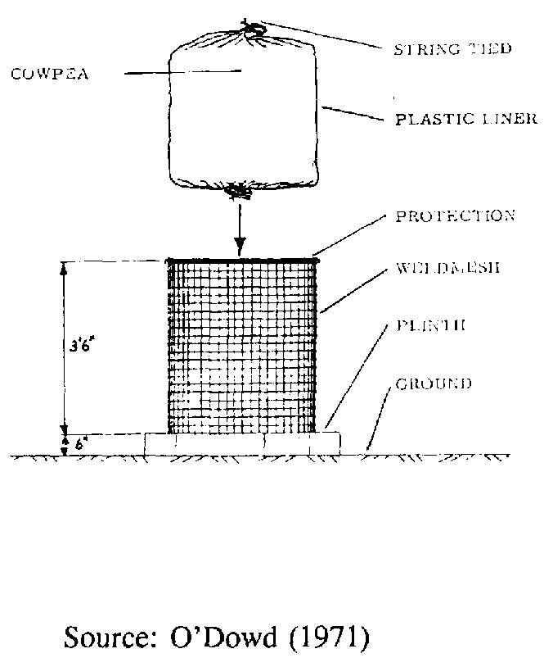
(vi) Synthetic Silos
Various attempts have been made to develop small scale storage bins, using synthetic materials such as butyl rubber (O'Dowd, 1971) and high density polyethylene (CFTRI, 1975).
However, such bins proved to be either too expensive or prone to damage by pests. Also the management level required by such storage facilities is probably too high for most rural situations.

Slide 20
Conclusion
Traditional storage structures need to be improved scientifically.
Intensive research is required to evolve modern storage structures suitable to different agro-climatic conditions of India.
State and central government agencies should possess temporary storage structures to handle bulk grains without any loss and damage.

Slide 21
Thank you

