Slide 1
MILITARY Explosives
Notes:
Delete this slide when you finish preparing the other slides.

Slide 2
Explosive
A chemical explosive is a compound or mixture which, upon the application of heat or shock, decomposes or rearranges with extreme rapidity, yielding much gas and heat.
For a chemical to be an explosive, it must exhibit all of the following:
Formation of gases : a burning combustible forms gases
Evolution of heat : Rapid generation and liberation of heat in large quantities accompanies every explosive chemical reaction that causes the gaseous products of reaction to expand and generate high pressures.
Rapidity of reaction : Unless the reaction occurs rapidly, the thermally expanded gases will be dissipated in the med-ium, and there will be no explosion.
Initiation of reaction : must be capable of being initiated by the application of shock or heat to a small portion of the mass of the explosive material. A material in which the first three factors exist cannot be accepted as an explosive unless the reaction can be made to occur when desired.

Slide 3
Sensitivity : ease with which the explosive can be detonated by a shock or blow.
Deflagration : Explosion maybe propagated relatively slowly by the conduction or radiation of heat from burnt part to the unburnt part. E.g. propellants
Detonation : Reaction is propagated by a pressure wave action.
Pressure wave : a wave that travels at high speed through the explosive substance, compressing and heating each layer of the substance .
homemade explosives (HMEs) as explosives produced from precursor chemicals either physically blended or combined in a chemical reaction.
precursor chemicals as chemicals that can be used, through blending or chemical reaction, to produce HMEs.
improvised explosive device (IED) as “A device placed or fabricated in an improvised manner incorporating destructive, lethal, noxious, pyrotechnic or incendiary chemicals and designed to destroy, incapacitate, harass or distract. It may incorporate military stores, but is normally devised from non-military components.”

Slide 4
Categories of explosives
On the basis of rate of decomposition
Low Explosives : Smokeless powders, pyrotechniques
High Explosive
Primary : Extremely sensitive to shock, friction and heat
Secondary : Relatively insensitive to shock, friction and heat
Notes:
Low explosives burn rapidly (or deflagrate). High explosives ordinarily deton-ate. There is no sharp line of demarcation between low and high explosives. The chemical decomposition of an explosive may take years, days, hours, or a fraction of a second. The slower forms of decomposition take place in storage and are of interest only from a stability standpoint. Of more in-terest are the two rapid forms of decomposition, burning and detonation. The term "detonation" is used to describe an explosive phenomenon of almost instantaneous decomposition. The properties of the explosive indicate the class into which it falls. In some cases explosives may be made to fall into either class by the conditions under which they are initiated. For convenience, low and high explosives may be differentiated in the following manner.

Slide 5
Military Explosives
Military explosives are manufactured for specific purposes.
Commonly used military energetic compounds include the explosives
2,4,6-trinitrotoluene (TNT),
hexahydro-1,3,5-trinitro-1,3,5-triazine (RDX),
octahydro-1,3,5,7-tetranitro-1,3,5,7-tetrazocine (HMX)
Notes:
https://fas.org/man/dod-101/navy/docs/fun/part12.htm

Slide 6
The requirements of a military explosive are stringent, and very few explosives display all of the characteristics necessary to make them acceptable for military standardization. Some of the more important characteristics are :
Availability and Cost.
Sensitivity
Stability
Power
Brisance
Density
Volatility
Hygroscopicity
Toxicity

Slide 7
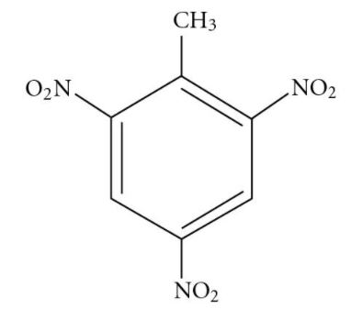
TNT
TNT (2,4,5-trinitrotoluene) - C₆H₂(NO₂)₃CH₃
Was dominant military explosive during World War I
Was conserved during World War II by mixing it with ammonium nitrate.
Characteristics of TNT:
Has a low melting point
not sensitive to shock
Will not spontaneously explode
Can include a detonator if the goal is to produce a pressure wave
Can quickly change from a solid to hot, expanding gas

Slide 8
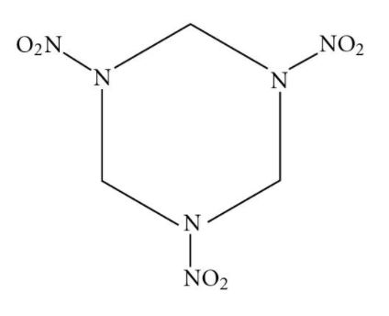
RDX
RDX (cyclotrimethylenenitramine) /Research Department Explosive/ Royal Demolition Explosive.
Also called cyclonite, hexogen and T4.
Remains stable in storage and at room temperature
Most powerful and brisant of the military high explosives
Reaches maximum pressure so rapidly that a shock wave forms
Must be used in conjunction with a detonator to produce an explosion.

Slide 9
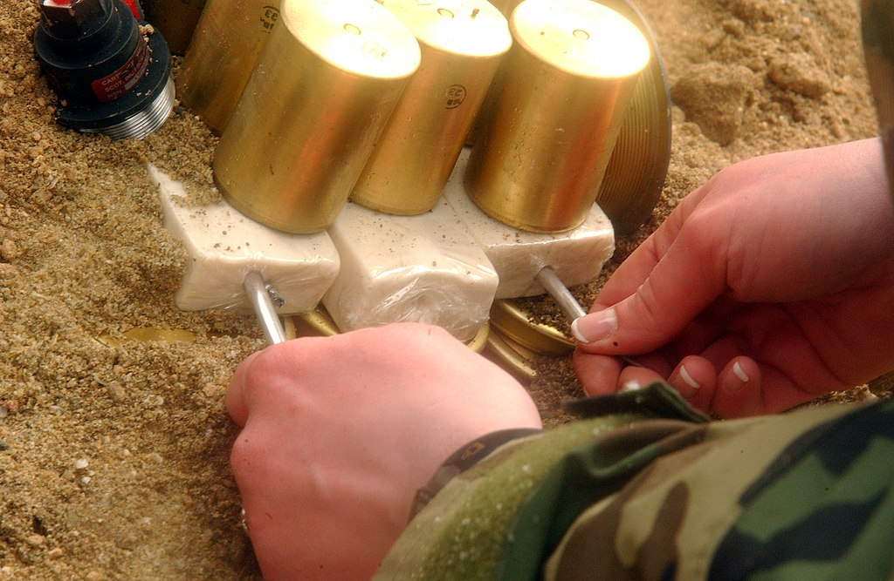
C-4
Composition C-4 is a common variety of the plastic explosive. A popular explosive choice among terrorists
Uses RDX as explosive agent.
Military plastic explosive that is about 90% RDX; remainder is a plastic binder material and oil (Bound by a mixture of 5.3% dioctyl sebacate (DOS) or dioctyl adipate (DOA) as the plasticizer (to increase the plasticity of the explosive), thickened with 2.1% polyisobutylene (PIB, a synthetic rubber) as the binder, and 1.6% of a mineral oil often called process oil.)

Slide 10
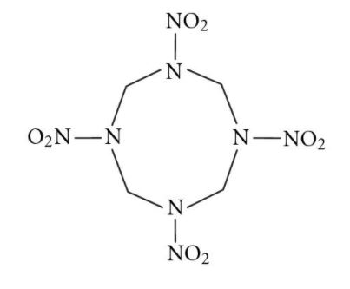
HMX
High-melting-point explosive.
Also known as octogen.
About 30% more powerful than TNT.
Powerful, yet shock-sensitive,
nitroamine-based high explosive
Chemically related to RDX

Slide 11
References
https://slideplayer.com/slide/10948770/
Wikipedia

