Slide 1
Causes of embryo abortion
In wide crosses (Inter specific and integeneric crosses), the hybrids do not develop due to pre or post fertilization barriers. Pre-fertilization barriers include all factors which hinder effective fertilization such as:
1) Differences in flowering time of two parents.
2) Lack of stigma receptivity and pollen viability.
3) Inability of pollen to germinate
4) Failure of pollen tube to reach the ovule due to slow growth
5) Cross incompatability due to any other reason

Slide 2
Post-fertilization barriers hinder (or) retard the development of zygote after fertilization which is due to
1) Degeneration of endosperm leading to starvation and abortion of hybrid embryo
2) Embryo, endosperm incompatability, where the endosperm produces toxic substances that kill embryo
3) Malfunctioning of endosperm due to abnormal behaviour of antipodal cells, nucellues, integuments around the embryo.
The problem of post fertilization barriers can be resolved by excising and culturing of young hybrid embryos (embryo culture/Embryo rescue) while some of the pre-fertilization barriers may be overcome by invitro pollination and in vitro fertilization.

Slide 3
Embryo Rescue: “Embryo rescue” refers to a number of in vitro techniques whose purpose is to promote the development of an immature or weak embryo into a viable plant.
Embryo rescue has been widely used for producing plants from hybridizations in which failure of endosperm to properly develop causes embryo abortion.
In embryo rescue procedures, the artificial nutrient medium serves as a substitute for the endosperm, thereby allowing the embryo to continue its development.
Embryo rescue techniques also have been utilized to obtain progeny from intraspecific hybridizations that do not normally produce viable seed.

Slide 4
In the autotrophic phase, which usually begins in the late heart-shaped embryo stage. At this time the embryo is capable of synthesizing substances required for its growth from salts and sugar.
Germination will usually occur on a simple inorganic medium, supplemented with 58 to 88 mM(2–3%) sucrose.
In general, low concentrations of auxins have promoted normal growth, gibberellic acid has caused embryo enlargement, and cytokinins have inhibited growth. In addition to supplying vitamins and amino acids to the medium, natural extracts often also supply growth regulators.
Media requirements differ depending on stage of embryo development. For cultures initiated using very young embryos, more than one media formulation may be needed.

Slide 5
Factors involved in embryo rescue
Media
Murashige and Skoog (MS) (Murashige and Skoog, 1962) and Gamborg’s B-5 media are the most commonly used basal media for embryo rescue studies.
Types and concentrations of media supplements required depend greatly on the stage of development of the embryo.
Embryos initiated at heterotropic phase stage(proembryo) require a complex medium. Amino acids, particularly glutamine and aspargine, are often added to the medium. Various vitamins may also be included. Natural extracts, such as coconut milk and casein hydrolysate, have sometimes been used instead of specific amino acids.
Sucrose often serves both as a carbon source and osmoticum [232 to 352 mM (8–12%) ].

Slide 6
Temperature and light
The growth requirements of embryos often mimic those of their parents, with embryos of cool-season crops requiring lower temperatures than those of warm-season crops.
Cultures are usually initially cultured in the dark to prevent precocious germination, but are moved to a lighted environment to allow chlorophyll development after 1 to 2 weeks in the dark.
Time of culture
Cultures are often initiated at various intervals following pollination to maximize chances of recovering viable plants. Since an interaction between media and time of culture is expected, it is important to test a range of media ranging from complex with high sucrose to simple with low sucrose at the various culture times.

Slide 7
General embryo rescue procedures
Embryo culture
It is the most commonly used embryo rescue procedure is embryo culture, in which embryos are excised and placed directly onto culture medium.
Fruit from controlled pollination of greenhouse- or field grown plants is collected prior to the time at which embryo abortion is thought to occur. Since embryos are located in a sterile environment, disinfestation of the embryo itself is not required. In some cases, the entire ovary is surface-sterilized.
The embryo will be placed directly into culture after its excision so that it does not become dry. For heart-shaped and younger embryos, the embryo should be excised with the suspensor intact.

Slide 8
Ovule culture
Embryos are difficult to excise when very young or from small-seeded species. To prevent damaging embryos during the excision process, they are sometimes cultured while still inside the ovule. This technique is referred to as ovule culture or in ovolo embryo culture.
As with embryo culture, ovaries are collected prior to the time at which embryo abortion is thought to occur. The ovary is surface sterilized and the ovules removed and placed into culture.
This step ranges from extremely easy to accomplish, for large-seeded species in which only a single ovule is present, to time-consuming and difficult, for small-seeded polyovulate species.

Slide 9
Ovary culture
In ovary or pod culture, the entire ovary is placed into culture. Ovaries are collected and any remaining flower parts removed. Disinfestation protocols must remove surface contaminants without damaging the ovary. The ovary is placed into culture so that the cut end of the pedicel is in the medium. At the end of the experiment, seed are removed from the fruit that develop in culture.

Slide 10
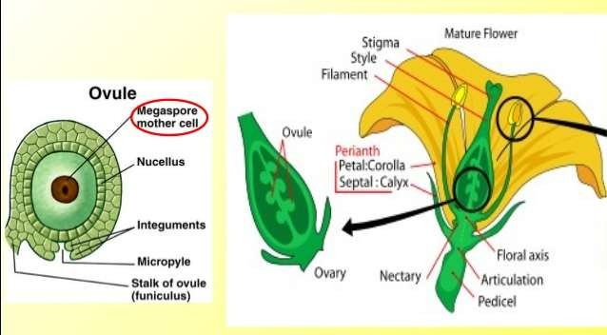

Slide 11
Application of Embryo Rescue
Overcoming dormancy- in some fruit plants embryos require period of after ripening before germination. for example Prunus, Taxus etc.
Breeding cycle shortening- seeds witch takes 10-20 days for maturation places on in vitro culture to overcome maturation time.
Inter specific hybrids recovery- some time distant crossed may fail cause of inability pollen to germinate, failure of pollen tube to grow, degeneration of endo-sperm, all causes fail to embryo germination so this problem over come by embryo rescue.

