Slide 1

QTL mapping: Definition and case studies

Slide 2
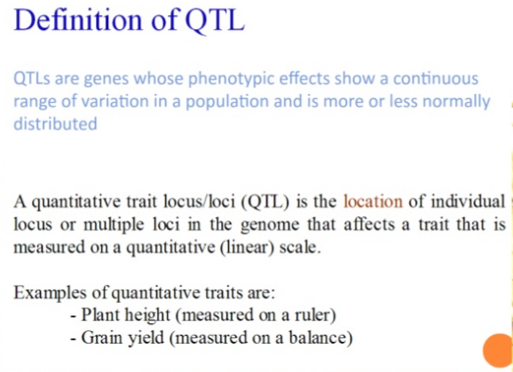

Slide 3
QTL Mapping:
The process of constructing linkage maps and conducting QTL analysis i.e. to identify genomic regions associated with traits is known as QTL mapping.
Identification and location of polygenes or QTL by use of DNA markers.
It involves testing DNA markers throughout the genome for the likelihood that they are associated with a QTL.
Principles of QTL mapping
Genes and markers segregate via chromosome recombination during meiosis, thus allowing their analysis in the progeny.
The detection of association between phenotype and genotype of markers.
QTL analysis depends on the linkage disequilibrium.
QTL analysis is usually undertaken in segregating mapping populations.

Slide 4
Prerequisites for QTL mapping
Availability of a good linkage map (this can be done at the same time the QTL mapping)
A segregating population derived from parents that differ for the trait(s) of interest, and which allow for replication of each segregant, so that phenotype can be measured with precision (such as RILs or DHs)
A good assay for the trait(s) of interest
Software available for analyses
Molecular Markers
Sophisticated Laboratory

Slide 5
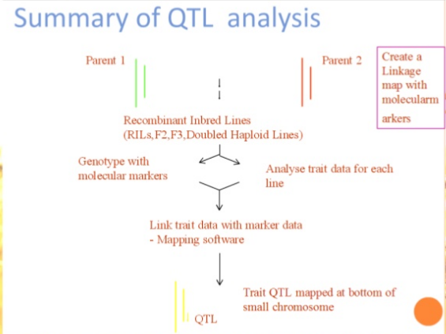

Slide 6
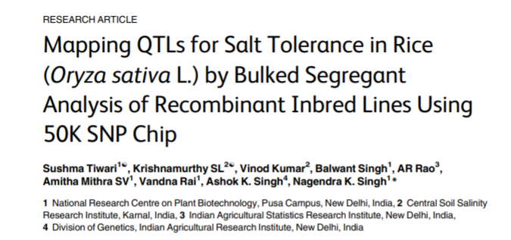

Slide 7
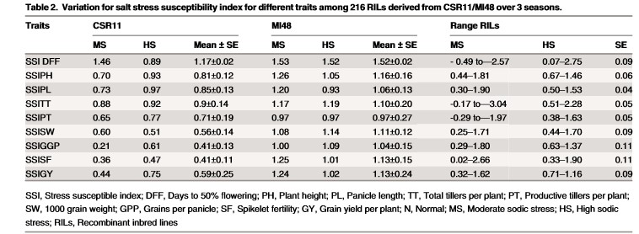
SALT STESS SUSCEPTIBILITY INDEX

Slide 8
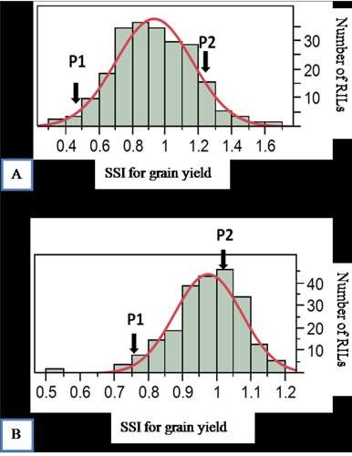
MODERATE SODICITY
HIGH SODICITY

Slide 9
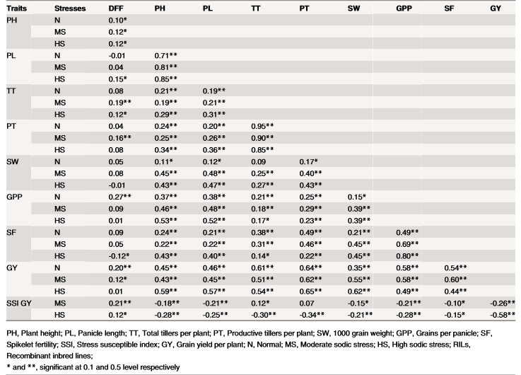
Correlation coefficients of yield and yield component traits with SSI for grain yield under normal, moderate and high sodicity regimes in CSR11/MI48 RILs.

Slide 10
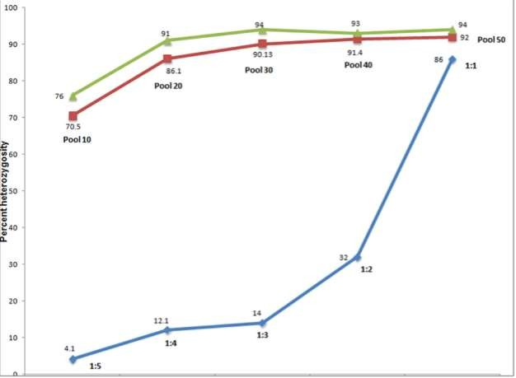
Analysis of heterogeneous loci in different RIL pool sizes and mixture of parental DNA samples using 50K SNP chip
Genomic DNA from 10 to 50 individual RILs of CSR11/MI48 mapping population were pooled in equal amounts, with higher pools including all the RILs of lower pools for the analysis of allele heterogeneity (Redline). Computational expectations on Bootstrap analysis of the pools of 10 to 50 lines, showing successive increase in heterogeneity upto 94% (Greenline).
Observed heterogeneity with mixing of genomic DNA from the two parental lines in the
proportions of 1:5,1:4,1:3,1:2 and 1:1 (Blueline).

Slide 11
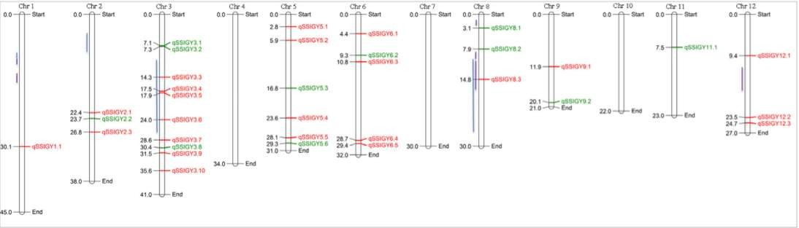
QTL positions identified in CSR27/MI48 population by BSA using 50k SNP chip
Physical map position of QTLs with green color showing tolerant allele coming from tolerant parent CSR27 (11loci), red color showing tolerant allele coming from sensitive parent MI48 (23loci). Blue and violet bars represent earlier identified QTLs by (Ammar et al and Panditeta) ,respectively

Slide 12
Outcome:
Study out of 34 QTLs of CSR27/MI48 population five QTLs were reported earlier in the and found 29 novel QTL regions on rice chromosomes 1,2,3,5,6,9,11 and 12 due to dense SNP map of polymorphic locus covering all regions of the genome.
Earlier highest 41 QTLs have been reported by Ghomi et al, on all the 12 rice chromosomes for salinity tolerance at seedling stage in rice.
There are several reports on QTL mapping for salt stress by SSR genotyping on whole population in rice but no one has done QTL mapping by BSA approach for salt stress in rice.It gives clear picture that QTL mapping effective in identification of tolerant alleles.

Slide 13


