Slide 1


Concepts of Bio-fertilizers

Slide 2

Concept of biofertilizer
INTRODUCTION
Biofertilizer technology is not a new concept.
It involves inoculation of beneficial microorganisms that help nutrient acquisition by plants through fixation of nitrogen, solubilization and mobilization of other nutrients.
Multifarious advantages of biofertilizers leads to its wide applicability in sustainable agriculture.

Slide 3
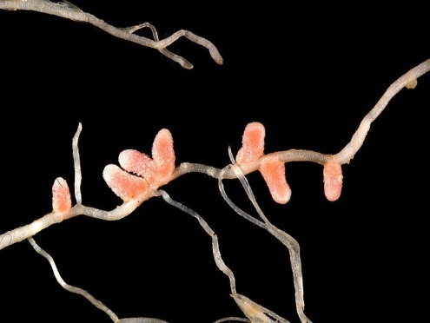
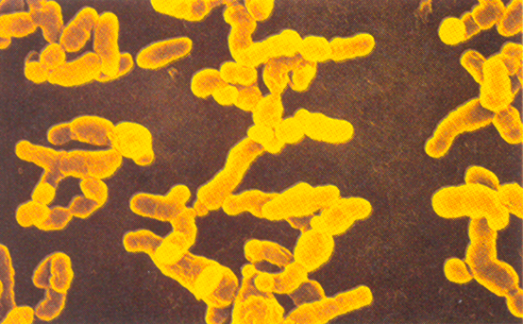
Concept of biofertilizer
Biofertilizer concept goes back as early as 300 BC when our ancestors realized the importance of legume crops bearing nodules.
The perspective of biofertilizer came into existence through discovery of many organisms capable of nitrogen fixation, P-solubilization, P. mobilization, potash solubilization and micronutrient transformation in the soil.
Legume root nodules
The role of biofertilizers assumes special significance due to increased cost of chemical fertilizers and their ill effects on soil health
Rhizobium bacteria
inside nodule

Slide 4
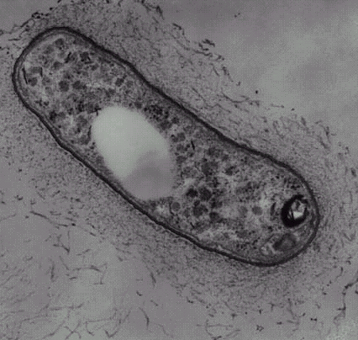



Concept of biofertilizer
Biofertilizers
The term biofertilizer refers to preparation containing live microbes which helps in enhancing the soil fertility either by fixing atmospheric nitrogen, solubilization of phosphorus or decomposing organic wastes or by augmenting plant growth by producing growth hormones with their biological activities.
Rhizobium Bacteria
Bacteria in root surface
Bacteria in root surface
Legume inoculation

Slide 5
Concept of biofertilizer
Advantages of Biofertilizers
Renewable source of nutrients
Sustain soil health
Supplement chemical fertilizers.
Replace 25-30% chemical fertilizers
Increase the grain yields by 10-40%.
Decompose plant residues, and stabilize C:N ratio of soil
Improve texture, structure and water holding capacity of soil
No adverse effect on plant growth and soil fertility.
Stimulates plant growth by secreting growth hormones.
Secrete fungistatic and antibiotic like substances
Solubilize and mobilize nutrients
Eco-friendly, non-pollutants and cost effective method

Slide 6
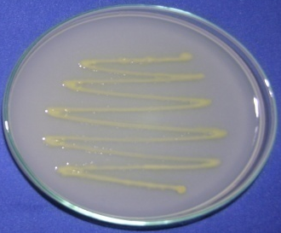
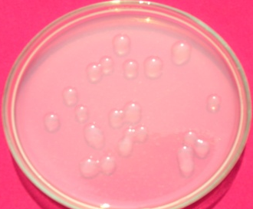
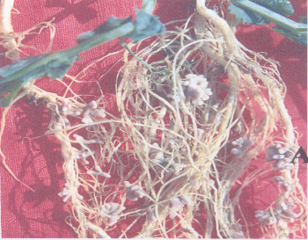
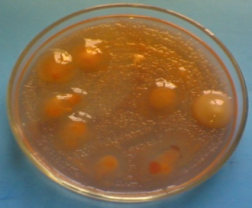
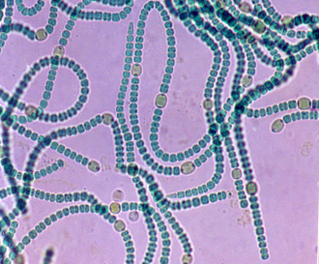
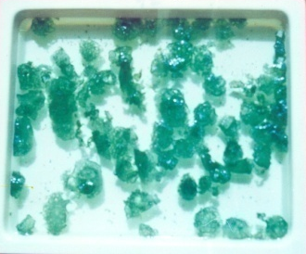
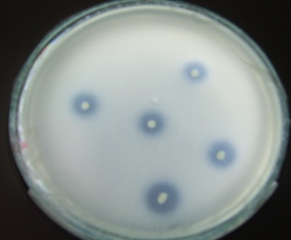
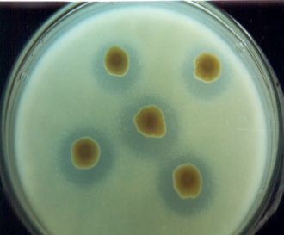
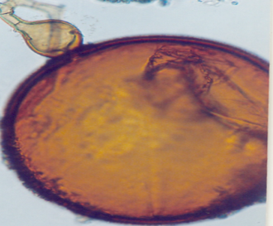
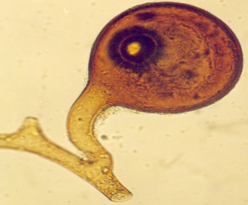
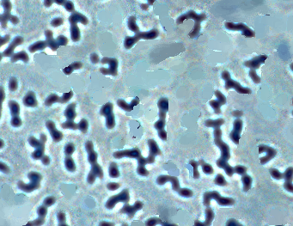
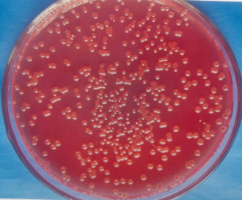
Concept of biofertilizer
BIOFERTILIZER ORGANISMS
RHIZOBIUM
AZOTOBACTER
PSB
BLUE GREEN ALGAE
AZOSPIRILLUM
VA-MYCORRHIZA

Slide 7
LET US SUM UP
Concept of biofertilizer
Application of biofertilizer is not a new concept.
Importance of legume crop bearing nodules has significant role for improving soil fertility.
Soil harbours many beneficial microorganisms that help in nitrogen fixation, phosphate and other nutrient transformation in the soil for better crop growth.

Slide 8
Concept of biofertilizer
LET US SUM UP
The term biofertilizer refers to preparation containing live microorganisms, which helps in enhancing the soil fertility either by fixing atmospheric nitrogen, solubilization / mineralization of phosphorus and potassium or decomposing organic wastes or by producing plant growth substances.
The advantages of biofertilizers are many fold, sustain soil health, supplement chemical fertilizers, increase grain yield, secrete plant growth substances, solubilize and mobilize nutrients etc.

Slide 9

Thank you…

