Slide 1
Air distribution system and types of seed dryers for heated air-drying

Slide 2
Types of Air distribution systems for seed Drying
There are three main types of air distribution systems
Main and lateral duct system
Single central perforated duct
Perforated false floor system
Main and lateral duct air distribution system: In this system the main duct can be located in the center of the bin, or it can be located at one side of the bin
When the central duct is located outside the bin under the floor it can also serve to empty the bin
When the main duct is located on the side of the bin it can be located inside the bin or on outer wall of the bin
Single central perforated duct system: For this air distribution system there must be equal thickness of seed not exceeding 6 feet, around the duct, which is made of perforated metal
For drying the air should be forced upwards through the seed. The sidewalls of the bin must be perforated so that air can flow laterally through the seed
This type of air distribution system is more commonly used for drying maize cobs

Slide 3
Perforated false floor air distribution system: This is most commonly used air distribution system for heated air-drying. In this method the air is introduced under the perforated false floor, the air passes up through the perforations and through the seed
The false floor can be made of hardware cloth, screen or perforated metal sheet. The metal false floors are more durable and convenient to use. It is recommended that this type of flooring must be supported on concrete blocks placed at every 3 to 4 ft. interval
It is followed the floor will support load upto 500 lbs/square ft. The channels and openings for the flow of air must be carefully designed too carry the air stream satisfactorily
When perforated metal 110 flooring is used the total area of all the openings in the steel sheet should not be less than 8-10 % of the storage floor area
This is important when the drying floor does not extend completely to the sidewalls
Multiple Storage Bins : These are used to dry several types of seeds simultaneously using the same drying fan or fans. In this method sliding air gates are there for controlling the flow of air to the respective bins
Multiple bin arrangements are advantageous when 2 or more kind of seeds are grown

Slide 4
Types of seed dryers for heated air-drying
Layer in Bin Dryer: In this method the bin is filled to a specific depth depending upon seed moisture, the drying unit and bin sizes. After drying this seed to safe moisture level for storage, next level is added. The diameter of the bin will range from 21 to 40 ft. and requires 5 to 20 HP motors. It is most efficient but slow drying method. The seed is uniformly dried between the top and bottom of the bin
Batch in bin dryer: In this type the high moisture seed is loaded in the drying bin. The seed is dried to safe moisture level, cooled and removed to storage bin. The drying equipment used is similar to that of layer drying but requires high capacity of heater and fan. Seed depths are typically 2.5 to 4.0 ft. the deeper the seed depth lower is airflow and slow is the drying process

Slide 5
Batch Dryer: These are bins with inner air chamber (plenum) surrounded by two parallel perforated steel walls to contain a desired thickness of seed. The fan heater unit is connected to one end or side of the plenum as heated air for drying and natural air for cooling can be forced through the seed. Batch dryers are generally rectangular or cylindrical. Fan power ranges from 3 to 40 HP. The number of batches per day may be 8-10 for small dryers and 2-3 for large units.
Continuous Dryers: In this method there is a continuous flow of seed through heating and cooling sections. The flow of the seed can be regulate d. Heated air is forced through the upper 2/3 or ¾ of the seed column. The dried seed is removed for storage continuously.

Slide 6
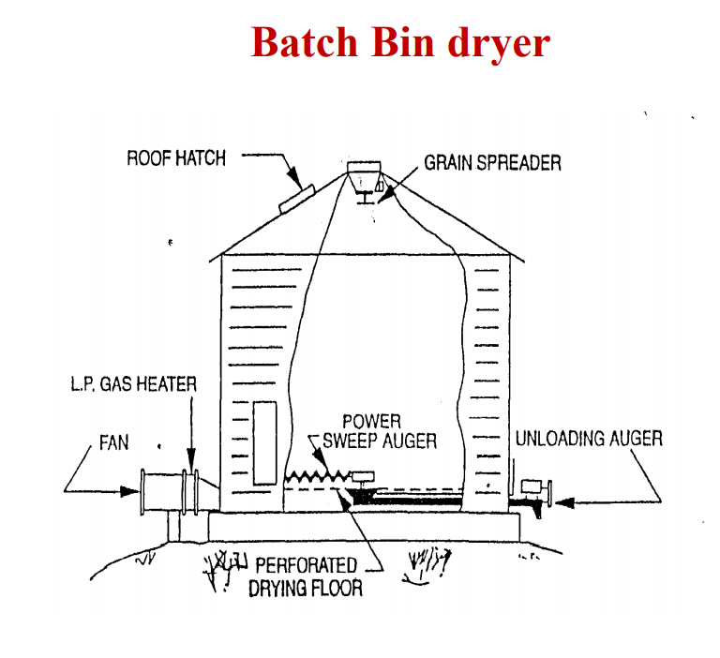
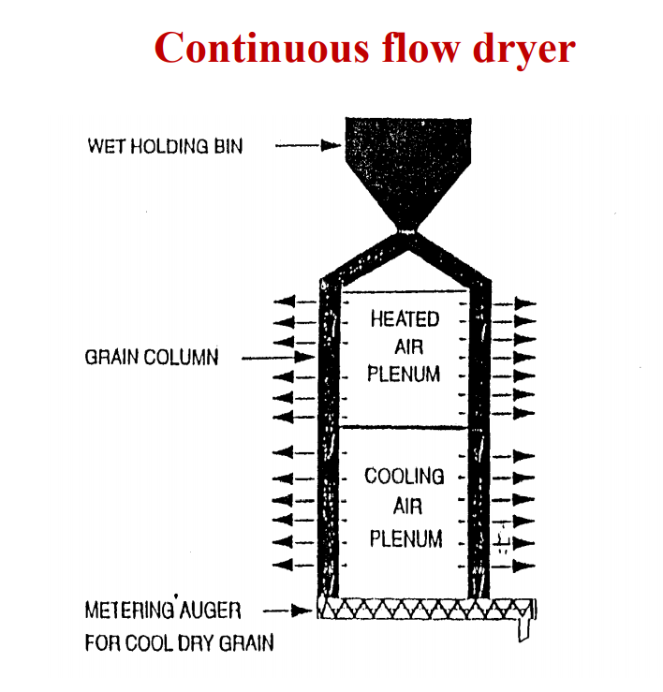

Slide 7
Procedure for heated air drying in bins
Put the seed into the bin to the recommended depth and there should be uniform distribution of trash and broken seeds.
Operate the dryer at recommended temperature for that seed using a thermostat
When drying is completed, continue blowing air through seed without heat to bring the seed temperature down to air temperature or to 50o F if air temperature is lower
This may require around 30 minutes to 2 hours depending on the quantity being dried and the air temperature
The seed must be dried to safe moisture levels as given below. Wheat, sorghum and rice to 12 % Oats, barley and corn to 13 % Soybeans to 11%

Slide 8
Wagon Drying : It is a special type of batch drying with heated air. The seed is directly loaded from a combine into a wagon that is specially built for drying. The wagon is drawn to the dryer and connected to the canvass distribution duct. Three to four wagons can be dried at a time.
The heated air is forced through the perforations of the wagon floor for drying the seed. After drying is over it is disconnected from the heating system and the seed is cooled with a small fan of half to three and half HP as required.
After cooling the wagons are taken to storage bins. Advantages of wagon drying are
1. Drying is continuous
2. It is versatile
3. Low initial cost
4. Saves on seed handling
5. Can be used for other purpose

Slide 9
Bag Drying: The drying is carried out in bags when many varieties are to be handled simultaneously or when seed lots are small in size and when the seed is received from the field in jute bags. The drying depth is one sack deep in a typical design of 25-40 cu.m. of air per minute per cu.m. of seed at a static pressure of 3 cm or even less
Box Drying : It is a modified bag drier. The identity of small seed lots can be maintained despite bulk handling. The boxes are made locally with perforated bottoms. Hot air is forced through the bottoms. After drying the boxes are shifted to storage area

Slide 10
Management of seed drying operations
Dry the seed soon after it is received. If there is any delay aerate the bin by fitting with a fan. Aeration prevents heating of the seed.
Care may be taken not to accumulate trash at one place. This problem is more when the seed is discharged through conveyor. Using a spreader can solve it. Small trash has high resistance to sir flow.
Observe the temperature in different drying zones. When the temperature of the top layer is equal to incoming air, drying of the entire bin is completed. Moisture content should be tested at random through out the bin to ensure that no wet spots are present.
If germination percentage falls 1-2 % during drying check for the following:
1. Excessive holding time before drying commences 2. Insufficient air flow 3. Excessive static pressure 4. High relative humidity of drying air 5. Drying air temperature may be more than 43oC 6. Excessive seed depth 7. Uneven air flow through the seeds

Slide 11
Storage structures for Seed drying
Building requirements for a seed drying system depend upon the size of operation, the number of different seeds to be dried, the level of mechanization desired and future expansion
These may be made of steel, wood, plywood or concrete and they may be cylindrical or rectangular in shape
Features of storage bins used for forced air drying
Vertical load on the foundation, which should be strong enough to hold the seed lots
The roof and walls of bins must be airtight for drying to proceed satisfactorily
The openings for filling and removal of seed should be large and convenient to use. A full size entrance door is desirable
A hand space about 1 m should be provided for easy inspection of seed. Cleaning and spraying operations should be convenient
For fumigation, the structures should be airtight, with a provision for temporary sealing of all openings
The structure should be able to dry and store more than one kind of seed

Slide 12
The drying air should be uniformly distributed through all portions of the seed lot for efficient drying
The flow of air leaving the seed should proceed rapidly so that back pressures do not hinder the flow of drying into the seed
Types of Air distribution systems for seed Drying
There are three main types of air distribution systems
Main and lateral duct system
Single central perforated duct
Perforated false floor system
Management of seed drying operations
Dry the seed soon after it is received
Care may be taken not to accumulate trash at one place
Observe the temperature in different drying zones

Slide 13
Factors affecting seed drying
Initial seed moisture content
Relative humidity of the air
Temperature
Air flow rate
Seed size
Seed depth
Permeability of seed to moisture migration
Amount of trash in the seed lot
Design of drying system

Slide 14
THANK YOU

