Slide 1
SEED CLEANING AND METHODS OF SEED CLEANING

Slide 2
SEED CLEANING
Seed lots received from the field are often at high moisture content and contain trash and other inert material, weed seeds, deteriorated and damaged seeds, off-size seeds, etc
Seed processing is necessary in order to dry the seeds to safe moisture level; remove or reduce to the extent possible the various undesirable material, weed seeds, other crop seeds, deteriorated or damaged seeds
In seed cleaning the seed is separated from undesirable material (i.e. inert matter, weed seeds, other crop seeds, light and chaffy seeds, deteriorated and broken seeds) on the basis of physical differences like density, surface texture, affinity to liquids and electric conductivity is known as seed cleaning
Physical differences like length, width, shape, weight etc. are common in crop species and they form the basis for seed cleaning operations

Slide 3
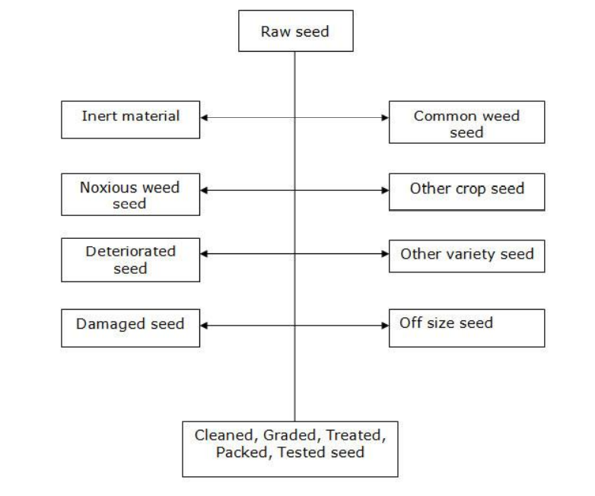

Slide 4
Cleaning of seeds involves three steps
1. Pre-cleaning and pre-conditioning :
It refers to the operations such as shelling, debearding etc. that prepares the seed lots for basic cleaning and also for the removal of particles such as trash, stones, clods etc. larger than crop seed
Some pre-cleaners also remove particles that are lighter in weight and smaller in size than the crop seed. Precleaning is not required for hand harvested and winnowed seed lots
Equipment used for pre-cleaning and pre-conditioning are
Scalper or Rough Cleaner
Huller Scarifier
Debearder
Maize Sheller

Slide 5
a. Scalper or Rough Cleaner:
Scalpers are used to remove large trash
They consist of a vibrating screen and the screen perforations are large enough to allow the seeds to pass through and retains the large inert matter on the screen, which is scalped off and removed from the seed lots
The single sieve pre-cleaners are called as scalpers and the multiple sieve units are referred as rough cleaners
The rough cleaners are the simple air screen seed cleaners that separate large trash over a large hole screen and separation of small foreign material through a small hole screen
Most scalpers are arranged to make the air separation before the seed reach the screen
b. Huller – Scarifier:
Huller is a device to remove husk or outer seed coat
Scarifier scratches the seed coat
These usually abrade the seeds between two rubber-faced surfaces or impel the seeds against rough surfaces such as sandpaper

Slide 6
In a huller scarifier, the seed falls from the feed hopper on to a rotating disc, where they are thrown against the hulling and scarifying surface by centrifugal force either once or twice and the seed is hulled or scarified to the desired extent
After this operation the seeds are moved into a suction chamber where the suction removes the light, fine dust and the seed is discharged at the bottom of the chamber
The severity of aberration or impact can be controlled accurately to prevent damage
Hulling (removal of an outer coat or husk) and scarification (scratching of the seed coat) can be done separately or jointly with a huller scarifier
c. Debearder
The Debearder removes the hair like structures present on the seeds
The Debearder machine has a horizontal beater with arms rotating inside a steel drum
The machine rubs the seeds against the arms and against each other
The degree of action is determined by the processing time, beater clearance and beater speed

Slide 7
d. Maize Sheller
The size of maize sheller’s vary from small hand operated ones to large motor driven shellers
Hand operated maize sheller are used for shelling small seed lots like breeders seed and nucleus seed, while the Power operated maize shellers are used for high capacity shelling specially for foundation seed lots and certified seed lots
2. Basic Seed Cleaning
It refers to actual cleaning and grading of seeds and is essential process in seed cleaning operation
The basic seed cleaning is done over an air screen machine commonly referred to as an air screen cleaner. It is the basic equipment in all seed processing plants

Slide 8
Air Screen Machine
Principle: The separation of undesirable material from seed is done on the basis of differences in seed size and weight. The air screen machine uses three cleaning elements
Aspiration: the light seed and chaffy material is removed from the seed mass through aspiration
Scalping: Good seed are dropped through screen openings but large material (trash, clods etc.) are scalped off over the screen into a separate spout
Grading: The good seed ride over the screen openings, while smaller particles (undersized, weed seeds, shriveled) drop through the screen perforations
Parts of air screen cleaner:
1. Feed hopper: It consists of a container to receive the seed, hopper flights and augers to spread the seed across the width of the hopper and a feed control at the bottom of the hopper for steady flow of the seeds

Slide 9
2. Screens: Screens perform both scalping and grading operations. They separate crop seed from foreign material, other crop seeds and weed seeds. Screens are constructed of either perforated metal sheet or wire mesh. The openings in the perforated metal sheet may be rounding, oblong or triangular. Openings in wire mesh screens are square or rectangular
3. Clay crushing rolls: these are installed to crush clay lumps without damaging the seed. These are two rubber rolls made of hard rubber to crush clay lumps without damaging the seed. The rolls are adjustable to various opening width or they be left apart when not needed
4. Brushes: Brushes are used to clean the screens and they travel back and forth under each screen. Cleaning efficiency is directly related to the percentage of the perforations that remain open
5. Tappers or screen knockers: These are used over scalping screens to keep them clean
6. Shoes: the vibrating or shaking sections of the machines into which the screens are fitted are called shoes. A shoe contains fittings of two screens one for scalping and the other for grading
7. Eccentrics : the device used for shaking the shoes is called eccentrics.
8. Fans: Number of fans range form one in small cleaners to four in large cleaners. But most of them have two air systems, which are called as upper and lower air systems

Slide 10
9. Air Chest: Air passageways from the fans are connected to air chamber, which allow the material lifted by the air stream to settle. This is done by decreasing the air velocity as it passes through air chest or air chamber.
Principle of Operation of air screen machine:
1. The air blast removes lightweight seed and chaffy seed
2. Scalping screen removes material larger than the crop seed
3. Grading screen drop out material smaller than crop seed
4. Eccentrics do the shaking motions of the screens
5. The two shoes in 4 screen cleaner move in opposite direction to balance each other also to reduce machine vibrations to minimum
6. In four screen cleaner, the screens do the following
First screen does scalping
Second screen does grading
Third screen does close scalping
Fourth screen does close grading

Slide 11
Seed to be cleaned is fed from the feed hopper
Top screen is used for rough scalping
Third screen is used for close scalping
Second screen is used for grading
Lower air separation
Fourth screen is used for final close grading

Slide 12
THANK YOU

