Slide 1
Upgrading equipment working principles- specific gravity separator, colour sorter and indented cylinder separator

Slide 2
I. Specific gravity separator
Seeds of the same size and general shape can often be separated because they differ in specific gravity or relative weight
This difference is very useful in removing light, immature seeds or heavy sand and rocks to improve the purity and germination of crop seeds
If seeds which differ in specific gravity (relative weight / unit of volume) are placed on substrate of intermediate density, seeds of higher specific gravity will fall down through the substrata, while seeds of lower specific gravity will be buoyed up the substrata. Here air is used as separation substrata
As seeds flow on the deck of the gravity separator, they enter a column of air coming up through the porous surface of the deck
The pressure of terminal velocity of the air rising through the deck can be controlled very closely to separate two kinds of seeds differing in specific gravity, the air is adjusted so that only the lighter seeds are lifted up off the deck surface
These lighter seeds are held up by air pressure and tend to float on the deck surface. The heavier seed possess a velocity greater than that of the air columns so they are not lifted and so will lie on the deck surface.

Slide 3
The air column thus stratifies the seed mixture into vertical zones of relative weight with the heavier seed lying on the deck and the lighter seeds lifted up to the top of the seed mass
Adjustments
1) Feed rate
2) Air flow
3) End slope
4) Side slope
5) Deck oscillation speed
6) Deck speed

Slide 4
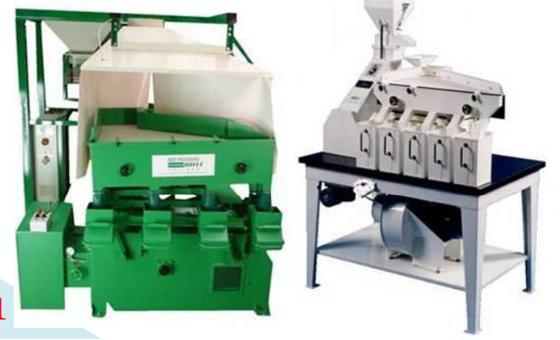
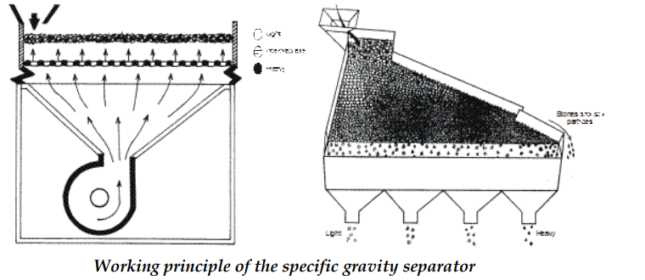
Specific gravity separator

Slide 5
II. Colour separator
Many large crop seeds such as peas and beans differ in colour between varieties. Colour variation may also occur due to immaturity or disease
Electronic colour sorting machines can separate such seeds by difference in colour and also remove mud balls and discoloured seeds in the same operation
The electronic colour sorter views each seed individually with photo electric cells. The seed is compared with a selected back ground or colour range and is discharged from the machine according to its colour
If it is the great desired colour, the seed is discharged through the good seed spout
If its colour or shade falls within the reject range, a blast of compressed air deflects the seed and sends it in to the reject discharge spout
These are highly sensitive. Since the machine views each seed individually, capacity is low, but the initial cost is high and operating cost is less
The usefulness of machine is greater with large seeded crops

Slide 6
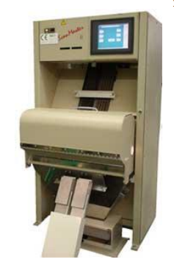
Colour separator

Slide 7
III. Indented cylinder separator
The indented cylinder separator is a rotating, almost horizontal cylinder with movable, horizontal separating adjustments which are mounted inside it
Indent lines are there inside the surface of the cylinder
The indented cylinder revolves, turning the seed mass to give each seed a chance to fit into indent
Short seeds are lifted out of the seed mass and are dropped into the lifting and long seeds remain in the cylinder and are discharged out via., a separate spout at the end of the cylinder
As the cylinder revolves, it creates centrifugal force which helps to hold the seed in the indent
Short seeds are held in the indent until the cylinder turns to the point where the indent is inverted enough for gravity to cause the seed to fall out of the indent
The length, surface texture and size of seeds determine how they fit into the indent, so that it can be lifted out of the seed mass

Slide 8
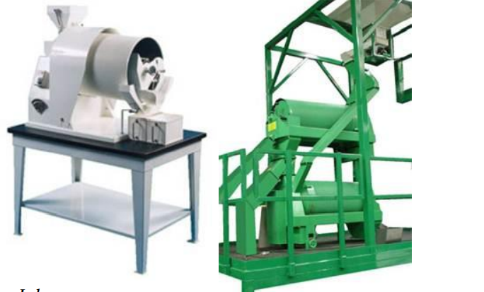
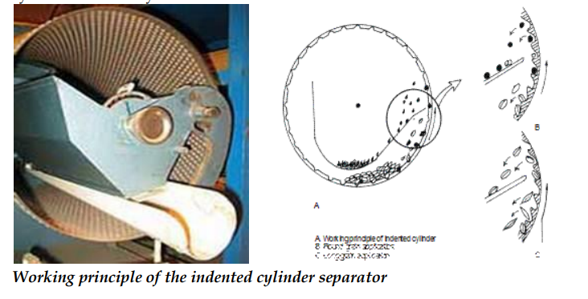
The speed of the cylinder creates centrifugal force which holds the seeds in the indent as it are lifted upward
Thus the shape and size of the seed to cause some seeds to fall out after being lifted only a short distance, while other seeds are lifted closer to the top of the cylinder before they fall out
Indented cylinder separator

Slide 9
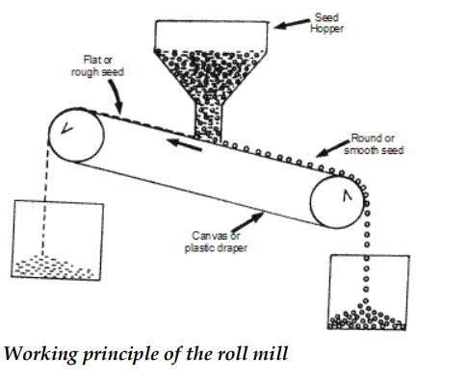
IV. Roll mill or dodder mill or velvet roll mill
It is used to separate the seeds based on surface texture and shape. This separator should be used only after the seed has been carefully cleaned and separated from the chaff. These are effective in separating seeds with a rough seed coat or shape angles from smooth seeds

Slide 10
Working principle of the roll mill
The roll mill consists basically of two roller, covered with flannel or velvet, placed side by side, so that they touch each other down their entire length.
The rollers are mounted on an incline and they turn in opposite directions. A curved adjustable shield is mounted above the rollers
Separating action: The mixture of smooth and rough seeds is fed into the place, where the rollers touch each other, at the high end of the machine.
As the rollers turn up and out, seeds that are rough or have sharp or broken edges are caught by the nap of the fabric covering the rollers
These seeds are thrown up against the curved shield. They strike the shield at an angle, bounce back down to the roller and are again thrown up against the shield
Smooth seeds bounce down the inclined position forward between the rollers, and discharge at the lower end of the machine
They are not affected by the fabric roller covering, and are not pitches over the side of the rollers

Slide 11
Adjustments
1) Rate of feed
2) Speed
3) Clearance between shield and rolls
4) The angle of inclination of rolls

Slide 12
Thank you

