Slide 1
Upgrading equipment working principles- spiral separator, magnetic separator and DISC separator

Slide 2
I. Spiral separator
The separator, which classifies seed according to its shape and rolling ability, consists of sheet metal strips fitted around a central axis in the form of a spiral
The unit resembles an open screw conveyor standing in a vertical position. The seed is introduced at the top of the inner spiral
Round seeds roll faster down the incline than flat or irregularly shaped seeds, which tend to slide or tumble
The orbit of round seed increases with speed on its flight around the axis, until it rolls over the edge of the inner flight into the outer flight where it is collected separately
The slower moving seed does not build up enough speed to escape from the inner flight
Most spirals have multiple inner flights arranged one above the other to increase the capacity

Slide 3
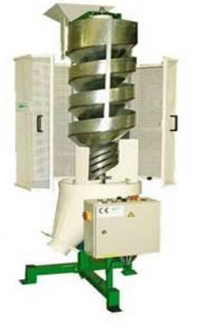
Spiral separator

Slide 4
II. Magnetic separator
The separation is mainly based on the affinity for liquids which is used for separation. Since seeds contains no free iron and are not attracted by a magnet they must be selectively pretreated with a magnetic material such as finely ground iron powder
Rough seed coats, cracked or broken seed coats, dirt lumps, chaff or seed with a sticky residue on the surface will hold the liquid and become sticky, so that iron powder will adhere to them
Smooth coated seeds will not absorb liquid. So no iron powder will adhere to them. The seed are then discharged from mixing chamber and brought into contact with a powerful magnet, which removes the iron coated seeds

Slide 5
Most magnetic cleavers pass the seeds over a revolving drum which has a high intensity magnetic field
Seeds with an affinity for liquids which are now coated with iron powder are attracted by the magnet and adhere to the drum until they are removed by a brush or scraper
Seeds which are relatively free of iron powder are not attracted by the magnet and will fall into a separate discharge spout
The first requisite of magnetic seed separation is that the seed to be separated must possess different seed coat characters
Crop seeds should have a smooth surface, while the seeds to be removed should have a rough surface which will retain liquid and can accept the iron powder
Success in separating the components depends upon the magnitude of seed coat differences and thoroughness with which the moistened seeds and the iron powder are blended

Slide 6
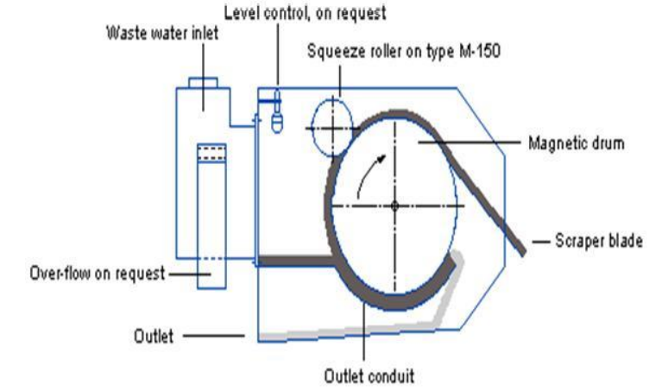
Magnetic separator

Slide 7
III) Disc separator
It consists of a series of discs, which revolve together on a horizontal shaft inside the cylindrical body. Each disc contains many under cut pockets.
The seed enter the intake end of the separator and move through the open centers of the discs towards the discharge end of machine.
As the discs revolve through the seed mass the pockets lift out short seed but rejects longer seed. Longer seeds are conveyed by flights on the disc spokes towards the discharge end of the machine where they go out through the tailings gate.
The rate of seed travel through the open disc centers is controlled by conveyor or blades attached to the spokes of the discs.
The disc separator makes a very precise separation. No factor other than seed length and shape affects its separation.
Flexibility is obtained by varying size of the pockets

Slide 8
As the seeds enter the cylinder, the small, short, easy to separate seeds are quickly removed. The center cylinder section removes the intermediate sizes of seeds still in the cylinder.
All indents in a cylinder are the same size, only the progressively declining amount of material to be lifted causes this difference in separating action.
Adjustments
Cylinder speed
Size of the indent
Trough setting
Tilt of the cylinder
Adjustable retarder

Slide 9
Thank You

