Slide 1

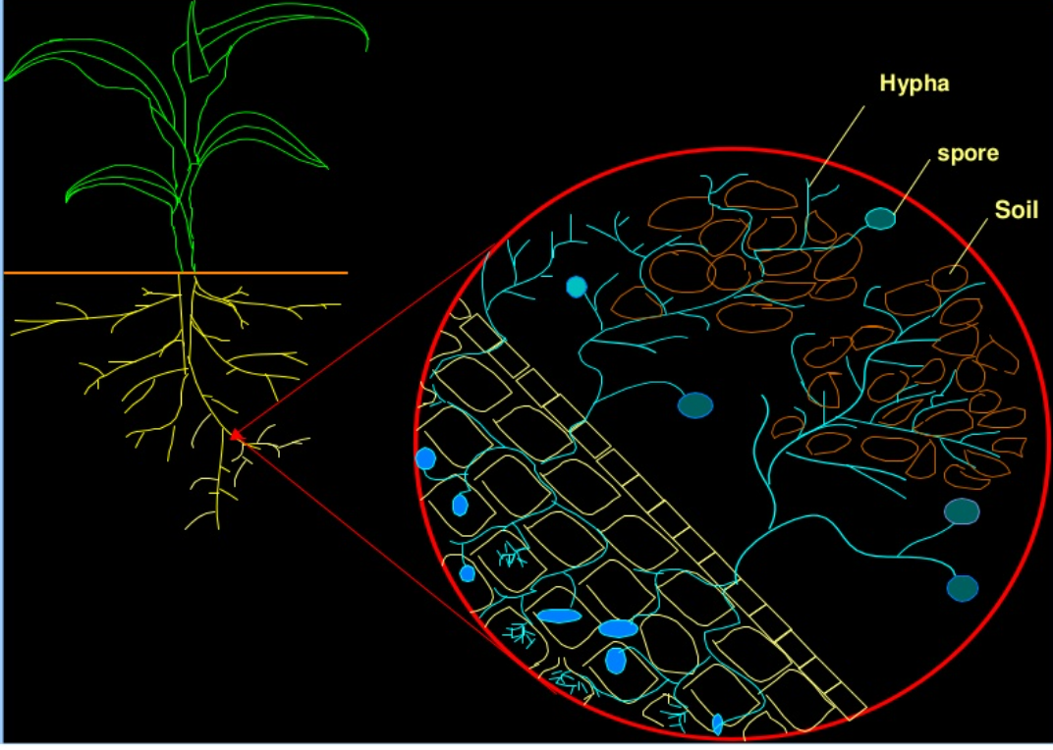
Center for Smart Agriculture
Isolation of AM fungi-Wet sieving method and sucrose gradient method
Module 1:
Session1:

Slide 2
INTRODUCTION
Mycorrhiza forms an interface between soils and plant roots Mutualistic associations of AMF with host plants.
Spores are adequate in number during the summer and the growth rate of roots will be maximum during this time period
Based on morphological character like spore wall, size, colour and hyphal attachment the AMF spore was identified.

Slide 3
INTRODUCTION
In some species the hyphae is viewed under maximum magnification because of the presence of lipid droplets
Beneficial effects of AM- used as bio-fertilizers for plant growth, especially in soils of low fertility

Slide 4
WET SIEVING AND DECANTING TECHNIQUE
Wet sieving and decanting is one of the popular technique
10 g of soil was mixed with 100ml of water in the 500 ml conical flask
The soil mixture was agitated vigorously to free the AMF spores from soil and allowed to settle for 15-45 minutes
The supernatant was decanted through standard sieves.
By using a dissecting microscope, spores were picked by means of pipette or needle.

Slide 5
SUCROSE CENTRIFUGATION TECHNIQUE
Spores were purified by re-suspending the sieving in the 40% sucrose solution with centrifugal action.
Centrifugation was carried out at 1750 rpm for 5 minutes.
The supernatant was removed and poured into the sieves
The spores that hold on the sieves are carefully rinsed with tap water.
The spores were collected by using dissecting microscope

Slide 6
Thank you…

