Slide 1


Slide 2
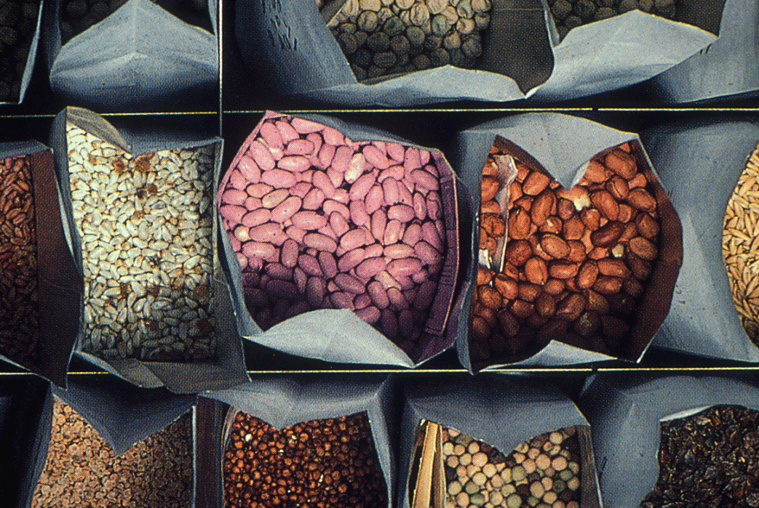
SEED INVIGOURATION TECHNIQUES

Slide 3
SEED ENHANCEMENT
Seed enhancement is a treatment of seeds that improve their performance, practiced before they are sowing of seeds.
Improve seed sowing, germination and seedling growth by altering seed vigour
Enhance physiological state of seed thereby and uniformity of germination.
Deliver nutrients to embryo required for germination

Slide 4
METHODS OF SEED ENHANCEMENT
SEED HARDENING-eg. pulses
SEED PELLETING-eg. Onoin, tomato, lettuce
SEED PRIMING-eg. All crops
SEED INFUSION-eg. Poppy, soyabean
SEED COATING-eg. vegetables
STEEPING-eg. sugarbeet
ENCRUSTING-eg. Maize, sunflower
SEED FORTIFICATION-eg. paddy

Slide 5
SEED HARDENING
Seed hardening can be defined as “a method to alter physiological and biochemical nature of seed in order to overcome factors responsible for drought resistance.”
The phenomenon in which seed testa is unusually hard and impervious to moisture and therefore becomes slow to germination is seed hardening.
Hydration should be done at 15-25˚C.
Potassium dihydrogen phosphate, potassium chloride and other chemicals are used.

Slide 6
USES OF SEED HARDENING
It helps in increasing productivity by overcoming moisture stress and nutrient deficiency for sustained production.
Hardening of seeds results in the absorption of more water due to increase in elasticity of cell wall and development of stronger & efficient root system.

Slide 7
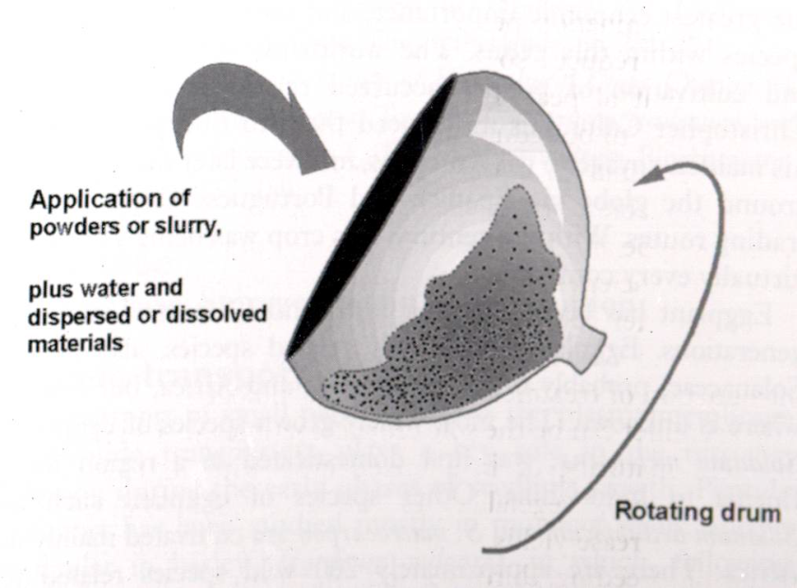
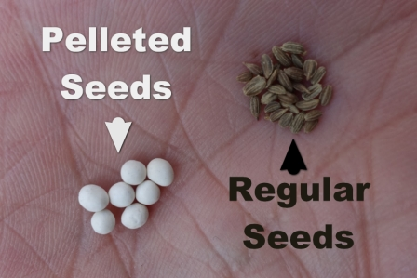
SEED PELLETING
It is the process of enclosing a seed with small quantity of inert material large enough to produce a unit standard size.
Tumbling action distributes, molds blend to give good size distribution.

Slide 8
TYPES OF SEED PELLETING
INOCULANT PELLETING:
The coating of seeds with bio fertilizers and bio control agents.
Eg: Rhizobium, Pseudomonas, Trichoderma.
USE:
It provides protection to seeds against pathogens
Fixes atmospheric nitrogen
NUTRIENT PELLETING:
Coating the seeds with macro & micro nutrients.
Eg: DAP, Gypsum, micronutrient mixture.

Slide 9
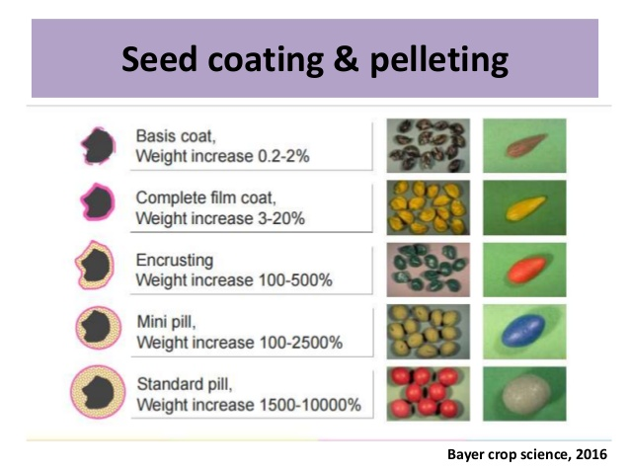
USE OF SEED PELLETING
Pelleting is used to improve drill/seeder performance by making seeds rounder, alter size
It improves singulation and speed of sowing.
For onion, the seed can increase in weight 6-fold due to pelleting

Slide 10
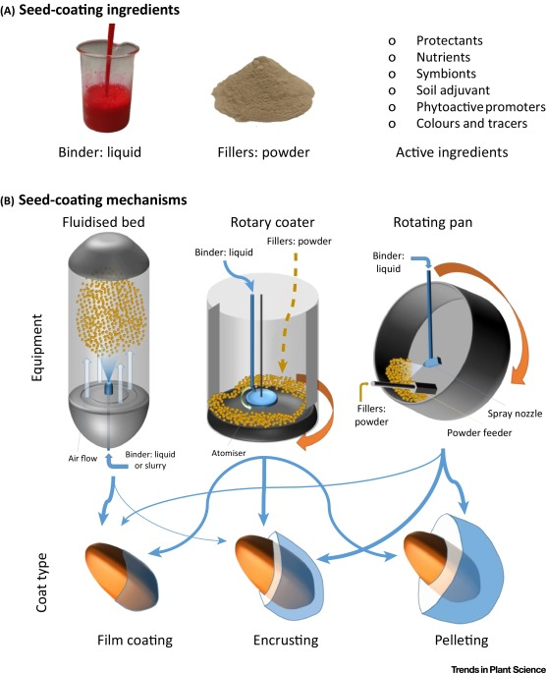

Slide 11
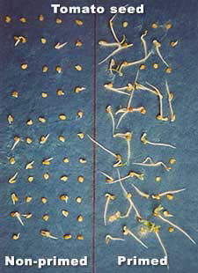
SEED PRIMING
It is the process of controlled hydration of seeds that permits or triggers pre germinative metabolic activity but prevents the actual emergence of radicle

Slide 12
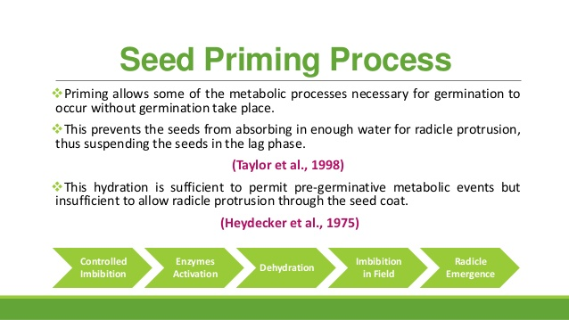

Slide 13
TYPES OF SEED PRIMING
OSMOPRIMING: Soaking of seeds in osmotic solutions.
Eg: Polyethylene Glycol, Mannitol
HALOPRIMING: Soaking of seeds in salt solutions.
Eg: NaCl, KCl, CaCl₂, KNO₃
HYDRO PRIMING: Soaking of seeds in water.
SOLID MATRIX PRIMING: Mixing of seeds with an organic and inorganic carrier and water for a period of time.
Eg: vermiculite, diatomaceous earth, peat moss, charcoal clay, etc.
Low matrix potential, minimal water solubility, high water holding capacity and surface area, no toxicity to seeds, and ability to adhere to seed surface
BIOPRIMING: Eg: Bacillus, Trichoderma, Rhizobium.

Slide 14
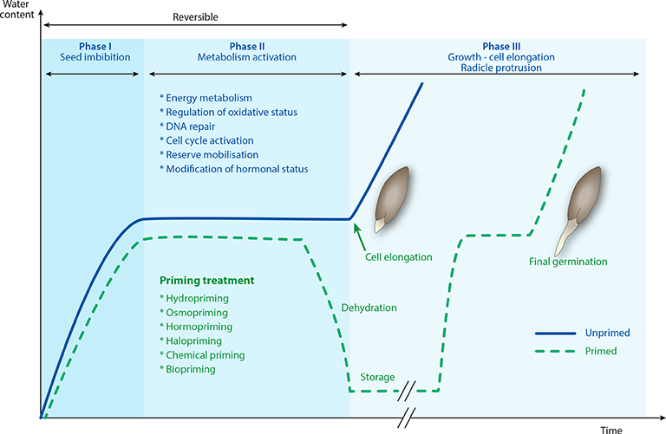
Notes:
before the end of Phase II, germination remains a reversible process: the seeds may be dried again and remain alive during storage and able to subsequently re-initiate germination under favorable conditions.

Slide 15
SEED ENCRUSTING
Encrusting is a method in which seed is covered by layers of materials that obscure the original shape & size of seed resulting in substantial weight increase.
The encrusting consists of biologicals or colourants or dyes, polymers and other ingredients.

Slide 16
USE OF ENCRUSTING
to pre-inoculate with rhizobia on small-seeded legumes (e.g. alfalfa or lucerne)
reduce size variation in maize,sunflower.
to add weight to avoid seed drift during sowing of low-density, chaffy turf grass seeds.

Slide 17
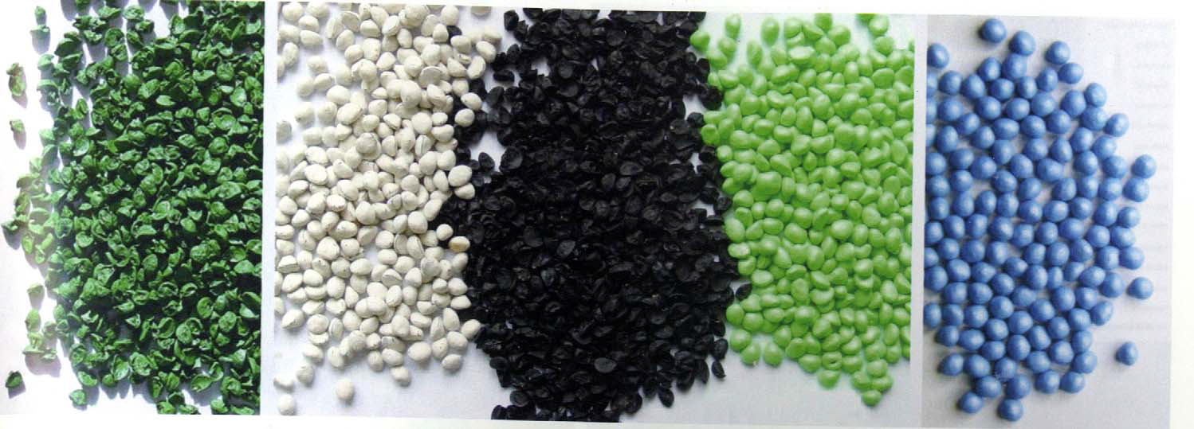
Film coating, encrusting and pelleting – onion seed

Slide 18


Colourants Polymers

Slide 19
SEED INFUSION
Infusion of nutrients, growth promoting substances can be done with organic solvents by the method of seed infusion.
Eg: acetone, dichloromethane.
This technique can be used in seeds of Poppy, fennel, soyabean
Seed infusion can also be used for breaking the seed dormancy.

Slide 20
PROCESS OF INFUSION
The organic solvents, slowly increase the chemicals in to the seed.
In this method there is no need for drying the seed materials to bring back the original moisture content of seed.
The organic chemicals are evaporative in nature, after infusion is over, just we have to keep the seeds as such for 5 to 10 minutes in dry condition, the organic solvents will evaporate during this time and we can perform sowing.

Slide 21
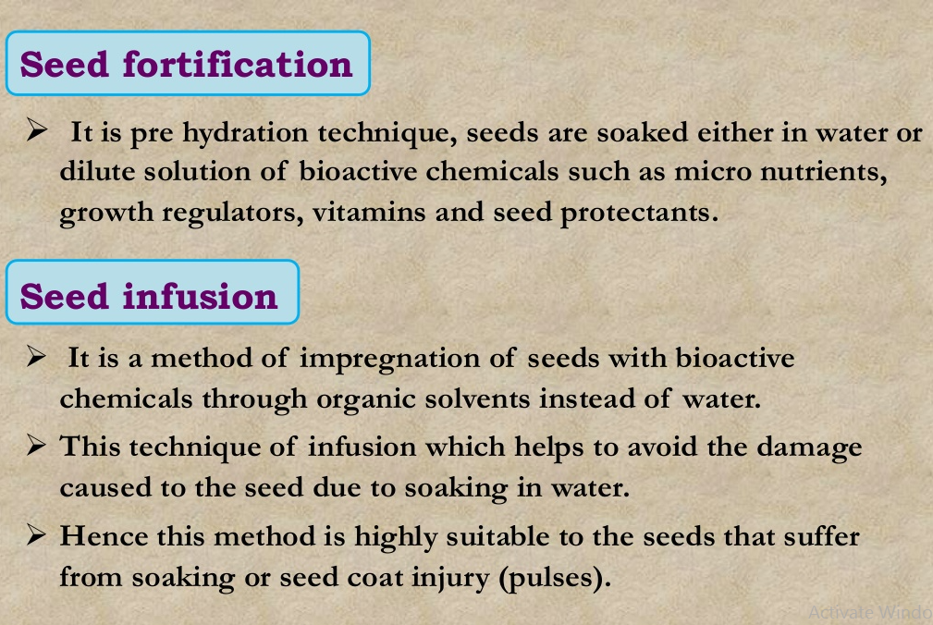

Slide 22
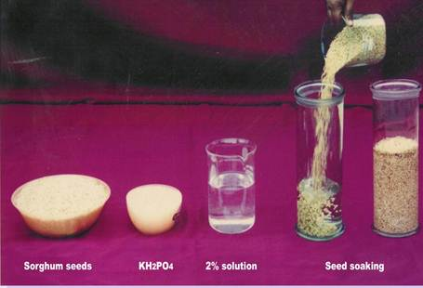
Pulses : Seeds can be soaked in ZnSO4, MgSO4 and MnSO4 100 ppm solution for 4 hours to improve the germination and vigour potential.

Slide 23
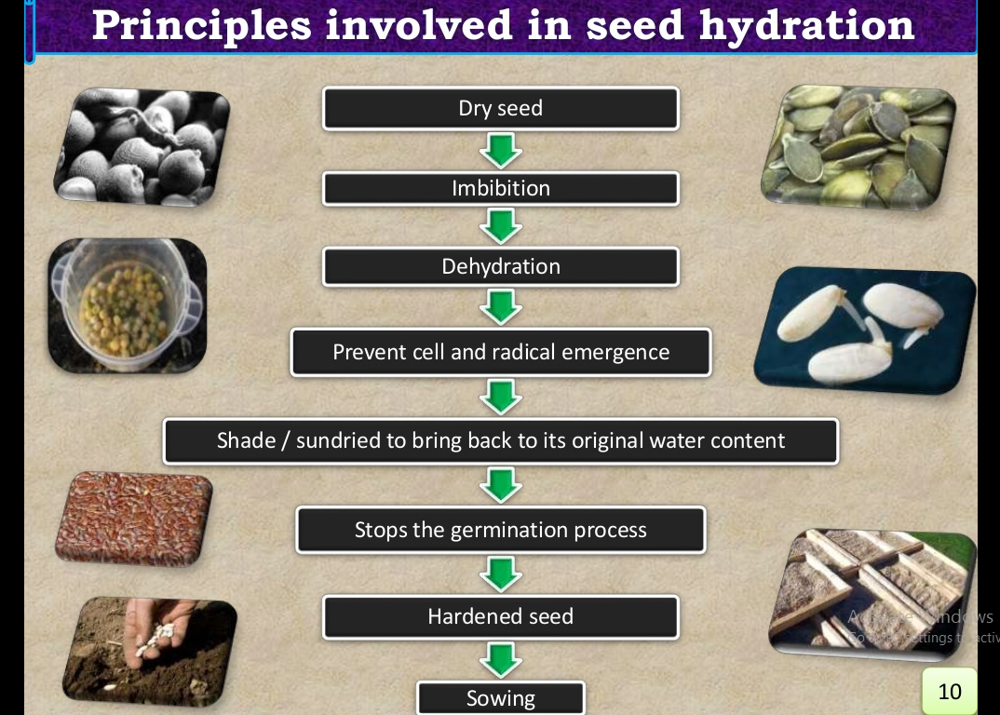

Slide 24


