Slide 1

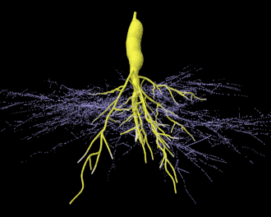
Center for Smart Agriculture
Mass Production of AM inoculants

Slide 2
Preparation of trap culture inoculum of arbuscular mycorrhizal (AM) fungal spores
Trap of healthy arbuscular mycorrhizal fungi (AMF) spores
Establish inoculum from monospecific cultures
Spore trap cultures can also aid in AMF identification
The spores may appear differently, due to weathering and intrinsic soil environment effect, either physical, chemical or biological. Trap cultures are important in the following situations

Slide 3
Procedures
Collect Rhizosphere soil with shoots of trap plant cut at the crown
Chop finely the roots and mix with the soils using a sharp chopper.
Mix the chopped roots and soil at 1:1 ratio (v/v) with autoclaved coarse sand in a mechanical mixer, or massaged well in a durable plastic bag
Transfer the soil mix to a 15 cm plastic pot.

Slide 4
Procedures
Plant seeds of suitable trap plant such as tropical signal grass, Brachiaria decumbens, into the pot.
Maintain the pot cultures in a greenhouse for at least 3 months, and check sporulation from time to time
Sanitary tests may also be carried out to ensure no contamination from parasitic fungi occurs.

Slide 5
Procedures
Keep fertilizer application to a minimum, to encourage AMF proliferation.
Trap culture pots are later left to dry under shade for up to 2 weeks.
Harvest the spores using the sieving and decanting techniques or the density-gradient centrifugation technique.
The monospecific spores are ready for inoculation onto seedlings of the desired crops

Slide 6
Inoculation of AMF
The seedlings are gently uprooted singly on in a small bunch, and have a gentle stream of water sprayed onto the roots so that they stick together.
Spores collected from 3.3.1 are suspended in water and about 200 µl of the spore suspension are pipetted onto the moist roots.
The inoculated seedlings are immediately transplanted into containers of suitable size, containing sterilized soil.

Slide 7
Inoculation of AMF
The soil is topped with a sterile growth medium, watered gently under shade, before transferring into the greenhouse.
To encourage colonization of AMF onto seedling, fertilizers are not given during the early growth stage of the seedlings.

Slide 8
Problems and potential for AMF inoculum production and utilization
Situations where effective indigenous AMF population is low.
Inoculation is best for transplanted crops, where soil disturbances has reduces AMF inoculum potential.

Slide 9
Thank you…

