Slide 1
Threshing, drying and cleaning process

Slide 2
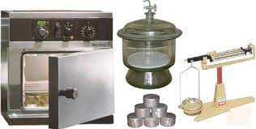
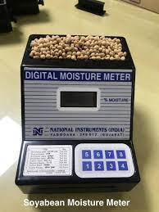
Threshing, drying and cleaning process
Manual method
Fermentation method
Mechanical method
Chemical method
Receiving of Harvested seed
Threshed
Shelled
Dried
Air oven method
Moisture meter
Moisture testing
Mechanical drying/ artificial drying
Physical drying/ sun drying
Seed drying
Batch drier
Continuous flow drier
Conditioning and pre Cleaning

Slide 3
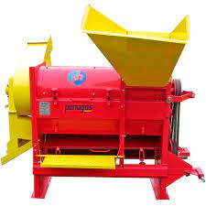
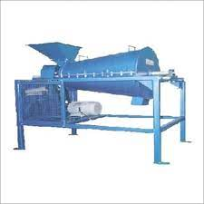
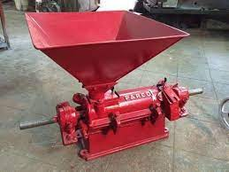
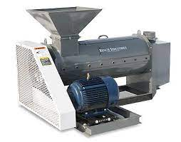
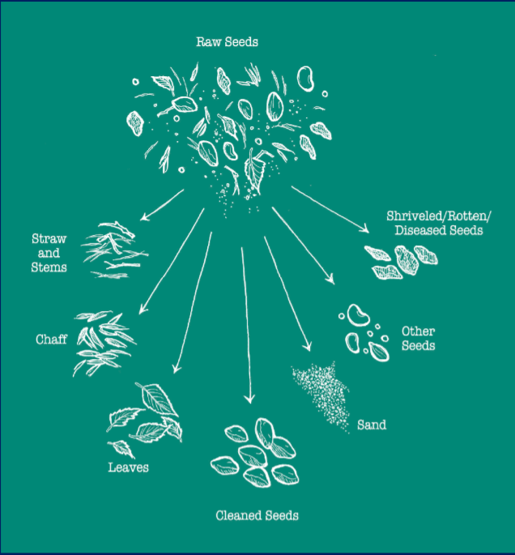
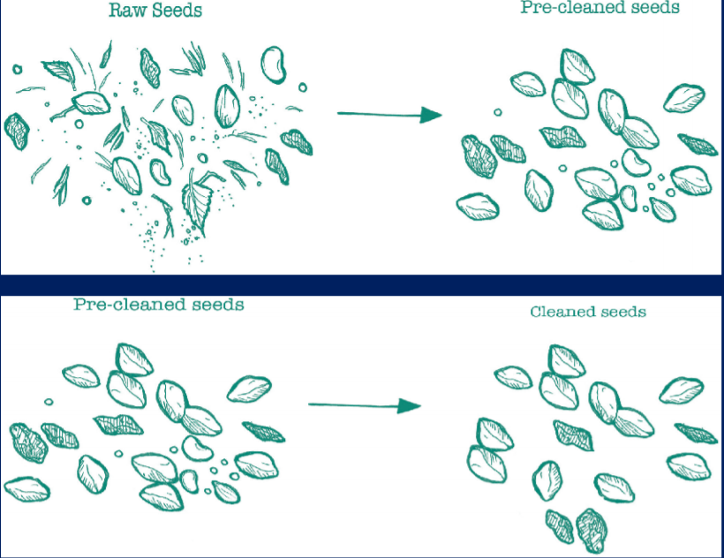
Sheller
Scarifier
Pre- cleaning
Huller
Debearder

Slide 4
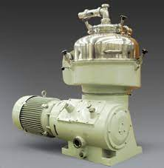
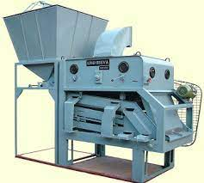
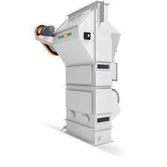
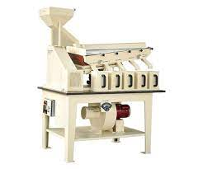
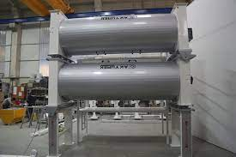
Grading equipment
Upgrading machines
Basic cleaning
Cleaner cum grader
Pre-cleaner and aspirator
Specific gravity separator
Indent cylinder
Disc separator
Roll mill
Magnetic separator
Inclined draper
Disc separator
Cleaner cum grader
Pre-cleaner and aspirator
Specific gravity separator
Indent cylinder

