Slide 1


VARIETAL IDENTIFICATION
through Grow Out Test

Slide 2

To determine the genetic purity status of a given seed lot of the notified cultivar / hybrid and the extent to which the sample in question conforms to the prescribed standards.
Objective

Slide 3
FIELD OF APPLICABILITY
Grow-out Test is the official measure for controlling the genetic purity of the seed lot. It serves as a pre-control as well as a ‘post-control’ test for avoiding genetic contaminations. According to the official regulations in India, it is pre-requisite for seed certification of hybrids of certain species such as cotton, castor, musk melon and brinjal.
The test is required to be conducted for checking the sellers label with respect to genetic purity status of the seed lot under the provisions of the seeds Act 1966. In addition grow-out test can also be used as a measure to judge the efficacy of the certification agency or the inspector.

Slide 4
Sampling
The samples for ‘Grow-out test shall be drawn simultaneously with the
samples for other seed quality tests in accordance with the prescribed sampling
procedures.
Size of submitted sample
The size of submitted samples shall vary according to the species as exemplified in
this Table.

Slide 5

Recommended size of submitted sample for Grow-out Test
1,000 g :–for maize, cotton, groundnut, soyabean and species of other genera with seeds of similar size;
500 g :–For sorghum, wheat, paddy and species of other genera with seeds of similar size;
250 g :–Beet and species of other genera with seeds of similar size;
100 g :–For bajra, jute and species of all other genera;
250 tubers / planting stakes / roots/ corms :-Seed potato, sweet potato and other vegetatively propagating crops.

Slide 6
Size of working sample
The working sample for grow out test shall be obtained through subsequent mixing and dividing of the submitted sample in accordance with the prescribed procedure for seed sampling.
The minimum population required for taking the observations shall be 400 plants; however, it will also depend on the maximum permissible off-type plants prescribed for the species under consideration in the Indian Minimum seed Certification standards
The number of seeds required for raising the crop to obtain the required number of plants shall depend on the germination percentage of the seed sample and hence seed rate should be adjusted accordingly.

Slide 7

Number of plants required per sample for grow out test
Maximum permissible off types (%) | Minimum genetic Purity (%) | Number of plants required per sample
0.10 | 99.9 | 4000
0.20 | 99.8 | 2000
0.30 | 99.7 | 1350
0.50 | 99.5 | 800
1.00 and Above | 99.0 and below | 400

Slide 8
Procedures
To achieve the accuracy and reproducibility of the grow out test results, the procedures provided hereunder must be followed:
Location of the grow out test
The grow out test shall be conducted in specified areas recommended for the
cultivar / hybrid or in off-season nurseries.

Slide 9

Standard sample
The standard sample of a cultivar (control) is the official standard against which all other samples of the seed of the cultivar will be judged.
The standard sample must not differ significantly in any character and be obtained from the originating plant breeder / breeding institute and be stored under controlled temperature and humidity conditions so as to use it each year to sow control plots for cultivars under test.
Further quantities of sample must be obtained from the originating plant breeder as and when required.
A comparison must be made between the two lots of the standard sample before changing from one standard sample to other.

Slide 10
Method of raising the crop
Standard and recommended agronomic / cultural practices such as field preparation, size of the plot, row length, distance between the rows, distance
between the plants, irrigation and fertilization, etc., in respect of the specific crop shall be followed both for the sample in question and its control (standard sample).
The germination percentage of the sample (s) in question and the standard sample must be determined to adjust the seed rate. The sowing should be done by dibbling or small plot drill. Seed drill must be carefully checked to ensure its cleanliness.

Slide 11

Subsequent thinnings is not recommended. The samples of the same cultivars must be sown in succession and the standard samples are sown at suitable intervals. (one standard sample for every ten sample to be tested).
The size of the plot, row length and spacing shall differ according to the crop.
Recommended specification for the above variables are provided in Table mentioned below which can suitably be modified if considered essential.
The field plots should be grown in two replicates to guard against failure in one part of the field and to reduce environmental and soil fertility variations.

Slide 12
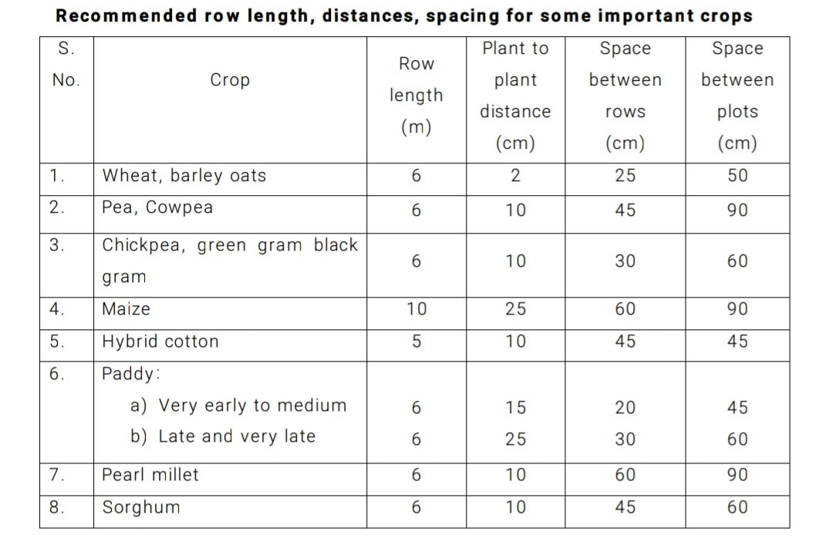

Slide 13

Methods for taking observations
Grow-out test plots must be examined throughout the growing season with emphasis on the period from the flowering to ripening. All plants must be examined keeping in view the distinguishing characters described for the cultivars both in the test crop as well as the control.
While taking the observation, the plants showing deviations in characters against the control should be tagged and examined carefully at a later stage to confirm whether they are off-types or not.
The number of the total plants and the off-type plants found should be recorded.

Slide 14

Calculation and interpretation of the results
Percentage of other cultivars, species or aberrants found must be calculated
upto first decimal place. While interpreting the results, tolerances should be applied
by using the reject number for prescribed standards with reference to sample size
as provided in Table.

Slide 15
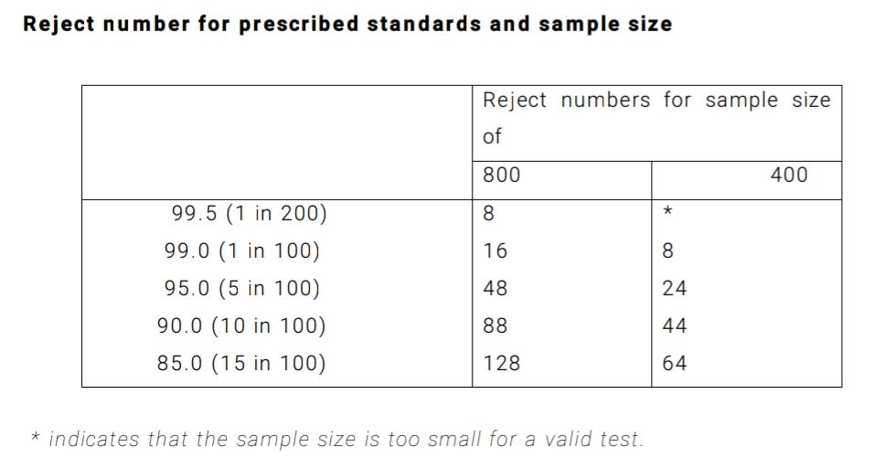


Slide 16

Reporting of results
The results of the grow-out test shall be reported as percentage of other species, cultivars or off-type plants.
If the sample is found to be a cultivar other than stated by the sender, the results shall be reported as such.
If plants of other cultivars are more than 15 per cent, the report shall state that the sample consists of mixture of different cultivars.
If nothing worthy of special comments is found, the report shall state that the results of the grow-out test of the sample in question revealed nothing to indicate that the name of the cultivar or species stated by the sender is incorrect.

